Slide 1
Staff Ride for Creek War,
Creek War Campaigns,
and Horseshoe Bend (HSB)
Fort Benning Maneuver Center of Excellence
Command and Tactics Directorate
History Instruction Office
Dr. Douglas Campbell

Slide 2
Table of Contents 1
--Research for the Horseshoe Bend Staff Ride . . Slide 6
--Horseshoe Bend Tour-Stand Guide
---Introductory Slides (includes map) . . Slide 20
---Tour-Stand 1, Park Headquarters Area . Slide 26
---Tour-Stand 2, Overlook Hill . . . Slide 31
---Tour-Stand 3, Riverside/Trail/Field . . Slide 37
---Tour-Stand 4, Gun Hill Area . . . Slide 44
---Tour-Stand 5, Red Stick Wall . . . Slide 50
---Tour-Stand 6, Tip of the Peninsula . . Slide 55
---Tour-Stand 7, Village Overlook . . Slide 60
---Tour-Stand 8, Redoubt Area . . . Slide 64
---Tour-Stand 9, Riverside . . . Slide 70
---Tour-Stand 10, Park Headquarters Area . Slide 75

Slide 3
Table of Contents 2
Historical Background Information for Horseshoe Bend
--The War of 1812 up through 1813 . . . Slide 78
--Creek and Red Stick Background, and the Creek Civil War Slide 95
--Overall Reaction to Fort Mims,
and Tennessean Relations with Indians . . Slide 125
--Creek War: Overall Setup and Issues . . . Slide 128
--Creek War Campaigns (except for Jackson’s Campaign)
---Floyd’s Autumn Raid . . . . Slide 142
---Claiborne’s Late-Autumn Raid . . . Slide 150
---Russell and McKee . . . . Slide 157
---Floyd’s Second Foray, and Milton’s Advance . Slide 161

Slide 4
Table of Contents 3
Historical Background Information for Horseshoe Bend (continued)
--Jackson’s Creek War Campaign
---Jackson and His Command . . . Slide 169
---Early Campaign through Tallushatchie . . Slide 173
---Fort Strother through Talladega . . Slide 180
---Jackson’s Time of Troubles . . . Slide 184
---The Start of a Recovery,
Battles of Emuckfau and Enitachopco Creeks Slide 191
---Preparation for and Transit to Horseshoe Bend Slide 198

Slide 5
Table of Contents 4
Historical Background Information for Horseshoe Bend (continued)
--Horseshoe Bend (HSB) Functional Topics
Order of Battle for Both Sides, Indian Allies . Slide 206
Weapons . . . . . Slide 215
Tactics . . . . . Slide 226
Terrain . . . . . Slide 238
Logistics and Commo . . . . Slide 244
Laws of War . . . . . Slide 247
--The Battle of Horseshoe Bend . . . . Slide 251
--Horseshoe Bend and Creek War Aftermath . . Slide 263
--Horseshoe Bend Participant Accounts . . . Slide 270
--Selected Creek War Site Visits . . . . Slide 284

Slide 6
Research for the Horseshoe Bend Staff Ride

Slide 7
INTRODUCTION: THE CHALLENGE OF
A HORSEHOE BEND STAFF RIDE
--There doesn’t seem to be much to this battle
--NO records, accounts, memoirs, etc. for Horseshoe Bend Red Sticks
--The battle is not the typical Indian Wars battle. The Indians were in the fort.
--And how is this supposed to be about coalition ops,
counterinsurgency (COIN), combined arms, and laws of war?
--What difference did weapons and tactics make in a melee?
--What about Jackson’s logistical scheme?
--Are there maps or something to analyze terrain?
ALONG WITH THIS GUIDE, SOURCES DO EXIST . . . .

Slide 8
The following slides contain books and essays
that support research for an HSB staff ride.
You may or may not have access to them, but some are online,
and their URLs were accessed in 2021.
The later slides in this file have information
which supports each stop.
The Tour-Stand Guide also specifies page references
in these books and articles,
as well as slide-number references in this file
for each stop.

Slide 9
Sources
General War of 1812
--US Army of Center of Military History on-line, American Military History, Vol. 1
also ON-LINE, pp. 131-148
http://history.army.mil/books/AMH-V1/ch06.htm
--Elting, Amateurs to Arms!
--Quimby, The U.S. Army in the War of 1812
--Hickey, The War of 1812

Slide 10
Sources
The Creek War and the Horseshoe Bend Battle
--Blackmon, The Creek War (US Army Center of Military History e-book);
https://history.army.mil/catalog/pubs/74/74-4.html
--Braund, ed. Tohopeka (essay anthology about Creek War elements, including HSB)
--Bunn & Williams, Battle for the Southern Frontier (general guidebook)
--Eaton, The Life of Andrew Jackson (very dated but interesting insights)
--Elting, Amateurs to Arms! (general War of 1812)
--Halbert & Ball, Creek War of 1813 and 1814 (dated with a somewhat flawed and idiosyncratic format, but still okay overall – online at various sites)
--Heidler & Heidler, Old Hickory’s War (mostly about the 1817-1818 First Seminole War, but along with Owsley & O’Brien, it discusses Creek War termination)
--Holland, Andrew Jackson and the Creek War: Victory at the Horseshoe (battle booklet)
--Kanon, Tennesseans at War, 1812-1815 (includes Jackson’s Creek War campaign);
also “A Slow Laborious Slaughter: The Battle of Horseshoe Bend,” in
Tennessee Historical Quarterly, Spring 1999, pp. 2-15
--O’Brien, In Bitterness and in Tears (Jackson versus Creeks and Seminoles;
contains detailed Creek War account)
--Owsley, Struggle for the Gulf Borderlands (acclaimed survey, especially for Creek War)
--Quimby, The U.S. Army in the War of 1812 (thorough chapters on the Creek War/HSB)
--Weir, A Paradise of Blood (as of 2021, the most recent Creek War book)

Slide 11
Sources
The Native Americans
--Abram, Forging a Cherokee-American Alliance in the Creek War (good account)
--Braund, Deerskins and Duffels (intra-Creek tensions re trade dependency on whites)
--Cave, Prophets of the Great Spirit (along with Martin, a study of religious aspect)
--Debo, Road to Disappearance (survey history of the Creeks, including Creek War)
--Ethridge, Creek Country (Creek ways of life)
--Ellisor, Second Creek War (the long-term fate of the Creeks in the South)
--Griffith, McIntosh and Weatherford (dual bio highlights Creek ways & Creek War)
--Hahn, The Invention of the Creek Nation (pre-Revolutionary War Creek-White politics)
--Martin, Sacred Revolt (insights into religious issues and Red Stick mindset)
--O’Donnell, Southern Indians in the American Revolution (Rev War Indian issues)
--Saunt, A New Order of Things (examines social tensions in Creek land)
--Stiggins, Creek Indian History (nearest thing to an ‘original source’ for the Creeks;
covers Creek ways, Creek Civil War, and Creek War up to Callabee Creek
--but not HSB)
--Sugden, Tecumseh: A Life (one of the better recent Tecumseh bios)
--Waselkov, A Conquering Spirit (Creek Civil War; addresses Creek attitudes)
--Winn, The Triumph of the Ecunnau-Nuxulgee (long-term fate of Creeks in the South)
--Woodward, The Cherokees (survey history of the tribe)
--Wright, Creeks and Seminoles (overview of Creek/Seminole life and problems)

Slide 12
Sources
The Tennesseans
--Buchanan, Jackson’s Way (good summary of the Indian-White clash in the South, including the Creek War, using Jackson’s life as a vehicle to describe it)
--Clark and Guice, Old Southwest (good overview of White-Indian-European interaction)
--Grenier, The First Way of War (colonial-era and Early Republic Indian wars)
--Kanon, Tennesseans at War, 1812-1815 (recent scholarly account)
--Remini, Andrew Jackson and His Indian Wars (Jackson’s chief current biographer)
--Southerland and Brown, The Federal Road (one of the Creek War’s causes)
--Medley, James, “Jackson’s Iron Will in the Creek War, 1813-1814,” in Studies in Battle
Command, pp. 21-27, Army University Press On-Line,
https://www.armyupress.army.mil/Portals/7/combat-studies-institute/csi-books/battles.pdf
--Whitfield, Early History of Tennessee, pp. 33-43, 57-117 (anecdotal overview of Tennessee’s early Indian wars)

Slide 13
Sources
Weapons & Tactics
There is no single weapons/tactics source for the Horseshoe Bend battle.
The sources on this slide are on-line.
--Tunnell, To Compel with Armed Force:
The Staff Ride Handbook for the Battle of Tippecanoe (Appendix)
https://www.armyupress.army.mil/Portals/7/educational-services/staff-rides/StaffRideHB_ToCompelWithArmedForce.pdf
(Tippecanoe occurred at about the same time as Horseshoe Bend, and its appendix discusses weapons and tactics of the time. Note detail flaw about rifle and smoothbore muskets)
--National Park Service. Manual for the Safe Use of Reproduction Flintlock Weapons in Historic Weapons Demonstrations
http://npshistory.com/publications/battlefield/hwp/18th-century-small-arms-manual-fd.pdf
--Toomey. The History of the Infantry Drill Regulations of the US Army
http://www.archive.org/stream/historyofinfantr00toomrich/historyofinfantr00toom rich_djvu.txt
THE VARIOUS DRILL MANUALS IN USE AT THE TIME OF HSB
--Duane. A Handbook for Infantry Containing the First Principles of Military Discipline http://babel.hathitrust.org/cgi/pt?id=nyp.33433008592945#view=1up;seq=5
--Smyth. Regulations for the Field Exercise, Manoeuvres, and Conduct of the Infantry of the United States. https://www.1812marines.org/wp content/uploads/2013/10/Smyth_s_Manual_with_plates.pdf
--Von Steuben. Regulations for the Order and Discipline of the Troops of the United States. https://archive.org/details/2575061R.nlm.nih.gov

Slide 14
Sources
Weapons & Tactics (continued)
--Katcher, The American War (short British guide to the armies)
--Nosworthy, With Musket, Cannon, and Sword (Napoleonic Wars; but one can still get a rough idea of conventional weapons and tactics)
--Waselkov, “A Reinterpretation of the Creek Indian Barricade at Horseshoe Bend” in Journal of Alabama Archeology, December 1986
file:///C:/Users/Tori%20Campbell/Downloads/a-reinterpretation-of-the-creek-indian-barricade%20(1).pdf

Slide 15
Sources
Law of War
--Andreapoulos & Schulman, The Laws of War (overview of LoW historical evolution)
--Doyle, The Enemy in Our Hands (brief section on Indian POWs)
--Solis, The Law of Armed Conflict (summarizes LoW history)
--Springer, America’s Captives (general survey of American handling of POWs)
--Witt, Lincoln’s Code (uses the Lieber Code to discuss historical American use of LoW)
--U.S. Army Articles of War, forerunner of the UCMJ, see
http://avalon.law.yale.edu/18th_century/contcong_09-20-76.asp (1776 version) OR freepages.military.rootsweb.ancestry.com/~pa91/cfawar.html (1806 version)

Slide 16
Sources
Other Websites (accessed 2021)
http://www.usgennet.org/usa/topic/preservation/epochs/vol5/pg42.htm Excerpt
from James Parton’s late-1800s biography of Andrew Jackson
http://homepages.rootsweb.com/~cmamcrk4/hbtoc.html Halbert and Ball’s late-1800s
account of the Creek War.
http://www.rhus.com/Creeks.html Extensive Creek bibliography
http://www.nps.gov/hobe Basic site address for HSB National Military Park
https://www.nps.gov/hobe/learn/historyculture/people.htm (this link is the Horseshoe Bend park’s page for muster rolls for Jackson’s force; note that these rolls are for the 1814 campaign, not just for the battle)
http://alabamamaps.ua.edu/historicalmaps/nativeamericans/index.html
(catalogue of contemporary Creek War maps)
http://npshistory.com/publications/hobe/adhi.pdf National Park Service administrative history of the Horseshoe Bend site
https://quod.lib.umich.edu/m/moa/AFJ9907.0001.001?rgn=main;view=fulltext;q1=Texas
+--+History (Lester Edwards’ The Life of Sam Houston. Houston was an HSB participant and Texas pioneer, and this is an old biography.)
http://npshistory.com/publications/hobe/clr.pdf National Park Service cultural,
landscape, and historical study of the Horseshoe Bend area. Informative.

Slide 17
Sources
Selected Personal Accounts
(also see accounts in this guide)
Andrew Jackson and the Creek War/Horseshoe Bend
--Bassett, ed. Correspondence of Andrew Jackson, Volume I
https://catalog.hathitrust.org/Record/001639368
--Moser, et al, eds. The Papers of Andrew Jackson, Volume III
https://trace.tennessee.edu/utk_jackson/4/
Others
--Alabama Department of Archives and History (various original Creek War sources)
https://archives.alabama.gov/Research/military.html
--Crockett, Narrative of the Life of David Crockett
https://www.gutenberg.org/files/37925/37925-h/37925-h.htm
(Crockett wasn’t at HSB, but was involved earlier in Jackson’s campaign)
--Day and Ullom, eds. The Autobiography of Sam Houston
--Georgia Historical Society, Letters of Benjamin Hawkins,1796-1806
https://dlg.galileo.usg.edu/georgiabooks/pdfs/gb0129.pdf
(Creek Indian Agent Hawkins’ letters pre-date the Creek War, but offer insights into US-Creek relations)

Slide 18
Horseshoe Bend research can be a challenge in source handling.
You will find detail conflicts, odd omissions, accusations, etc.
What if they don’t match?
--Situational awareness: thinking in time/space and awareness of the era;
consider sources’ influence, emotions, and aims
--Check quality:
---Primary Source / Secondary Source VERSUS . . . .
---Nature of source: who, what, where, when
---Background: publisher, sponsor, mentor
--Quantity:
---Only one? Don’t want to call someone a liar, but think about that source.
---If sources are good, then perhaps the majority rules, but . . . .
---Beware reinforced hearsay!

Slide 19
HORSESHOE BEND TOUR-STAND GUIDE

Slide 20
INTRODUCTION: TOUR-STAND INSIGHTS
--Do the research. Think!
Ask yourself questions. Why did these people act so?
Use the ‘academic back azimuth’—indirect sources
--For clues to Red Stick actions at HSB, review Red Stick attitudes
and the whole campaign. How did they fight elsewhere?
--Ditto for Jackson’s leadership, ‘coalition’ operations in Jackson’s diverse
command, ‘combined arms,’ and logistics. Think about the people, the objective, and terrain.
--How/why did this battle go and not go according to plan?
--For ‘laws of war,’ a hint: there weren’t any like what we have today.
Was there any substitute? Indians’ rights?
--How can this apply to today? Be careful:
one can make judgments about historical players,
but recall their era and try to see events as they saw them.

Slide 21
INTRODUCTION:
HSB Tour-Stand Subject-Matter Expert Topic List 1
(‘SME’; alias, the presenter/discussion leader;
more information for each stand is in later slides.
Some stands are divided into two parts
to increase staff-ride SME opportunities.)
1. Park Headquarters Area
Part 1: The War of 1812 up through 1813
Part 2: Origins of the Creek War
2. Overlook Hill:
Part 1: Creek War Campaigns & Jackson’s Campaign up to Horseshoe Bend
Part 2: Horseshoe Bend Terrain and Order of Battle for Both Sides
3. Riverside/Trail/Field:
Part 1: Creek & Red Stick Background, Red Stick Aims/Actions up to HSB
Part 2: Background for Jackson and His Tennesseans
4. Gun Hill:
Part 1: US Weapons and Tactics Overall, and for Horseshoe Bend
Part 2: The Cannonade and Actual Attack against the Wall
5. Red Stick Wall: Overall Red Stick Defensive Setup and Defense of the Wall

Slide 22
INTRODUCTION:
HSB Tour-Stand Subject-Matter Expert Topic List 2
(‘SME’; alias, the presenter/discussion leader;
more information for each stand is in later slides.
Some stands are divided into two parts
to increase staff-ride SME opportunities.)
6. Peninsula Tip: Coffee’s Mission and How/Why the Indian Allies Modified It
7. Village Overlook: Jackson’s Indian Allies versus Red Sticks
8. ‘Redoubts’:
Part 1: The Post-Wall Breach Melee
Part 2: Law-of-War Issues
9. Riverside:
Part 1: Battle Outcome
Part 2: Creek War Outcome
10. Park Headquarters Area: Integration

Slide 23
INTRODUCTION: A Further Word about Tour-Stand Topics
--As later slides will show, there are plenty of things to discuss at each tour stop. To augment these items and to put them in a different perspective, this slide offers suggestions about roles the tour-stand SMEs might assume if they so desire. However, if they do role play they and the group must take the role seriously and be realistic about the historical figure. It is not an invitation to do melodrama, a conjectural fantasy, or a comedy skit.
1. HQ: Tecumseh, Andrew Jackson, President James Madison
2. Overview Hill: Jackson, Red Stick leader
3. Outbound: Red Stick warriors, Tennessee militiamen
4. Gun Hill: Jackson, US regimental/brigade commander, militiaman, Regular Army Soldier, artillery company commander
5. Red Stick Wall: Menawa, Red Stick warrior/prophet
6. Peninsula Tip: Cherokee warrior, William McIntosh, John Coffee,
7. Village Overlook: Cherokee/Loyal Creek warrior, Menawa
8. ‘Redoubts’: militiaman, Sam Houston, Red Stick warrior/prophet, Jackson
9. Riverside Inbound: Coffee, Jackson, William Weatherford/Josiah Francis, Edward Nichols, Menawa
10. HQ Inbound: Integration session; no role play

Slide 24
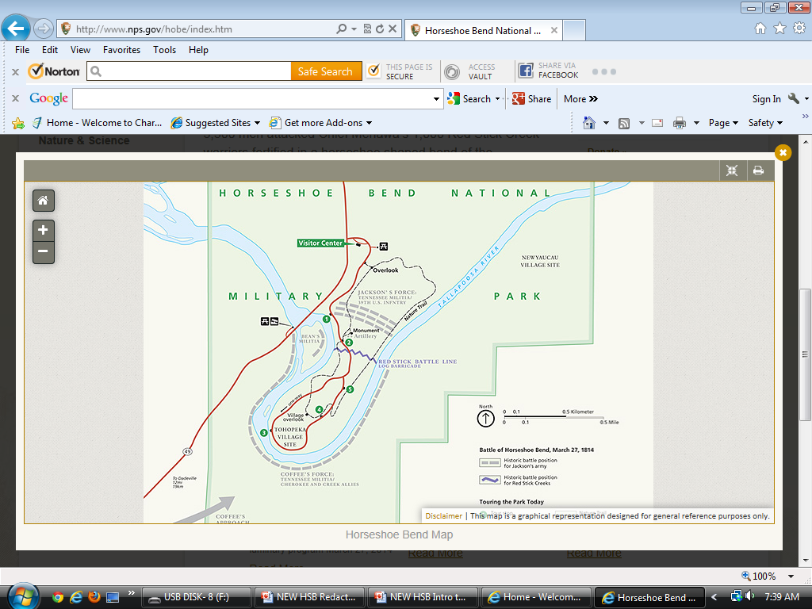
INTRODUCTION: Overview Map of the Tour Stands
1 & 10
2
3 & 9
4
5
8
7
6
Notes:
Map is from Horseshoe Bend Park brochure

Slide 25
The following tour-stand slides have
a directions slide, a reference slide,
and a menu slide with suggested tour-stand topic questions
for each stand.
Some stands are divided into two parts
to increase staff-ride SME opportunities.

Slide 26
TOUR STAND 1:
Park Headquarters Area

Slide 27
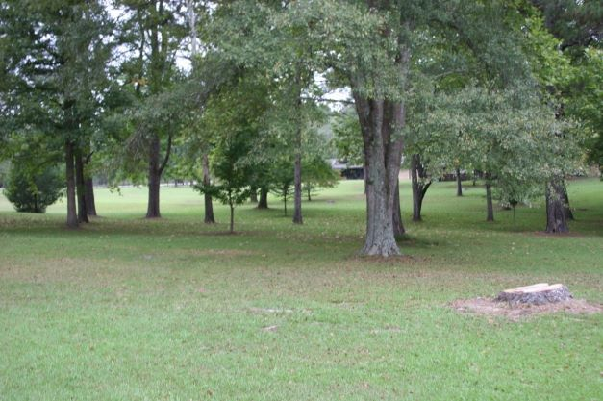
Tour Stand 1: Park Headquarters
Directions. There is plenty of room outside HSB Park HQ for multiple groups.
Looking north from the Overlook Hill parking lot,
park headquarters in the background (red circle)
Notes:
Photo by author

Slide 28
Tour Stand 1: Park HQ—War of 1812 thru 1813, and Creek War Origins
Reference Menu for Your Research
--This file’s slides 78-94 (War of 1812 issues), 105-127 (Creek Civil War), 285
--American Military History, V. 1, Chapter 6, especially pp. 132-146 (overview of War of
1812—the best quick, mostly reliable reference)
http://www.history.army.mil/books/AMH-V1/ch06.htm
--Blackmon, The Creek War, pp. 7-19, https://history.army.mil/catalog/pubs/74/74-4.html
--Braund, ed., Tohopeka, Ch. 2 (a view of Tecumseh’s impact);
Ch. 3 (discussion of white concerns)
--Bunn & Williams, Battle for the Southern Frontier, pp. 15-39 (brief background)
--Clark and Guice, Old Southwest, Chs. 7-8 (regional overview)
--Cave, Prophets of the Great Spirit, Chs. 3-4 (Tecumseh and the Creeks)
--Elting, Amateurs to Arms! Ch 1 & pp. 156-165 (difficulties / Creek War setup)
--Halbert and Ball, Creek War, Chs. 2, 4-9 (Tecumseh, Creek Civil War)
--Martin, Sacred Revolt, Chap. 5 (Tecumseh’s impact upon Creeks)
--Owsley, Struggle for the Gulf Borderlands, Chaps. 1-3 (regional overview)
--O’Brien, In Bitterness and in Tears, Chaps. 2-5, (regional overview)
--Sugden, Tecumseh, Ch. 19
--Stiggins, Creek Indian History, pp. 83-96 (ditto), 97-114 (Creek Civil War)
--Southerland and Brown, The Federal Road, pp. 8-40 (Creek War catalyst)
--Waselkov, Conquering Spirit, pp. 72-84 (ditto), 85-138 (ditto)
--Weir, Paradise of Blood, Chs. 2-4 (detailed regional overview)
--Wright, Creeks and Seminoles, pp. 129-175 (Creek conditions for war)

Slide 29
Tour Stand 1: Park Headquarters
Suggested SME Talking Points / Group Discussion Questions
Part 1: The War of 1812 up through 1813
--What were the US aims in the War of 1812 with Britain?
--As of the Ft. Mims Massacre, how had the War of 1812 gone for the US?
--What influence did the War of 1812 have upon southern whites,
southern Indians, and upon the strategic concerns of people like Jackson?
Was there a perceived British threat to the Deep South? How? Why?
What role did the Indians (i.e., Tecumseh) play in anti-British feeling?
--Did U.S. forces enjoy good logistical support in this war?
--What about the militia’s role and effectiveness in the War of 1812?
--Had the US matched aims and means well in this war so far?
Has an aims-means disconnect been a problem with other wars in our
history? Why/why not?

Slide 30
Tour Stand 1: Park Headquarters
Park HQ. There’s plenty of room outside HSB Park HQ to conduct an overview briefing and discussion of these topics.
Suggested SME Talking Points / Group Discussion Questions
Part 2: Origins of the Creek War
--Who was Tecumseh and what was his impact upon the Creeks?
--Why did the Creek Civil War occur, and why did it provoke a U.S. reaction?
--Did Creek Indian Agent Hawkins seem to grasp the Red Stick threat?
--What concerns did the Ft. Mims Massacre raise among southern whites?
--Did the Creek threat and war with Britain create a hybrid-war situation
for the US? Why/why not?

Slide 31
TOUR STAND 2:
Overlook Hill

Slide 32
Tour Stand 2, Overlook Hill:
Directions. From the Park HQ area, walk south about 200 yards to the hill that overlooks the battlefield from the north. When you look south from the hilltop, the field before you is where Jackson massed his brigades to attack the Red Stick Wall in the distance (small white posts mark the wall’s location).
Again, there’s plenty of room for more than one group to do this stand. It’s a good place to discuss the campaign and battle setup.

Slide 33
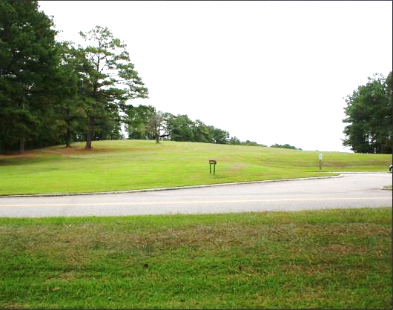
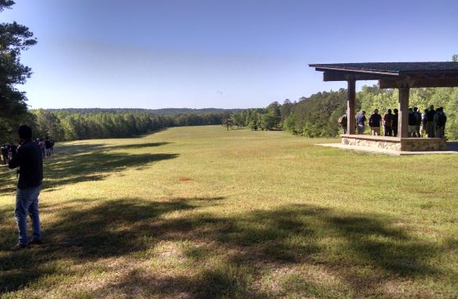
Looking southeast toward
Stand #2, Overlook Hill,
from near its parking lot
On Overlook Hill (Stand 2) facing south towards Stands 4 and 5
Notes:
Photos by author

Slide 34
Tour Stand 2, Overlook Hill:
Creek War Campaigns and Jackson’s Campaign up to Horseshoe Bend;
Horseshoe Bend Terrain, Order of Battle for Both Sides
Reference Menu for Research
--This file’s slides 125-203 (campaigns), 205-208 (overall order of battle),
238-243 (terrain), 245 (logistics), 286-290 (site locations)
--Bassett, ed. Correspondence of Andrew Jackson, Volume I (pp. 315-481; on-line)
--Blackmon, Creek War, pp. 19-33, https://history.army.mil/catalog/pubs/74/74-4.html
--Braund, ed., Tohopeka, Ch. 5 (Jackson’s campaign)
--Buchanan, Jackson’s Way, pp. 226-283 (Creek War, esp. Jackson, to HSB)
--Bunn & Williams, Battle for the Southern Frontier, pp. 40-82 (brief background)
--Clark and Guice, Old Southwest, Ch. 8
--Halbert and Ball, Creek War, pp. 185-274 (mostly Mississippi militia campaign)
--Kanon, Tennesseans at War, Chs. 3-4
--Medley, “Jackson’s Iron Will,” in Studies in Battle Command, CSI Press http://usacac.army.mil/cac2/cgsc/carl/download/csipubs/battles.pdf
--Moser, et al, eds. The Papers of Andrew Jackson, Volume III (on-line)
--O’Brien, In Bitterness and in Tears, pp. 73-139 (Creek War to HSB, OOB)
--Owsley, Struggle for Gulf Borderlands, pp. 42-79 (Creek War to HSB, OOB)
--Quimby, US Army in the War of 1812, pp. 371-467 (Creek War War to HSB)
--Remini, Jackson and His Indian Wars, pp. 62-76
--Southerland & Brown, Federal Road, pp. 40-50 (road’s role in east & west campaigns)
--Weir, Paradise of Blood, pp. 200-390

Slide 35
Tour Stand 2: Overlook Hill
Suggested SME Talking Points / Group Discussion Questions
Part 1: Creek War Campaigns & Jackson’s Campaign up to HSB
--What was the US Army campaign plan for defeating the Red Sticks?
--At the time of Horseshoe Bend, how were the eastern and western offensives doing?
--The US campaign against the Red Sticks was supposed to last a few months
max. At the time of this battle, why had it lasted seven months?
Any relevance to modern-day campaigns?
--Describe Jackson’s part of the Creek War so far:
---Any tactical victories? Why?
---Describe logistical and enlistment problems during the campaign. At the time of the battle, were these mostly resolved? How? Why?
---Discuss Jackson’s judgment and leadership up to Horseshoe Bend. Aggressive? Reckless? Why? How did he get away with it?
Impact upon support of the Red Sticks?
---How might this affect his conduct of his Horseshoe Bend Campaign?
---Indeed, is this HSB attack a raid? Aims? Logistics?
---Did the Red Sticks attack Jackson much in his campaigns? Why not?
How about for this day, as he took up attack positions here?
---Do you agree with how he ran the campaign? Any relevance?

Slide 36
Tour Stand 2: Overlook Hill
Suggested SME Talking Points / Group Discussion Questions
Part 2: Horseshoe Bend Terrain, Order of Battle for Both Sides
--Terrain
---What had the terrain been like along Jackson’s advance from Tennessee? How had the approach march gone on 27 March AM?
---From this hill, does the battle terrain look favorable for Jackson?
How might it not be? Overall OAKOC considerations? (Do not get into the actual 27 March battle.)
---We don’t know exactly what the vegetation and field looked like on 27 March, 1814, but would it need to be clear enough to put two brigades and a regiment into line?
---Why might that area have been cleared in some way?
--Order of Battle: Briefly describe the force size and composition for each side
---Describe the general make-up of Jackson’s side.
---Again, is this a raid or an attempt to seize and hold?
---For how many days does Jackson have food supplies for his move against HSB? How about ammunition? Why might this be?
---About how many Red Stick warriors and non-combatants?
Why might this be?

Slide 37
TOUR STAND 3:
Riverside/Trail/Field

Slide 38
Tour Stand 3, Island, Field or Trail:
Directions. From the Hill stand one has three options for a Stand 3 location.
1.The Park Road to the riverside parking lot. Descend the Hill back to the park road and follow it about 400 yards downhill to the small parking lot by the riverside. Conduct SME presentation and discussion here.
2. Descend the Hill to the park road. At the west end of the parking lot for the hill stop one will see a trail into the woods. Follow the trail, which eventually arrives at Gun Hill, the fourth stop. Stop somewhere along the trail for the SME presentation and discussion. There is not as much scenery on this trail; but one can get some idea of the un-cleared wooded terrain in this area.
3. The field. Walk south down from the Hill across the field toward the Red Stick Wall markers. About halfway there, stop and conduct SME presentation and discussion. Beware of snakes and/or chiggers in the summer months.
--Either way you get there, the purpose of the stand is mostly to discuss further the background of the people who fought here, as well as how attitudes on each side developed up to this point in the Creek War.

Slide 39
The park map excerpt shows three Stand 3 options.
From left to right: riverside parking lot; trail; and field
2
3
3
3
4
Notes:
Map is from Horseshoe Bend Park brochure

Slide 40
Tour Stand 3, Island, Field or Trail
Creek and Red Stick Background;
Red Stick Aims and Performance up until Horseshoe Bend
Reference Menu for Research
--This file’s slides 95-124, 136-141
--Braund, ed., Tohopeka, Ch. 1
--Stiggins, Creek Indian History, pp. 27-82 (Creek primary source)
--Debo, Road to Disappearance, pp. 3-71 (Creek life), 99 (~1832 census)
--Martin, Sacred Revolt, pp. 17-113 (spiritual factors)
--O’Brien, In Bitterness and in Tears, Ch. 1 (bgnd), Ch. 2-4 (tensions, Creek Civil War),
p. 38 (estimated numbers of adherents)
--Saunt, New Order of Things, pp. 11-63 (Creek background);
139-229 (pressures upon the Creeks)
--Griffith, McIntosh and Weatherford, Ch. 7 (focuses upon two Creek leaders)
--Weir, Paradise of Blood, Chs. 1, 5; pp. 88, 103-104, 114-116, 228, 246, 269,
314-315, 333 (Creek stresses through late 1813)
--Waselkov, Conquering Spirit, pp. 72-115, 171 (tensions, Creek Civil War)
--Wright, Creeks and Seminoles, pp. 129-172 (Creek conditions for war)
The Owsley, O’Brien, and Quimby Creek references for Stop #2 also apply here.

Slide 41
Tour Stand 3, Island, Trail or Field:
Suggested SME Talking Points / Group Discussion Questions
Part 1: Creek and Red Stick Background,
Red Stick Aims and Actions up until Horseshoe Bend
--As appropriate, briefly describe the Creeks. How many? Single tribe?
Government structure? Impact of matrilineal inheritance?
Religion? Economy?
--Then focus more upon Creek relationships with whites.
Dependence, and impact? Adoption of white ways and impact?
Land issues and impact?
--Were the Red Sticks reacting against what might be called
‘cultural imperialism’? Why?
--Describe what the Red Sticks wanted, and how they influenced
other Creeks?
--How many Red Sticks in Creekland? Unified action among the Red Sticks?
--Discuss how Creek culture and/or Red Stick aims
might have affected Red Stick performance in Creek War battles so far.
--Why might these Red Sticks at Horseshoe Bend be here?
--Explain your opinion of Red Stick leadership at Horseshoe Bend.

Slide 42
Tour Stand 3, Island, Field or Trail:
Background for Jackson and His Tennesseans
Reference Menu for Research
--This file’s slides 86-93, 125-127, 168-201
--Braund, ed., Tohopeka, Ch. 5 (Jackson’s campaign)
--Buchanan, Jackson’s Way, 1-78 (early Tennessee & Jackson); 226-83 (campaign)
--Crockett, Narrative of the Life of David Crockett, Chs. 5-6 (a Tennessean’s account)
https://www.gutenberg.org/files/37925/37925-h/37925-h.htm
--Kanon, Tennesseans at War, Introduction & Ch. 1 (Tennessean-Indian relations),
Ch. 2 (US & Tennessee militia issues and enlistment motivations)
--Remini, Jackson and His Indian Wars, Chs.1-3; half of Ch.4 up to HSB
--Whitfield, Early History of Tennessee, pp. 33-43, 57-117 (Tennessean-Indian wars)
Note that Tour Stand 6 addresses the background and motivations
for Jackson’s Indian Allies at Horseshoe Bend, so the entries below are FYI.
--Abram, Forging a Cherokee-American Alliance, Chs. 1-2 (Cherokee deep background)
--Woodward, The Cherokees, Ch. 5 (reviews Cherokee-Tennessean struggles up
through 1790s. Note: Woodward’s Creek War references are in Stop 6)

Slide 43
Tour Stand 3, Island, Trail or Field:
Suggested SME Talking Points / Group Discussion Questions
Part 2: Background for Jackson and His Tennesseans
--As appropriate, describe Tennessee’s background. How long a state?
--Focus more upon Tennessee’s frontier status and wars with Indians
in the thirty years prior to the Creek War.
--Describe Andrew Jackson’s background and demeanor.
--Why might Tennesseans fight in this war and this battle?
--Explain the difference between Tennessee militia, federal volunteers,
and US federal regulars. Discuss your leadership approach for each.
--What was Jackson’s approach? Examples? What role did the regulars play?
--So how was Jackson’s force a coalition? Were there any ‘coalition’ tensions
during the campaign? Were these resolved before the battle? How?
--How did Jackson handle other challenges, like supply and enlistments?
Note: since Stop 6 covers Jackson’s Indian Allies, it is probably best to do more in-depth discussion of their motives at that spot.

Slide 44
TOUR STAND 4:
Gun Hill Area

Slide 45
Tour Stand 4: Gun Hill Area
Directions. All of the three routes from Stand 3 lead toward Gun Hill: (a) Field—the hill will be on the right side of the field as one walks south toward the Red Stick Wall markers; (b) Trail--the trail leads right to it; and (c) Road--as one walks south about 200-300 yards on the park road uphill from the riverside, one will see a parking lot on the left and the small hill just beyond.
One reason for the Gun Hill name is that the park has a cannon on its crest. NOTE that this is a large naval cannon and not like the two small cannons that Jackson used in the battle. Nor is the naval cannon accurately placed. All historical research indicates that Jackson placed his small cannons and massed his assault forces near the base of the hill, where the Colonel Montgomery gravesite is nowadays. Thus, it is better to do this stop somewhere at the base of Gun Hill (Keep in mind that the culvert and park road distort the terrain contour.)

Slide 46
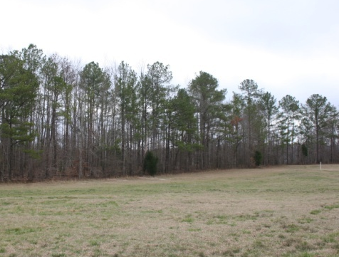
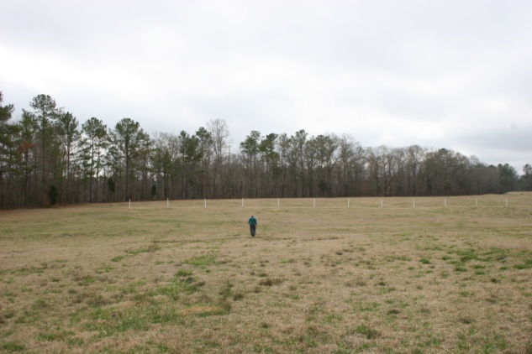
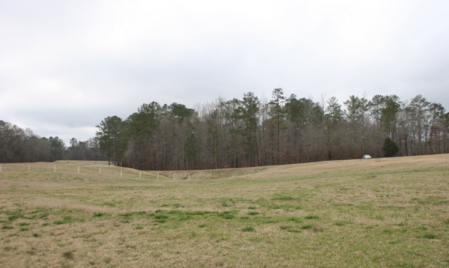
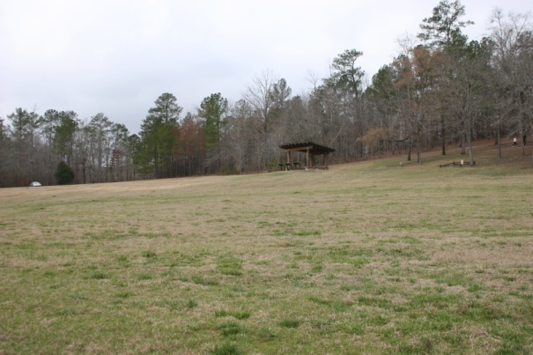
Red Stick Wall area (Stand # 5, white posts in the distance) from the north—
Gun Hill and pavilion (Stand # 4) are to the right.
Notes:
Composite photo by author

Slide 47
Tour Stand 4: Gun Hill Area
US Weapons and Tactics Overall, and for Horseshoe Bend;
The Cannonade and Actual Attack against the Wall
Reference Menu for Research
--This file’s slides 88-93 (War of 1812 weapons/tactics), 215-232 (Horseshoe Bend weapons and tactics), 251-258 (battle up to through the wall attack),
271-273, 275, 279-283 (personal accounts)
--Bassett, ed. Correspondence of Andrew Jackson, Volume I
(pp. 481-495 covers from 14 March through the battle; on-line)
--Blackmon, Creek War, pp. 33-36, https://history.army.mil/catalog/pubs/74/74-4.html
--Braund, ed., Tohopeka, Ch. 7
--Holland, Andrew Jackson and the Creek War
--Kanon, Tennesseans at War, pp. 99-106; and “A Slow Laborious Slaughter”
--O’Brien, In Bitterness and In Tears, pp. 141-147
--Owsley, Struggle for the Gulf Borderlands, pp. 79-80
--Weir, Paradise of Blood, pp. 406-411, 414-417
--Buchanan, Jackson’s Way, pp. 284-289
--Tunnell, To Compel with Armed Force,
https://www.armyupress.army.mil/Portals/7/educational-services/
staff-rides/StaffRideHB_ToCompelWithArmedForce.pdf
(Army University staff-ride guide for the 1811 Battle of Tippecanoe; pp. 110-120 can serve as a rough guide for weapons and tactics)

Slide 48
Tour Stand 4: Gun Hill Area
Suggested SME Talking Points / Group Discussion Questions
Part 1: US Weapons and Tactics Overall, and for Horseshoe Bend
--Focus upon describing the US forces at this spot and Jackson’s plans for
them. At the battle’s outset, what were the cannons supposed to do?
--How were the regular regiment, militia advance guard, and militia brigades
lined up? Why? Think about motivation, performance, weapons,
and the nearby enemy.
--Describe smoothbore muskets and the two small cannon.
NOTE there is no source that says what firearm each Soldier used,
but consider advantages / disadvantages for smoothbore and rifled muskets.
How much ammo might each Soldier carry on this trip?
--Briefly discuss linear tactics and why they were used back then.
Appropriate for this attack? Why, or was there another formation?
Would everyone have bayonets? Why not? Substitutes for bayonets?
--Why use cannon this small? Had they worked well in previous battles?
Why not use the cannon to shoot Red Sticks instead?
We don’t exactly know the types of shells used, but what was appropriate?
--Why not flank the wall—or, just skip the cannonade, and bull-rush the wall
with infantry or cavalry?

Slide 49
Tour Stand 4: Gun Hill Area
Suggested SME Talking Points / Group Discussion Questions
Part 2: The Cannonade and Actual Attack against the Wall
--Before the charge, why were the cannon and Soldiers so close to the wall?
--Regarding the Red Sticks, what would Jackson and his Soldiers have seen
from this position? Discipline issues?
--Describe the action at this spot from morning to 1230. Soldier morale as
the bombardment went for two hours? Leadership considerations?
--What spurred Jackson to order the infantry attack upon the wall?
Comparative force sizes?
--The exact way Jackson’s force approached the wall is unknown, but is worth a
conjectural discussion—and, conditions permitting, it’s worth a walk
across the field from Jackson’s position to the wall posts.
---Motivation as one advanced, and leadership implications?
---Relevance to linear tactics? Or could they have advanced
in columns? Thoughts/actions of the lead units? Follow-on units?
---Walk or run? When? Why?
---Fire one’s weapon at a preset point, or use as needed in close?
---What to do when at the wall? Weapons considerations? Fatigue?
The advantage of a larger force?

Slide 50
TOUR STAND 5:
Red Stick Wall

Slide 51
Tour Stand 5: The Red Stick Wall
Directions. From Gun Hill it’s only about 100 yards to the Red Stick wall. Walk along the road south to the wall-marker posts and then walk east along the posts and face north toward Jackson’s side.
Recommended, if conditions permit safely (i.e., vegetation, time of year, weather, etc.): walk across the field from Jackson’s line to the wall posts.

Slide 52
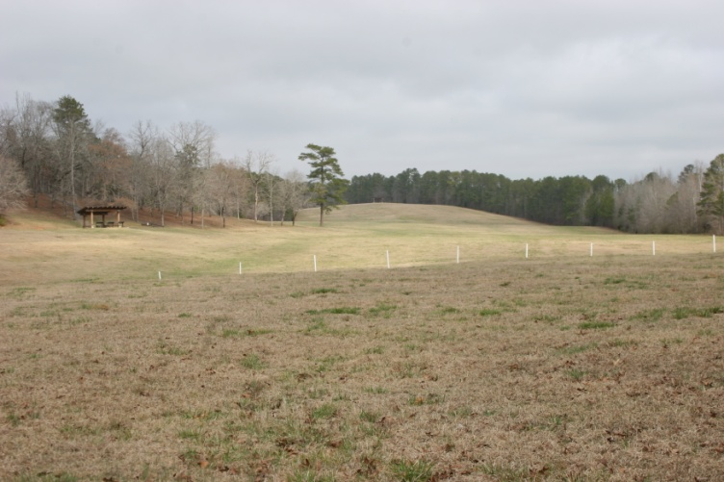
Red Stick Wall area (Stand #5, white posts in foreground) from the south—
Gun Hill and pavilion (Stand #4) are to the left.
Overlook (Stand #2) is in the distance.
Notes:
Photo by author

Slide 53
Tour Stand 5: The Red Stick Wall
The Red Sticks’ Overall Defensive Setup and Defense of the Wall
Reference Menu for Research
--This file’s slides 123-124, 136-141, 214, 224-225, 234-237, 245, 251-258, 271-272
--Braund, ed., Tohopeka, Ch. 4 (some discussion of Red Stick weapons),
and pp. 146-153 (HSB battle conduct)
--Buchanan, Jackson’s Way, pp. 285-287, 291-292 (Red Stick HSB defense)
--Martin, Sacred Revolt, pp. 156-162 (Red Stick impressions of Creek War
before Horseshoe Bend)
--O’Brien, In Bitterness and In Tears, Chs. 9-12 (Red Stick war performance)
--Owsley, Struggle for the Gulf Borderlands, pp. 81-82 (assessment of Creek defense
during war and at Horseshoe Bend)
--Stiggins, Creek Indian History, pp. 114-136 (Red Stick war performance prior to HSB,
and late-war morale issues)
--Weir, Paradise of Blood, pp. 403-405 (conjecture about Menawa’s plan), 409-410
--Waselkov, Conquering Spirit, pp. 166-68 (Red Stick spirit after earlier defeats)
--Waselkov, “Reinterpretation of the Creek Indian Barricade” (on-line)

Slide 54
Tour Stand 5: The Red Stick Wall
Suggested SME Talking Points / Group Discussion Questions
The Red Sticks’ Overall Defensive Setup and Defense of the Wall
--Look north from the posts and imagine seeing Jackson’s force
as the Red Sticks saw it.
--Describe Red Stick weapons and the wall. How far did the wall extend?
This guide describes two interpretations of its construction. In your opinion,
does one seem more plausible? Impact of each?
--Why might the Red Sticks have put so much faith and attention in it—to the
exclusion of Security elsewhere?
---The role of religion, Red Stick beliefs, and prophets?
---Past Red Stick performance—previous Creek War battles?
Overconfidence re Jackson’s force size?
---The presence of ~2000 US troops massed just north of the wall
versus the Red Sticks’ smaller force?
---Faith in an escape? Reports mention many canoes on the shore.
---Unfamiliarity, and/or distaste for western-style warfare?
---And what if Coffee’s Indians had not attacked from behind?
--How well did the wall do versus Jackson’s artillery?
--What happened to the wall defense as the village attack developed?
--Describe initial Red Stick response to the wall assault.

Slide 55
TOUR STAND 6:
Tip of the Peninsula

Slide 56
Tour Stand 6: The Tip of the Peninsula
Directions. From the Red Stick Wall follow the park road south and bear right where it forks and follow it along the west side of the peninsula to the tip. Distance from the wall to the tip of Horseshoe Bend peninsula is about 800 yards. There’s plenty of clear space, so stop anywhere along the shore.
The Red Stick village was north of you, where the open grove of trees is now. As far as anyone can tell, the Tallapoosa River’s size and flow are roughly the same as in 1814. Across the river from the tip is where Coffee’s Indian troops were supposed to help block any Red Stick escape, but instead decided to cross the river and attack the village.

Slide 57
Tour Stand 6: The Tip of the Peninsula
Coffee’s Mission and How/Why the Indian Allies Modified It
Reference Menu for Research
--This file’s slides 96-97, 110, 152, 160, 209-213, 253-257, 272, 275, 277-278, 281
--Abram, Forging a Cherokee-American Alliance, Chaps. 3-4
(Cherokees in the Creek War)
--Braund, ed., Tohopeka, Ch. 6 (ditto)
--Buchanan, Jackson’s Way, pp. 287-288
--Griffith, McIntosh and Weatherford, Ch. 7 (example of Creek split)
--Halbert and Ball, Creek War, Chs. 3 and 14 (Choctaw and Chickasaw actions)
--O’Brien, In Bitterness and In Tears, pp. 17-18, 55-56, 58-61, 134-135,
141, 153-154 (Indian allies); 144-145 (HSB); Ch.4 (Creek Civil War review)
--Owsley, Struggle for the Gulf Borderlands, pp. 79-80 (peninsula action)
--Waselkov, Conquering Spirit, Chs. 4-5 (Creek Civil War review)
--Weir, Paradise of Blood, pp. 263-266 and 301-314 (Choctaw diplomacy),
408 and 411-413 (peninsula action)
--Woodward, The Cherokees, Ch. 6 (Cherokee-Tennessee-US relations from 1790s
through Creek War)

Slide 58
Tour Stand 6: The Tip of the Peninsula
Suggested SME Talking Points / Group Discussion Questions
Coffee’s Mission and How/Why the Indian Allies Modified It
--Why did many Creeks and Cherokees actively support Jackson’s campaign?
--Did Jackson use them well in the campaign before this battle?
--What was John Coffee’s mission at Horseshoe Bend? What were his Indian
allies supposed to do? Was there a possible outside threat,
and what might be the reason for its failure to appear?
--What did the Cherokees do instead, and why? Their style of warfare?
--How difficult would it be to cross the Tallapoosa River?
--How did John Coffee react to the Cherokees’ actions? Adjustments?
Communications with Jackson?
--Why might the Red Sticks not defend this area well? (Note: these two
questions support similar questions at the Stop 5, the Red Stick wall.)
--What lessons can we take about culture differences (among allies, and
between enemies), coalition warfare, and command initiative in war?
--Counterfactual speculation: What if Jackson’s force was smaller? What if
there were no Indian allies? Indeed, what if the Choctaws, Chickasaws, or
Cherokees had joined the Red Sticks? What if the Cherokees hadn’t
crossed the river? What if Coffee had rebuked and refused the Cherokee
action? How long could Jackson’s forces have sustained a siege?

Slide 59
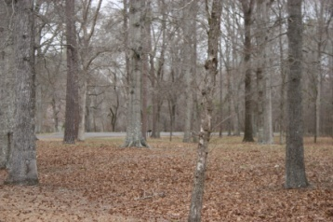
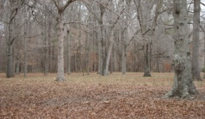
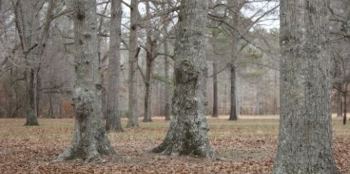
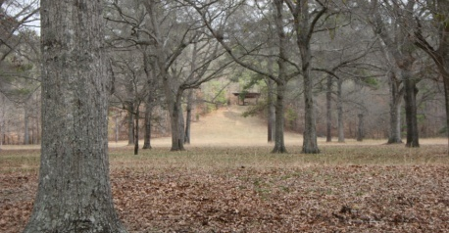
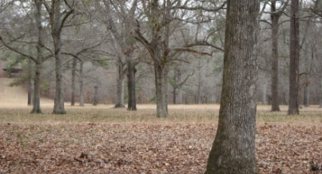
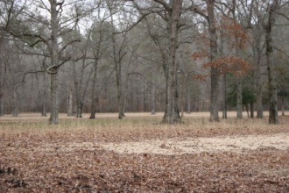
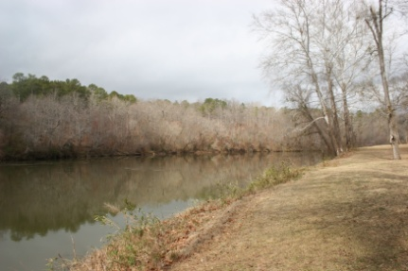
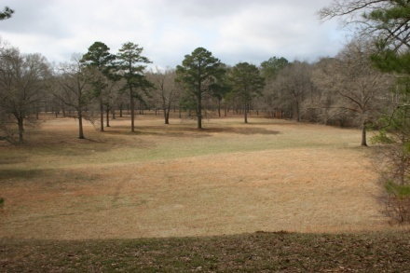
Looking north from the tip of the peninsula (Stand #6)
toward the village overlook (Stand #7, in red circle)
At the tip of the peninsula (Stand #6) looking southwest
across the Tallapoosa River
At the village overlook (Stand #7) looking south toward the tip of the peninsula (Stand #6)
Notes:
Photos by author

Slide 60
TOUR STAND 7:
Village Overlook

Slide 61
Tour Stand 7: Village Overlook
Directions. From the tip of the peninsula one can reach the village overlook in one of two ways.
One can follow the park road loop from the tip north along the east side of the peninsula about 400 yards to a small parking lot on the left. A trail goes west from the parking lot about 100 yards to the overlook.
One can ‘stump jump’ walk about 300 yards north across the tree grove directly to the overlook; but one must consider mud and critters.
Note that unlike the other tour stops, the overlook can get crowded if there are multiple groups. However, there is nothing wrong with doing the stop at the parking lot or elsewhere along the trail near the overlook.
At this spot, Coffee’s Indians and Spies/Guides moved north from the village and encountered increasing resistance from Red Stick warriors who had come from the Red Stick wall. The fighting became intense.

Slide 62
Tour Stand 7: Village Overlook
Jackson’s Indian Allies versus Red Sticks
Reference Menu for Research
--This file’s slides 209-213, 233-234, 256-257, 277-278
--Abram, Forging a Cherokee-American Alliance, pp. 76-79 (peninsula actions)
--Braund, ed., Tohopeka, pp. 133-135, 151
--Buchanan, Jackson’s Way, pp. 285 (Tohopeka construction), 288
--Griffith, McIntosh and Weatherford, 123 (Hillabees), 147, 150 (Weatherford’s action)
--O’Brien, In Bitterness and In Tears, pp. 38, 80-82, 136, 139, 144-145, 150
(Tohopeka, Hillabees, Weatherford actions, battle, casualties)
--Owsley, Struggle for the Gulf Borderlands, p. 66-67 (Hillabees), 80 (battle)
--Martin, Sacred Revolt, pp. 156-162 (Red Stick impressions of Creek War
before Horseshoe Bend)
--Stiggins, Creek Indian History, pp. 128-133 (Weatherford’s break with Red Sticks)
--Weir, Paradise of Blood, pp. 408, 411-413

Slide 63
Tour Stand 7: Village Overlook
Suggested SME Talking Points / Group Discussion Questions
Jackson’s Indian Allies versus Red Sticks
--Describe what happened in this part of the battlefield after the Cherokees
crossed the river.
--Style of fighting in this area at this time: linear tactics or something else?
Why? Room to maneuver?
--Was there any means for non-Indian Soldiers to determine which Indian
warriors were allied and which were Red Sticks?
--What impact did this fighting have on the action at the wall?
--Of the various forces under Jackson’s command,
which group suffered the highest casualties?
--What was the impact of the various US campaigns upon Red Stick welfare
food, homes, etc.?
--Indeed, how long had this settlement and fort been here?
--What do we know of the Red Sticks at Horseshoe Bend? Many Hillabee
Creeks were here? Why?
--Why weren’t the other prominent Red Stick leaders like Weatherford here?
--How many Red Stick non-combatants—women, children, and elderly--were at
Horseshoe Bend? Where were the rest?

Slide 64
TOUR STAND 8:
Redoubt Area

Slide 65
Tour Stand 8: The Redoubt Area
Directions. From the village overlook take the trail east to the small parking lot, rejoin the eastside park road, and proceed north along the road about 300 yards to the road fork. Any spot in the field areas near the fork will be suitable for this stop.
An option is to follow the trail west through the woods on the west side of the peninsula. It twice crosses the park’s tour road that you took to the peninsula’s tip for Stop #6: the first crossing is between Stops 5 and 6, and the second is at Stop 5. Other than those crossings, there are no clear stopping points for the discussion, but you can get a better idea of the complex terrain.
After Coffee’s men pushed north from the village and Jackson’s main force breached the wall, the fight became a melee. As the hours passed, the fight was characterized by: (a) individual fights by unidentified US units against Red Stick holdouts; and (b) thwarting a Red Stick retreat to the river. Original-source accounts for this stage are poor.
However, a number of accounts say that the Red Sticks had some kind of back-up redoubt system in the area you’re now standing in (perhaps stacked logs; bunkers along the bluffs), and that this area is generally the scene of the battle’s later stages.

Slide 66
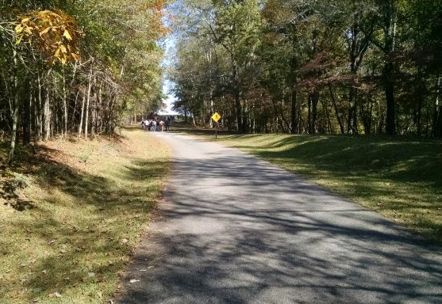
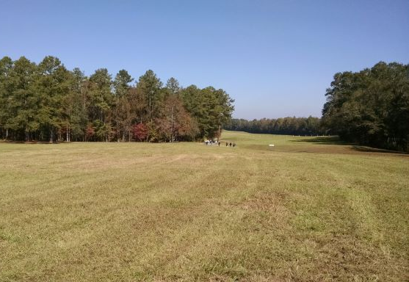
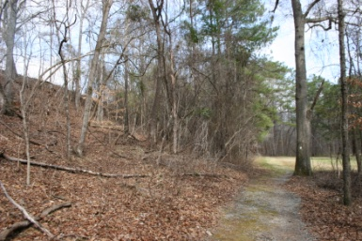
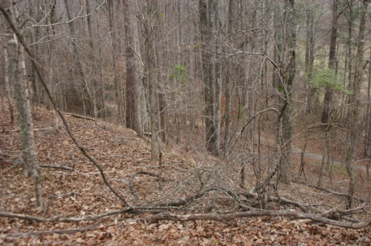
At the ‘plateau’ for Stand 8,
looking north
toward the Red Stick Wall
Travelling slightly uphill
from the Stand 7 parking lot to Stand 8
Looking up and down the plateau slope near Stand 8
Notes:
Photos by author

Slide 67
Tour Stand 8: The Redoubt Area
The Post-Wall Breach Melee, and Law-of-War Issues
Reference Menu for Research
--This file’s slides 247-250, 258-262, 271-273, 276, 279-283
--Andreopoulos, et al, Laws of War, Ch.5 (Law of War issues in colonial America)
--Bassett, ed. Correspondence of Andrew Jackson, Volume I (pp. 488-493; on-line)
--Braund, ed., Tohopeka, pp. 149-153 (redoubt fighting and endgame)
--Buchanan, Jackson’s Way, pp. 289-292 (ditto)
--Day and Ullom, eds. The Autobiography of Sam Houston
(one person’s wall and post-wall actions)
--Edwards, The Life of Sam Houston (ditto; old biography; online)
--Kanon, Tennesseans at War, pp. 102-105 (redoubt fighting and endgame)
--O’Brien, In Bitterness and In Tears, pp. 147-151 (ditto)
--Owsley, Struggle for the Borderlands, pp. 80-82 (ditto)
--Solis, Law of Armed Conflict, Chs. 1-2 (quick overview of Law of War to 1900)
--Weir, Paradise of Blood, pp. 417-428 (redoubt fighting and endgame)
--Witt, Lincoln’s Code, pp. 1-26 (Intro to American Law of War issues overall and of the Early Republic), 88-96 (Indians & Jackson)
--U.S. Army Articles of War (UCMJ forerunner)
http://avalon.law.yale.edu/18th_century/contcong_09-20-76.asp (1776 version) freepages.military.rootsweb.ancestry.com/~pa91/cfawar.html (1806 version)

Slide 68
Tour Stand 8: The Redoubt Area
Suggested SME Talking Points / Group Discussion Questions
Part 1: The Post-Wall Breach Melee
--Why might accounts of this stage of the battle not track individual-unit actions
as clearly as earlier stages? Think of the nature of these two forces,
and the nature of this part of the battle.
--What does the existence of the redoubts say about the Red Sticks’ tactical
acumen and possible battle plan?
--Why might it take Jackson’s command several hours—by some accounts, into
the next morning--to secure the area and beat the Red Sticks?
Consider:
---Jackson’s advantages: relatively small area, multiple-axis attack,
and at this time/place, outnumbers the Red Sticks at least four to one.
---Nature of the terrain and Red Stick resistance
---The cannons’ utility for this type of fight? Indeed, how might
the existing weapons of the time affect this part of the battle?
---The nature of Jackson’s forces → willingness to close with a tenacious,
dug-in enemy; fratricide concerns between converging forces?
--Any difference between this fighting and that seen at Okinawa in WW2,
at Hue in Vietnam, or at Fallujah and several other places in OIF?

Slide 69
Tour Stand 8: The Redoubt Area
Suggested SME Talking Points / Group Discussion Questions
Part 2: Law-of-War Issues
--Was there a formal law-of-war treaty at that time? Other guidelines?
--What explains the depredations by some of Jackson’s men?
---Review again the background of Indian-White relations for the Creeks
and Tennesseans at that time.
---The moods of the fighters on both sides during the melee?
---Indian ally attitudes toward the Red Sticks?
---Jackson’s control?
--Did Jackson ever ask the holdouts to surrender? Why might the Red Stick
warriors not surrender?
--Were there Red Stick POWs? Warriors or non-combatants? What happened
to them? Modern-day parallel?
--Indeed, what LoW/PoW issues apply from this battle to today?
--Again, any difference between this fighting and that seen at Okinawa in WW2,
at Hue in Vietnam, or at Fallujah and several other places in OIF?

Slide 70
TOUR STAND 9:
Riverside

Slide 71
Tour Stand 9: Riverside
Directions. From the ‘redoubt area’/road junction, walk north on the park road about 500 yards back to the riverside parking pullout area.
The island just across the river adds one more aspect to the battle’s end-game fighting. Red Sticks trying to escape by the river were shot by Lieutenant Bean’s riflemen stationed on the island. This is a good spot to discuss battle’s end and aftermath.

Slide 72
Tour Stand 9: Riverside
Battle and Creek War Outcomes
Reference Menu for Research
The same sources for Stop 8 may apply to research here.
--This file’s slides 261-282
--Bassett, ed. Correspondence of Andrew Jackson, Volumes I and III (on-line)
--Braund, ed., Tohopeka, Ch. 8 (the best overall source; + Weatherford’s actions)
--Buchanan, Jackson’s Way, Ch. 18-Epilogue (short & long-term actions/effects)
--Bunn & Williams, Battle for the Southern Frontier, pp. 84-7, 97-115 (summary)
--Clark and Guice, Old Southwest, pp. 146-159 (War of 1812 effect), 161-168 (migration effect); Ch. 12 (later effect upon Creeks)
--Debo, Road to Disappearance, pp. 81-103 (focuses upon Creeks)
--Ellisor, Second Creek War, Chs. 1-3 (run-up to violence over 1830s removals);
pp. 81, 245-247, 330-331 (Menawa’s later actions)
--Heidler & Heidler, Old Hickory’s War, Chs. 1-3 (implications for 1st Seminole War)
--Kanon, Tennesseans at War, pp. 105-110 (immediate effect for TN forces)
--Martin, Sacred Revolt, pp. 163-168 (focuses upon the Creeks)
--O’Brien, In Bitterness and in Tears, Chs. 14-19 (War of 1812 & 1st Seminole War),
Ch. 20 (long-term)
--Waselkov, Conquering Spirit, pp. 171-173 (war’s impact upon Creekland)
--Weir, Paradise of Blood, pp. 428-464 (post-battle actions)
--Wright, Creeks and Seminoles, pp. 175-320 (HSB to 1st Seminole War to removal)

Slide 73
Tour Stand 9: Riverside
Suggested SME Talking Points / Group Discussion Questions
Part 1: Battle Outcome
--Describe the fate of the Red Sticks’ attempted escape.
Why would Jackson’s troops shoot fleeing Red Stick warriors?
--Compare how well Jackson and the Red Sticks anticipated an escape.
--Why might Red Sticks say they anticipated an escape,
and that more of them escaped than Jackson claimed?
--Compare smoothbore muskets and rifle muskets.
---Why use rifles here with the ‘Spies and Guides’?
---What about elsewhere on the battlefield?
---A rifled musket’s firing rate/accuracy v. escaping Red Sticks?
--Briefly state final casualty totals.
Why did Jackson’s force submerge its dead?

Slide 74
Tour Stand 9: Riverside
Suggested SME Talking Points / Group Discussion Questions
Part 2: Creek War Outcome
--What effect did this battle have upon the Creek War?
--Condition of the Red Sticks and Creeks overall after the battle?
--Did Jackson think that Horseshoe Bend had ended the Creek War?
--So re the Creeks, what did Jackson and the other US forces do afterwards?
--Describe William Weatherford’s actions. Why did he switch sides?
What about Menawa in the 1830s?
--Why was the August 1814 Treaty of Ft. Jackson so harsh?
--What impact did Horseshoe Bend/Creek War have upon the War of 1812?
--Did fighting with the Red Sticks end? Why not?
--What does the ‘end’ of the Creek War say about any insurgency-type situation
where outside players and sanctuaries are involved?

Slide 75
TOUR STAND 10:
Park Headquarters Area

Slide 76
Tour Stand 10: Park Headquarters Area
Integration Session
Directions. From the riverside stop walk back toward park headquarters. Pick a spot near the overlook hill or park headquarters to integrate the lessons your group learned on the battlefield tour.

Slide 77
Tour Stand 10: Park Headquarters before Departure
Integration
Suggestions are below—also address issues that arose during your tour
--Characteristics of the Offense and Defense for Jackson and the Red Sticks?
--Were logistics and leadership key to US victory: greater numbers than the
Red Sticks expected on the day of battle, and better focus?
--Any similarities between this campaign/battle and present-day affairs?
---Expeditionary ops. What advantages did Jackson have that we don’t
have in OIF/OEF/other insurgencies, and vice versa?
---How might this campaign and battle have gone bad for Jackson?
---So what good things can we take from Jackson’s campaign?
---Outside support issues for Jackson and the Red Sticks?
---Can insurgencies be based upon cultural issues that we don’t understand?
Can a seemingly bad idea still inspire people? Rebel intimidation?
What role does rebel/local disunity play in insurgencies?
---Easy to be judgmental about poor Red Stick tactics and the misbehavior
of some of Jackson’s men—can these omissions and crimes be repeated,
and/or have they been repeated? Explain.
--For such a simple battle, why are the accounts so different?
--Horseshoe Bend is the Indians’ worst battlefield defeat in US history—and yet
Red Stick fighting continued. Lessons re insurgency termination?

Slide 78
The War of 1812 up through 1813

Slide 79
The War of 1812 starts with a US declaration of war on Great Britain on 18 June 1812. The war will last until a 24 December 1814 peace treaty and actual cessation of hostilities early in 1815.
CAUSES OF THE WAR OF 1812
--Americans were upset with Great Britain’s seizure of American merchant ships and sailors to support its years-long struggle with France’s Napoleon Bonaparte.
--Particularly relevant to the Horseshoe Bend battle was American suspicion that British agents were behind Indian unrest in the old Northwest (e.g., modern-day Illinois, Indiana and Ohio) as well as budding unrest among the Creeks in the American South.
--’Warhawks’ in the US Congress and elsewhere in the country believed that the US must stand up for its sovereign rights on the seas and also end the perceived British-inspired Indian scourge.

Slide 80
SPEAKING OF INDIAN UNREST IN THE NORTHWEST,
TECUMSEH AND THE PROPHET 1
--Two Shawnee brothers led an Indian unity and spiritual movement
versus U.S. encroachment/influence, 181
---Tecumseh: political leader / warrior / spiritual leader
---The Prophet: main spiritual leader
--Specific aims:
---Get right with the Great Spirit and Indian ways, because white ways have corroded Indian strength
---Tecumseh also proposed Indian unity, and violence if needed, to stop white American land greed and corrosive influence
--Rather than achieving unity, the brothers divided even their own tribe. However they had enough followers--factions from diverse tribes--to create a capital, ‘Prophetstown,’ in Indiana Territory.

Slide 81
THE NORTHWEST INDIAN SITUATION:
TECUMSEH AND THE PROPHET 2
--Meanwhile, the Indiana territorial governor, William Harrison, had secured much Indian land via an 1809 treaty with compliant tribal leaders (he used Indian debt and poverty as leverage). Tecumseh was outraged, and repeatedly objected.
--Tecumseh had to balance his peaceful public opposition with his discrete push for Indians to fight the whites if necessary. The British sympathized with Tecumseh, but their support waxed and waned with the diplomatic relations with the US. Mostly they hesitated because they didn’t want to start a war with the US over this matter. Not all Indians were discrete, and some occasionally attacked whites in the Old Northwest. Between the brothers’ public actions and these attacks, tensions in the Old Northwest remained high.

Slide 82
THE NORTHWEST INDIAN SITUATION:
TECUMSEH AND THE PROPHET 3
--In fall 1811, Tecumseh went to the Deep South to rally the tribes there. He did not achieve much success overall, but did have a decisive impact upon the Creeks, fomenting a civil war between pro-US Creeks and pro-Tecumseh ‘Red Sticks’ (more to follow).

Slide 83
TECUMSEH, THE PROPHET,
AND THE BATTLE OF TIPPECANOE 1
--While Tecumseh was away, Harrison’s force of regulars and militia advanced upon Prophetstown. The Prophet sanctioned a night-time attack on Harrison’s armed camp at nearby Tippecanoe Creek. It achieved Surprise, but was poorly organized and relied too much on ‘spirit.’ The Prophet didn’t command the assault so much as let key followers do their own thing. Recall this for the Creek War.
--For his part, Harrison had fortified his camp well enough to repel the Prophet’s attackers. Harrison was also in better command of the situation than the Prophet. Harrison stopped the attack and then destroyed Prophetstown after the Indians broke contact.

Slide 84
TECUMSEH, THE PROPHET,
AND THE BATTLE OF TIPPECANOE 2
--The troubled Indian unity movement remained so, but Tecumseh’s followers and allies reacted violently over the next year, with several small-scale independent raids. However, Tecumseh’s people struggled with deprivation and sought British help. This fueled further white suspicions regarding the Indian-British connection. When the War of 1812 started, Tecumseh and his followers allied with the British in Canada, east of Detroit.

Slide 85
WAR OF 1812 STRATEGIES/AIMS
UNITED STATES
Take advantage of Britain’s French distraction to:
--Take Canada
---Defeat Indian threat
---Obtain bargaining chip versus the British
--End Royal Navy harassment on the high seas
--Confirm sovereignty via the above—but sovereignty in itself
became paramount as the US encountered problems
with the other objectives
GREAT BRITAIN
--Defeat Napoleon Bonaparte = distraction → 1814
--Hold Canada
--Blockade U.S.

Slide 86
US WAR OF 1812 AIMS v. MEANS 1
--Throughout the war, US political leaders stuck to their strict financial principles and did little to fund the war seriously. By 1814 the US had de facto defaulted on its debts.
--This did nothing for meeting the ambitious war aims. Indeed, many New Englanders opposed the war because it hurt trade.
--At the start of the war, the US Army had increased to about 12,000 men due to a late-breaking mobilization bill, but its size didn’t even approach the bill’s 35,000-troop authorization until two years later.
--Instead the country preferred militia or temporary federal volunteers, and this is quite relevant to our story. The militia operated under a US law that forbade federal service longer than three months in any given year, forbade any foreign service, and lacked any means of enforcing its minimal standards. States and individuals were to supply arms. Volunteers could serve longer, depending on enlistment contract.

Slide 87
US WAR OF 1812 AIMS v. MEANS 2
--The consequences were campaigns where ill-trained militia struggled in battle, or where militia/volunteers left service in the middle of a campaign.
--Another problem relevant to our story was logistics, which was atrocious during this war. Beyond the previously mentioned financial woes, the US Army didn’t even have a Quartermaster department until just before the war (President Jefferson had eliminated it ten years earlier). The fledgling organization was expected to oversee logistic contracts with civilian suppliers during a war that was often fought over long distances in rough, unsettled terrain. Contract-logistical corruption and incompetence bedeviled many US campaigns, including those in the Creek War.
--By the way, the US Navy was in no shape to challenge Royal Navy operations on the high seas. Though well trained and competent, its twenty ships could not prevail against the Royal Navy’s hundreds of ships—even with Britain’s distractions in Europe.

Slide 88
US WAR OF 1812 AIMS v. MEANS 3
Branches and Weapons
--The US Army on the eve of this war was at the end of over ten years of concentrated neglect. Before the 1812 expansion, the Army consisted of about 6500 poorly supported troops in isolated garrisons. The artillery and cavalry arms were quite weak; and as mentioned, there had been no quartermaster corps until war’s eve.
--Though the Springfield and Harper’s Ferry Armories produced the 1795 Model smoothbore muskets, units often used their own weapons. This was especially the case with the militia, which by law was supposed to supply its own arms. In an 1802 US government survey of state militia arms and troop totals, Tennessee did not even bother to reply, while Georgia reported a serious dearth of arms for its available militiamen. This is an interesting point given that citizens and militia of both states had recently been in long-term Indian wars, and that these citizen-soldiers would play prominent roles in the Creek War.

Slide 89
US WAR OF 1812 AIMS v. MEANS 4
--Horseshoe Bend staff-ride participants sometimes ask about existing doctrine, training schools, and manuals. There was nothing like what we have today. West Point was in its infancy, and it mostly focused upon engineering. Branch and staff schools were in the future.
--Officer professional education, especially for militia leaders like Andrew Jackson, came via self study. The ancient classics and the on-going campaigns of Napoleon were of interest.
Notes:
See Michael Bonura, Under the Shadow of Napoleon: French Influence on the American Way of War, pp. 42-48

Slide 90
US WAR OF 1812 AIMS v. MEANS 5
Tactics
--There were at least three drill/tactics manuals used in this war, and militia units often made up their own variations of the linear tactics that the manuals taught. Many units still used Von Steuben’s “Blue Book” drill manual from the Revolutionary War. Just before the war started, US Army Inspector-General Alexander Smyth published a manual which simplified French linear tactics existing in the 1790s. During the war, the War Department endorsed William Duane’s tactics manual, which simplified French tactics even more. Smyth and Duane met controversy for a variety of reasons. For example, militia liked the simplicity, but regulars felt the tactics were too simple to handle combat contingencies.
--The linear tactics that the various manuals endorsed were still basically the same.

Slide 91
US WAR OF 1812 AIMS v. MEANS 6
Tactics
--A review of these manuals may give the impression that they were mere drill-and-ceremonies guides, but one must recall that linear drill movements were the tactics.
--Linear tactics used regiment-size line formations of either two or three ranks, shoulder-to-shoulder, with emphasis upon close-range volley fire and use of the bayonet to complete or repel attacks. These minimized the musket’s weaknesses and exploited its strengths to achieve massed combat power. Further, their close ranks provided a sense of cohesion and protection to the troops, and assisted the officers’ ability to command and control the unit.
--Conventional linear tactics since the Revolutionary War had changed little. A transition from three-rank to two-rank linear infantry formations was underway.

Slide 92
US WAR OF 1812 AIMS v. MEANS 7
Officers
--The biggest example of a lack of unified US Army guidance came with the officers. The officer corps that existed during the Jefferson and Madison administrations was small and of quite uneven quality. Most notorious was MGEN James Wilkinson, a scoundrel who Madison retained as a frontline leader until late in the War of 1812.
--At war’s start, some top leaders were Revolutionary War veterans who were junior officers in that previous war, but who were now old and out of practice.

Slide 93
US WAR OF 1812 AIMS v. MEANS 8
Officers
--Militia officers had similar problems. Local politics often determined state militia promotions, so quality was quite uneven. Tennessee frontiersman, lawyer and politician Andrew Jackson won election as Tennessee militia commander in 1802. He had no formal military training, and it was fortunate for the US that he had some Indian fighting experience and an overall knack for combat leadership. The same goes for Jackson’s top militia lieutenants like John Coffee. By 1814, wartime stresses eliminated most of the dregs, and proven leaders like Jackson, Coffee and Winfield Scott would arise.

Slide 94
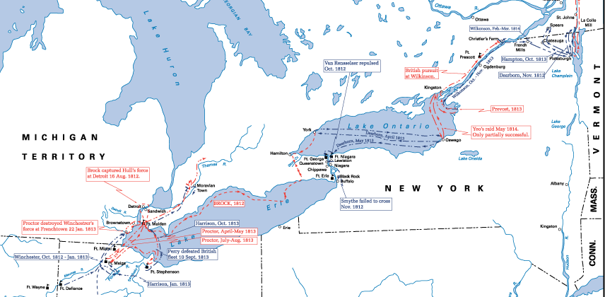
US WAR OF 1812 PERFORMANCE
AS THE CREEK WAR BEGAN IN AUGUST 1813
--As the Creek Civil War developed and produced the Fort Mims massacre in summer 1813—which started the Creek War proper--the British continued to hold Detroit and west Lake Erie after Tecumseh’s Indians and the British Army captured Detroit in 1812.
--All other American advances into Canada had failed.
--The US Navy was mostly stuck in port. Britain’s naval blockade tightened on the east coast, accompanied by occasional coastal raids.
--Since 1812, southerners feared a British move on New Orleans or up through Spanish Florida into Indian land. It had not yet happened because the British were distracted, but rumors often flew. There was suspicion, albeit unfounded, that the Creek unrest was Britain’s doing.
Notes:
Map is from US Military Academy History Department Maps & Atlases
https://www.westpoint.edu/sites/default/files/inline-images/academics/academic_departments/history/War%20of%201812/OperationsNorth.gif
Accessed 8 September 2021

Slide 95
Creek and Red Stick Background,
and the Creek Civil War

Slide 96
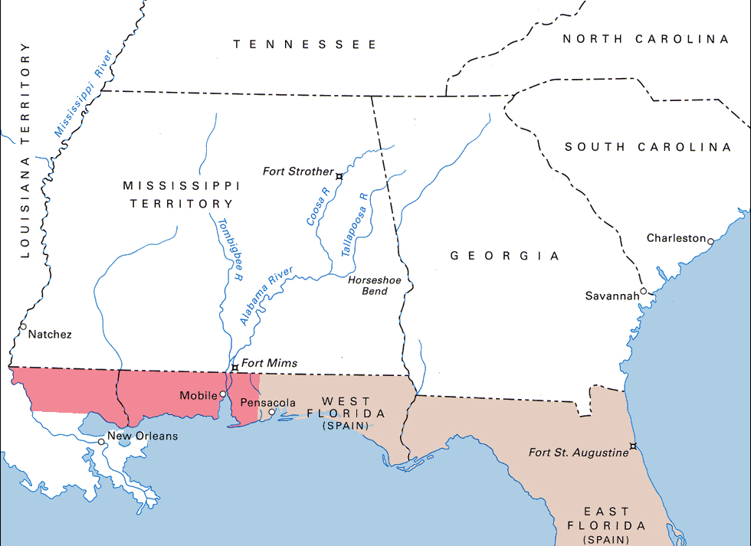
THE NATIVE-AMERICAN DEEP SOUTH, 1813
1790: 30,000
1800: 80,000
1810: ~250,000
Cherokee
Chickasaw
1790: 60,000
1800: 100,000
1810: ~250,000
Upper Creek
Choctaw
Lower
Creek
~20,000
See next slide for details.
1810: ~77,000
Notes:
--The White settlement in the Alabama-Tombigbee Rivers area went from ~750 in 1801 to 2600 in 1810. Martin, Sacred Revolt, 155.
--Map is from the US Army Center of Military History’s American Military History, Volume 1, 2005 edition
https://history.army.mil/books/AMH-V1/ch06.htm#e
Accessed 8 September 2021
--Overlay info is from the author.

Slide 97
THE NATIVE-AMERICAN DEEP SOUTH, 1813
Notes on the Previous Slide
--The green circles on the previous slide show how white American settlements increasingly encroached upon Indian lands from many directions. Note the dramatically increased white populations in Tennessee and Georgia, and the population in Creekland (‘Upper Creek’ and ‘Lower Creek’ will be explained in a later slide). The black lines represent roads that the U.S. government authorized through Indian land. Note that Florida was Spanish territory; and though Spain was not fighting the U.S. in the War of 1812, it was allied with the British against Napoleon. Americans feared that the Spanish were too much under British influence, and were equally concerned that the British would incite Indian unrest in the South as they had in the Old Northwest. The chief fear was that the British might invade into the South using the Indians as allies.

Slide 98
THE CREEK NATION: ‘MUSCOGEE’ 1
A LOOSE CONFEDERACY OF VILLAGES, TRIBES, & CLANS
GOVERNMENT
--There was no one leader of the Creeks, even if whites wanted to deal with one prominent leader. At times one Creek leader, such as Alexander McGillivray in the late 1700s, would step forward and try to act as first among equals; but any such leader was wise to heed the counsel of his peers within the confederacy.
--Instead, this confederacy of tribes such as the Alabamas, Uchees and Cussetas worked together via the headmen of associated towns such as Tuckabatchee, Coweta, and Cusseta. To complicate matters further, some towns like Coweta were ‘red’ towns and took the lead in war-related matters, while ‘white’ towns like Coosa handled internal affairs and external diplomacy. Each town had its own council of prominent men who advised a headman, or ‘mico.’

Slide 99
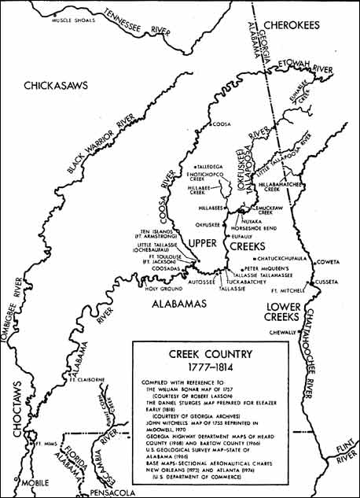
Courtesy
of the
Alabama Archeological Society.
Map by James McKinley
Note: at the time
of the Creek War,
the Lower Creeks
also occupied much of
west-southwestern Georgia.
However, the area on this map was the epicenter of the Creek War.
Notes:
Horseshoe Bend National Park, “Teaching with Historic Places, National Park Service, U.S. Department of the Interior, The Battle of Horseshoe Bend: Collision of Cultures,” https://www.nps.gov/teachers/classrooms/upload/TwHP-Lessons_54horseshoe.pdf Accessed 6 October 2021

Slide 100
THE CREEK NATION: ‘MUSCOGEE’ 2
CLAN 1
--White Americans divided the Creeks into two groups: Upper Creeks, who occupied much of what is now Alabama; and Lower Creeks, who occupied southwest Georgia, north Florida, and what is now east Alabama. It was an artificial distinction, but generally the Upper Creeks were less ‘westernized’ than Lower Creeks.
--The complexity did not end with town and tribe. Various blood-kin clans operated throughout the confederacy. These had nicknames such as ‘Wind,’ ‘Bear,’ and ‘Alligator.’ The Wind Clan was the most prominent.
--What made these clans important for our story is that Creeks normally did not marry within their own clan; and inheritance, domicile, and child-rearing ran through the wife and her family, not the husband.

Slide 101
THE CREEK NATION: ‘MUSCOGEE’ 3
CLAN 2
--The marriage custom promoted intermingling of clans within the confederacy and also freed Creek males for hunting, sports, government and fighting. Women handled the rest; again, the mother’s family—not the father’s—oversaw childrearing.
--It also meant that children of marriages between white traders and high-born Creek women produced mixed Creek-European offspring who were prominent in Creekland (a current popular academic term for such mixed-race people is métis, for what it’s worth).

Slide 102
THE CREEK NATION: ‘MUSCOGEE’ 4
RELIGION, WORLD VIEW, AGRICULTURE
--The Creeks believed in one life-giving spirit, and assigned spiritual powers to various natural features and animals. Spiritual leaders could arise based upon their ability to discern spiritual signals. The annual ‘busk’ harvest festivals hailed the natural cycle and demanded ritual purification.
--As such, Creeks believed in a natural harmony, but this attitude did not always mean peaceful interaction. Instead, it stressed order, such as redressal of wrongs. Creek customs allowed certain means of retribution to prevent acts such as murder from fomenting long-term blood feuds within the confederacy. The Creeks also had ‘sanctuary’ towns to allow passions to cool regarding transgressors.
--Part of that harmony—order--could be seen in a Creek town’s agriculture, which was communal. Families worked individual farm plots but the harvest and busk were for the community. It also appeared in the rhythm of daily Creek life and in individual Creeks’ social roles.

Slide 103
THE CREEK NATION: ‘MUSCOGEE’ 5
FOREIGN POLICY AND WARMAKING 1
--The Creeks had a formidable reputation for war and adroit diplomacy. Via a series of destructive raids against villages, the Creeks fought the Cherokees in a long war in the mid 1700s. They also fought the Choctaws later that century. Given the loose nature of the confederacy, individual groups of Creeks were prominent in late-1700s Indian wars in Tennessee and Georgia.
--They fought in the classical Indian style, via emphasis upon raids and individual prowess in battle. It was an honor to gain the title of ‘tustunugee,’ meaning ‘warrior,’ or even ‘hadjo,’ meaning ‘wild in battle.’ This approach to fighting would yield disaster in the Creek War when Creeks fought fiercely but in a poorly organized and prepared manner.

Slide 104
THE CREEK NATION: ‘MUSCOGEE’ 6
FOREIGN POLICY AND WARMAKING 2
--Creek writer George Stiggins remarked that Creeks observed no firm distinction between combatants and non-combatants. Prisoners might be forcefully adopted, enslaved, or killed in revenge rituals.
--While three colonial powers—Britain, France, and Spain—jostled for influence in the South, the Creeks were famous for playing them against each other to their own advantage.

Slide 105
TROUBLE IN CREEKLAND 1
--Dependency. Even during colonial times, the Creeks were vulnerable to unequal trade terms. They craved European things they could not make, such as firearms, or could not make as well, such as home/farm implements and textiles. The dependency created problems:
---Increasing debt which the Europeans and later the Americans used to bargain the Creeks out of land. The debt vortex intensified because the Creeks had no real trade commodity other than animal skins, which they over-hunted to meet onerous trade terms.
---Disruption of lifestyle. The Creek need for these items crippled their sense of independence and undermined traditional crafts.
--US Pressure. The Revolutionary War and Louisiana Purchase meant that the Creeks now dealt mostly with one neighbor, the United States. The Creek Confederacy could no longer play rival powers as well as it had previously.

Slide 106
TROUBLE IN CREEKLAND 2
--The Land Issue. The estimated 20,000 Creeks faced a US white migratory tidal wave, especially from Georgia, whose population climbed from 82,000 in 1790 to over 250,000 in 1810. In spite of laws forbidding settlement on Creek land, white Georgia squatters did it anyway, provoking a low-grade undeclared war between squatters and individual Creek bands through much of the 1790s. The Creeks’ debt problem assisted Georgian and US efforts to settle the fighting by purchasing Creek land; and white authorities had bought half of modern-day Georgia from the Creeks by 1812.
--Top US leaders believed that white settlement of Indian land was inevitable. Both Presidents Washington and Jefferson considered moving the southeastern Indians further west to prevent inter-racial tensions and to allow the Indians to preserve their way of life.

Slide 107
TROUBLE IN CREEKLAND 3
--Aggravating the land issue was the US government’s desire to build roads through Creek land for enhanced trade and security with the newly acquired Louisiana Territory. Most galling to some Creeks was the October 1811 completion of the Federal Road which ran through the middle of Creekland as it connected Georgia’s capital, Milledgeville, with New Orleans, Louisiana (see map, slide 96).
By March 1812 over three-thousand white Americans had traveled the Federal Road, and more were coming. Some Creeks made money running tolls, inns and other concessions along the way. A few Creeks saw other opportunities, and attacked travelers either for gain or because they didn’t like these intruders.
Notes:
The Federal Road statistic is from Weir, Paradise of Blood, 89.

Slide 108
TROUBLE IN CREEKLAND 4
--Perhaps the biggest threat to the Creeks was an insidious one: increasing ‘westernization’ – one might call it ‘cultural imperialism’ nowadays -- as more Creeks adopted white ways. The U.S. Agent to the Creeks, Benjamin Hawkins, actively promoted Creek assimilation. He sympathized with the Creeks and worked well with many, but saw assimilation as the only way the Creek nation would survive against the white migratory tide. Creek leaders like William McIntosh were on Hawkins’ side and often prospered as well. Many Creeks, even future Red Sticks like William Weatherford, made individual fortunes as ranchers or plantation owners. This development challenged traditional Creek handling of resources. Others resisted the white influence, and the Federal Road through their land was yet one more serious irritant as it divided those who saw in it profit and progress, and those who saw it bringing more disruption and ultimate ruin.

Slide 109
TROUBLE IN CREEKLAND 5
--Whither the Creeks? The old Creek emphasis upon communal order and traditional ways was in crisis. Many Upper Creeks and some Lower Creeks questioned the changes. Creek Agent Hawkins’ preferred outcome—Creek males becoming farmers and such, just like white males—threatened many Creeks’ identity. Why should the men embrace work that their culture assigned to the women? And would women want men in their sphere of influence anyway? To these people, the new order was neither orderly, nor glorious, nor meaningful.
--Into this crisis strode Tecumseh in autumn 1811 . . . .
Notes:
See Weir, Paradise of Blood, 88.

Slide 110
TECUMSEH AND THE CREEKS 1
--In his autumn 1811 visit to the southeastern tribes, Tecumseh got relatively few takers for his message of Indian spiritual revival and unity versus white expansion. The Chickasaws rejected him outright. A small number of younger Choctaws and Cherokees were receptive, but their leaders stifled such interest and rejected Tecumseh.
--Some controversy exists about what Tecumseh actually said to the Creeks, but a general consensus indicates that he preached unity and spirituality via prophets (both Shawnee and Creek) who had visions. Tecumseh added that unity and force would become important if the anticipated war between the US and Britain actually occurred. Finally, he promised a supernatural sign—shaking the earth--of his call for more decisive action after he returned north.
Notes:
Griffith, McIntosh and Weatherford, 76, cites a Benjamin Hawkins quote of Tecumseh, “Shake your war clubs, shake yourselves; you will frighten the Americans, their arms will drop off from their hands, the ground will become a bog, and mire them, and you may knock them on the head with your war clubs.”

Slide 111
TECUMSEH AND THE CREEKS 2
--Thanks to the crisis in Creekland, about one-third to one-half of the Creeks (maybe 9,000) liked Tecumseh’s message. Different explanations exist for why these people were called the ‘Red Sticks,’ but the common one is that this group was willing to raise the red war club against the white threat. These slides will refer to them thusly, and to their Creek opponents as Loyal Creeks.

Slide 112
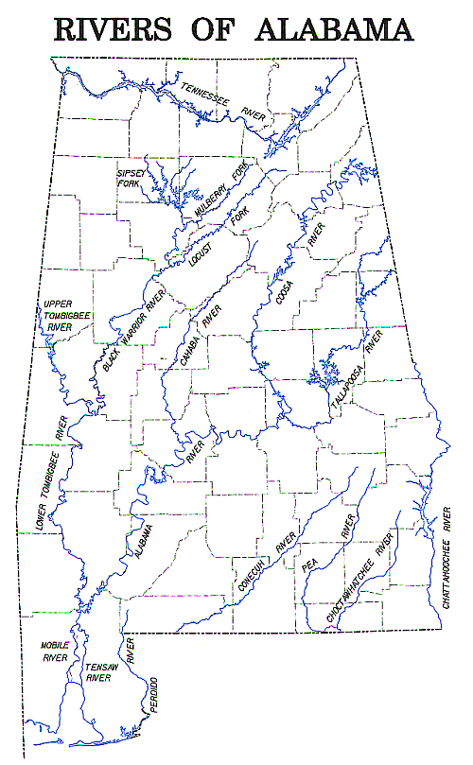
You will need this map
as you read about the campaigns
and all the river references.
Notes:
Map is from Alabama state breeding-bird atlas
http://conservationgis.alabama.gov/ALBBA/IMAGES/rivers-of-alabama.jpg
Accessed 8 September 2021

Slide 113
THE CREEK CIVIL WAR, 1812-1813: Part 1
INITIAL DEVELOPMENTS, LOCATIONS 1
--As if to confirm Tecumseh’s promise, strange omens occurred. A comet appeared, and then in late 1811 a massive earthquake struck the south central US. Among the Red Sticks, such events inspired true believers, opportunistic leaders and followers alike.
--Red Stick and Loyal Creek sympathies existed throughout Creekland, but generally Red Stick ideas prevailed among the Upper Creeks along the Alabama, Cahaba, Black Warrior, Tallapoosa, and southern Coosa rivers. Loyal Creeks were strongest among Lower Creek areas near the Chattahoochee and Flint Rivers, as well as along parts of the Tallapoosa and far upper Coosa Rivers. Again, numbers are mere guesses, but perhaps 9000 of the roughly 20000 Creeks were in the Red Stick camp.
Notes:
See Weir, Paradise of Blood, 114-116, 358.

Slide 114
THE CREEK CIVIL WAR, 1812-1813: Part 2
INITIAL DEVELOPMENTS, LOCATIONS 2
--One Creek chief estimated that the Red Sticks had about 2500 warriors and Loyal Creeks had at least 1000. Later in the Creek War, US theater commander Thomas Pinckney estimated that the Red Sticks started the war with about 4000 fighters, and had under 3000 poorly armed and fed warriors by the end of 1813.

Slide 115
THE CREEK CIVIL WAR, 1812-1813: Part 3
INITIAL VIOLENCE
--Tecumseh’s Creek prophets proceeded to identify ‘good’ and ‘bad’ Creeks, and the rebellious fervor became ever more violent. To cleanse themselves of white ways, some of the more extreme Red Stick factions destroyed ranches, livestock, and even firearms—foolish acts if they anticipated a war with the United States government. Attacks between Red Stick believers and skeptical Loyalists increased.
--Already, tensions between the two groups flared over attacks on Federal Road travelers. At Hawkins’ insistence, Loyal Creek chiefs led posses that killed a suspected murderer in a Creek town designated by custom as a sanctuary.
--A small Red Stick group followed Tecumseh north. One party returned in spring 1812 and, thinking that war between the US and Britain had started, massacred white farmers while enroute in Tennessee. The same thing happened in early 1813 as another party returned from the Detroit Front fighting.

Slide 116
THE CREEK CIVIL WAR, 1812-1813: Part 4
HAWKINS AND LOYAL CREEKS RESPOND
--White concern increased with the killings in and around Creekland. Tennesseans, recalling their nasty decades-long wars with various tribes, were quite alarmed about Red Stick raids in their midst.
--US Creek Agent Hawkins and top Loyal Creek leaders appointed a Creek ‘national police’ force which caught and executed the Red Sticks responsible for the Tennessee murders. Red Stick supporters believed the executions violated Creek custom, which required clan leaders to determine punishment. By late spring 1813, attempts at reconciliation between the factions failed amidst murder and retaliation. In summer, open civil war erupted.

Slide 117
THE CREEK CIVIL WAR, 1812-1813: Part 5
ACTIONS 1
--Red Sticks seized several towns, mostly in the Upper Creek area, and purged local societies violently. For example, they forced Loyal Creeks to abandon one of Creekland’s most prominent towns, Tuckabatchie near the Tallapoosa River, after a siege (see map on slide 122). They started designating certain places as holy grounds that were supposed to have supernatural power to repel non-believers. They aimed to cleanse Upper Creekland first and then proceed to the Lower Creek region.

Slide 118
THE CREEK CIVIL WAR, 1812-1813: Part 6
ACTIONS 2
--Loyal Creek refugees and many other Lower Creeks banded together near the US Creek Agency on the Flint River in Georgia. At Hawkins’ urging, some leaders like William McIntosh led their own destructive raids against Red Stick settlements. Creek Agent Hawkins was concerned about the strife but, perhaps due to health issues, didn’t seem to grasp its severity. He hoped the Creeks would solve this crisis internally, and even told visitors and newcomers the problem was not too serious.
--However, the struggle was very serious, and events later in summer would prove same.
Notes:
See Weir, Paradise of Blood, 104, 114-116.

Slide 119
THE CREEK CIVIL WAR BLOWS UP, SUMMER 1813, Part 1
--In July 1813 a Red Stick band led by Peter McQueen went to Pensacola in Spanish Florida to procure weapons for the growing civil war. Concerned about showing open support for unrest in the US, the Spanish gave the Red Sticks mostly non-weapon supplies. A sidelight to this trip was a growing but never-proven rumor throughout the region that the party carried a letter from Tecumseh asking for arms to support a future joint Red Stick-British campaign against the US. Also, along the way, they destroyed small farms belonging to whites and to Creeks they didn’t like.
--The civil war, and news of McQueen’s mission and Tecumseh’s alleged letter, alarmed whites and Loyal Creeks in the ‘Tensaw’ district north of Mobile. They mobilized and started building forts to protect themselves, mostly on the west side of the river system that ran south into Mobile. At the end of July, the Mississippi territorial governor assigned militia commander Ferdinand Claiborne and a small force to assist the locals.
Notes:
--Stiggins, Creek Indian History, 102: the Red Sticks wanted revenge for the Burnt Corn attack, and also resented having to report to these forts when they travelled on the Alabama River.
--Martin, Sacred Revolt, Chap. 7 alleges that the Red Sticks never meant for this to be a war against the whites. Instead it was supposed to be a purge of backsliders within their own nation.
--Weir, Paradise of Blood, 117-142.

Slide 120
THE CREEK CIVIL WAR BLOWS UP, SUMMER 1813, Part 2
--The locals needed help. Many of their forts were ramshackle affairs. Worse, hearing of McQueen’s trip, the locals in late July tried to ambush McQueen’s band on its return at Burnt Corn Creek, about fifty miles north of Pensacola. The ambush achieved surprise but fell apart as the Red Sticks routed the undisciplined militia in a counter-attack.
--Buoyed by success, some Red Stick leaders wanted to attack the Lower Creek region, as well as whites in neighboring US states. They were overruled by those who wanted revenge against the weak whites and Loyal Creeks who tried to ambush McQueen. The Red Sticks targeted Fort Mims, a quickly built stockade isolated east of the Alabama and Tombigbee Rivers about thirty miles north of Mobile. They hit the place on 30 August 1813 (see map on slide 122).

Slide 121
THE CREEK CIVIL WAR BLOWS UP, SUMMER 1813, Part 3
--White/Loyal Creek security at Fort Mims was atrocious, and the Red Sticks’ surprise attack overran it. The Red Sticks’ victory was a mixed blessing, however. Magical powers did not appear, breeding some disaffection among Red Sticks. Worse, the warriors got out of hand and murdered many women and children taking refuge in the fort. This would breed a brutal US response.
Notes:
--Stiggins, Creek Indian History, 111-112: there was a small Red Stick squad of ‘shock troops’ who were supposed to be bullet-proof, but this did not work for three of them. On p. 114-115, Stiggins writes that many Red Sticks were angry with the prophet Paddy Walsh because his promises of magical protection did not work. This provoked dissension, and removal of Walsh from that area. Martin, Sacred Revolt, 156, writes that after the Burnt Corn battle, Red Stick leaders and prophets lost control of their own people. See also Griffith, McIntosh and Weaterhford, Chap. 8. Note Weatherford’s (Red Eagle’s) controversial involvement and how sources may differ over same.

Slide 122
Tuckabatchie
Burnt Corn
Fort Mims
Notes:
Map is from Alabama state breeding-bird atlas
http://conservationgis.alabama.gov/ALBBA/IMAGES/rivers-of-alabama.jpg
Accessed 8 September 2021

Slide 123
DIGRESSION ABOUT RED STICK LEADERSHIP 1
--The nominal Red Stick leader at Fort Mims was William Weatherford, a.k.a. ‘Red Eagle.’ Why did apparently ‘westernized’ Creeks like Weatherford and Peter McQueen become Red Sticks?
--Recall that inheritance and child rearing were matrilineal. Some Red Sticks had English fathers/grandfathers and associated Anglicized names, but they were raised by their mothers’ clans within the Creek nation. Also, as individuals they had their own motives. Josiah Francis, a.k.a. ‘Hillis Hadjo,’ was praised as a dedicated Red Stick or condemned as an opportunistic fraud. Accounts of prophet Paddy Walsh describe a Red Stick true believer.
--As for Weatherford, some say Red Stick fanatics coerced this popular local leader’s support by threatening his family. Others say that though Weatherford doubted the Red Stick path, he was also committed to Creek ways. Implied in some accounts is mutual animosity between Weatherford and leading Loyal Creeks.
Notes:
For Weatherford, good sources are Griffith, McIntosh and Weatherford, passim; O’Brien, In Bitterness and in Tears, pp. 42-43, 157; Wright, Creeks and Seminoles, pp. 166-170; and Stiggins, Creek Indian History, 103-106.

Slide 124
DIGRESSION ABOUT RED STICK LEADERSHIP 2
--Note that the account has mentioned various Red Stick leaders, and there were several more. No one chieftain led all Red Stick affairs, which illustrates the often diffuse nature of Indian leadership in the Indian wars. It wouldn’t help the Red Stick cause, and already there was trouble. Weatherford allegedly urged mercy at Ft. Mims, but his Red Stick ‘followers’ didn’t show it.
--There are not many accounts of Red Stick strategy discussions during Creek War. The existing ones often indicate that the different leaders had different ideas about how to fight the US. At times, they acted in something approaching harmony, but often they either argued or simply decided to go their own way.

Slide 125
Overall Reaction to Fort Mims,
and Tennessean Reaction

Slide 126
THE US AND THE WHITE SOUTH EXPLODE OVER FT. MIMS 1
--A less organized Red Stick attack on Fort Sinquefield north of Fort Mims failed on 1 September, but the Ft. Mims Massacre terrified local whites, who mostly abandoned the Tensaw area. It was well they did, because Red Stick guerilla raiders made the Tensaw land east of the Mobile river system unlivable for whites and Loyal Creeks.
--News of Ft. Mims and other Red Stick actions electrified Americans, especially white southerners. The war against Britain was going poorly, especially in the Lake Erie area, and Americans knew of Indian atrocities against US POWs after the Raisin River battle near Detroit. Unfounded rumors of British mischief in the South abounded. After all, there was a British trading post in Pensacola, Spanish Florida. Given stories about Creekland violence, the US already pondered moving forces into the area. Fort Mims accelerated those plans.
--Per white expansionist aims, people like Andrew Jackson saw a Creek war as a chance to seize Indian ground; but recall that White-Indian violence was a long-running current-events issue back then . . . .

Slide 127
THE US AND THE WHITE SOUTH EXPLODE OVER FT. MIMS 2
--”The Dark and Bloody Ground”: a term used by one Indian leader to describe Kentucky and Tennessee in the late 1700s as the tribes battled the white-settler migration into their land. The Tennesseans who comprised most of Jackson’s force at Horseshoe Bend were either the settlers or descendants of same who had fought a vicious low-grade war with the Cherokees and their occasional Creek, Chickasaw, and Shawnee allies. The on-off struggle featured ambushes, raids, retaliatory strikes, and outrages by both sides—and it lasted about twenty years, between the 1770s and 1790s.
--Tennesseans also recalled the recent Red Stick murders in their state, so the news of Ft. Mims alarmed them greatly. Tennessee was answering US mobilization plans for the Creek Civil War when news of Fort Mims arrived. Tennessee militia commander Jackson stressed an offensive to pre-empt Red Stick action. Also, upon hearing of Fort Mims the federal government ordered action into Creek territory.
Notes:
See also Crockett, Narrative of the Life of David Crockett of the State of Tennessee, 73. In this passage, he persuades his reluctant wife to support his enlistment by saying that if he and others fail to stop the Red Sticks elsewhere, they will surely attack Tennesseans like the Crocketts in their homes.

Slide 128
Creek War Campaigns:
Overall Setup and Issues

Slide 129
THE CREEK WAR CAMPAIGNS: THE PLAN 1
--Even before Ft. Mims, Creek unrest had led the War Department to order Tennessee and Georgia to mobilize up to 5,000 militiamen in July 1813. News of the massacre galvanized the process, and forces in Tennessee, west Mississippi Territory, and Georgia were starting their separate moves in late September/early October.
--In mid-October 1813, the War Department assigned Major General Thomas Pinckney as overall commander of the Creek operation, with his headquarters in Milledgeville, Georgia. Pinckney provided some coordinating authority to this operation, but such coordination could be tough given distances and primitive communications.

Slide 130
THE CREEK WAR CAMPAIGNS: THE PLAN 2
Overall, Pinckney planned to send multiple converging forces into the heart of Creekland. These forces aimed to
eliminate Red Stick armed opposition,
destroy Red Stick settlements and supplies,
and establish forts for security and supply.
(Note: destruction of Indian subsistence agriculture was a common strategy in both colonial and US Indian wars),
--Ferdinand Claiborne’s militia, regulars and Choctaw allies would proceed from the west part of Mississippi Territory (what is now Alabama and Mississippi) to the Coosa and Tallapoosa River junction.
--John Floyd’s Georgia militia and Loyal Creek allies would go from the Fort Hawkins Creek Agency (near modern Macon) into Creek land via the Federal Road to the same Coosa/Tallapoosa confluence.
--Two Tennessee forces under Andrew Jackson’s overall command, including Cherokee and Loyal Creek allies, would follow the Coosa and Tallapoosa Rivers to same.
See maps next slides.

Slide 131
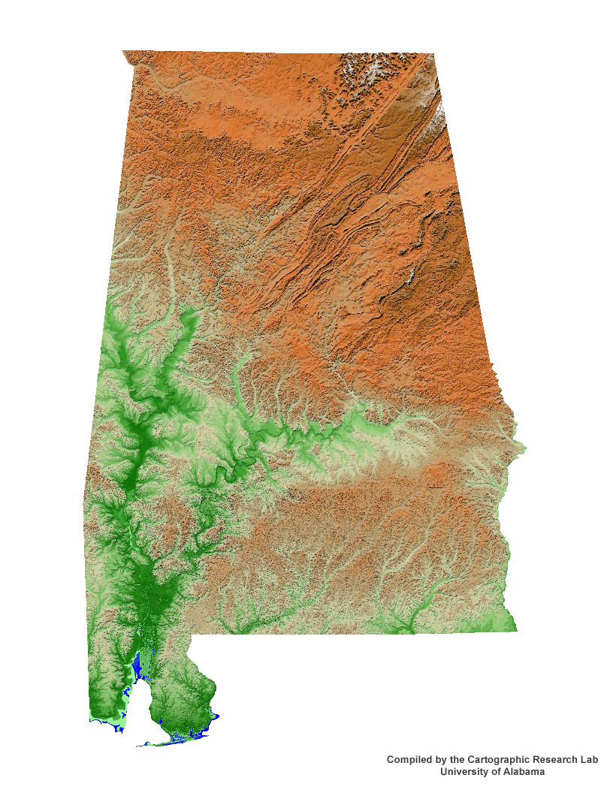
THE CREEK
CAMPAIGN:
THE PLAN 1
John Cocke:
From East
Tennessee
(supposed to join
with and serve
under Jackson)
Andrew Jackson:
From West
Tennessee
Thomas Pinckney,
in Georgia:
Overall commander
Ferdinand
Claiborne:
from the
west part
of
Mississippi
Territory
John Floyd:
from Georgia
(Fort Hawkins,
near present-day
Macon)
Notes:
Map is from Alabama state breeding-bird atlas
http://conservationgis.alabama.gov/ALBBA/relief.jpg
Accessed 8 September 2021

Slide 132
THE CREEK
CAMPAIGN:
THE PLAN 2
Cocke
NOTE:
Given
the US Army’s material and force-size advantages,
the campaign should have taken about
three months.
See next slide.
Jackson
Pinckney
Floyd
Geographical objective
for all three
forces
Claiborne
Notes:
Map is from Alabama state breeding-bird atlas
http://conservationgis.alabama.gov/ALBBA/IMAGES/rivers-of-alabama.jpg
Accessed 8 September 2021

Slide 133
BIG TAKEAWAYS RE THE CREEK WAR CAMPAIGNS, PART 1
THE US SIDE 1
--The US campaign took nearly a year. Reasons:
---The logistical and enlistment woes that bedeviled other War of 1812 operations also hurt these campaigns. The US side won most of its battles, but struggled to sustain operational momentum.
---Command Issues. From his Georgia headquarters, Pinckney struggled to control detached forces in a relatively undeveloped region. The Mississippi District commander, Thomas Flournoy (a.k.a. Flourney), was upset that Pinckney commanded some of the units in his area, and so withheld key logistical and troop support at times. Among the Tennesseans there were problems between Jackson who operated initially with the western Tennessee militia and Cocke who was with the East Tennessee militia, over logistics and operational command. Jackson commanded all Tennessee forces, but Cocke was uncooperative at critical times.
--Ultimately, the US prevailed due to perseverance, denial of Creek resources, and the aggressive action of Jackson’s force.

Slide 134
BIG TAKEAWAYS RE THE CREEK WAR CAMPAIGNS, PART 2
THE US SIDE 2
--Most histories of the campaign say little about how well the US commanders used scouts and spies, but Jackson was remarkably confident and well-informed as he moved deep into Creekland toward his objectives. He used so-called ‘spies and guides’ liberally; his Horseshoe Bend order of battle shows at least three dedicated scout companies. In fact, the legendary frontiersman David Crockett served in that role during some of Jackson’s Creek War operations. The other US Creek War commanders used Indian allies, too.
--In many US attacks on Red Stick positions—Tallushatchie, Talladega, Autassee, Holy Ground, and Horseshoe Bend—commanders tried to envelop and trap the Red Sticks. Again, there was no standard or doctrine for this move. Most likely, US leaders wanted to round up or annihilate the rebels by maneuver and surprise. They might even have been inspired by classical victories like Cannae; but most had no formal military training. Such things as field manuals and the Principles of War didn’t exist back then, either.

Slide 135
BIG TAKEAWAYS RE THE CREEK WAR CAMPAIGNS, PART 3
THE US SIDE 3
--Until Horseshoe Bend, US forces overran their objectives but usually did not bag all of the Red Sticks. At Holy Ground the terrain obstructed maneuver. At Talladega a subordinate unit didn’t move as ordered. At Autassee, the area was too large for the small force to encompass. Indeed, the US forces were often too small for the ambitious envelopment plans.
--Perhaps because the Red Sticks escaped these traps, they believed they could repeat the move at Horseshoe Bend if the battle went bad . . . .

Slide 136
BIG TAKEAWAYS RE THE CREEK WAR CAMPAIGNS PART 4
THE RED STICK SIDE 1
The Red Sticks’ defense against the US Army’s campaigns
often puzzles modern-day observers.
--There was relatively little of the guerilla-style fighting that one associates with Native Americans. Red Stick raiders did make the eastern Tensaw region unlivable for several months; US patrols often encountered enemy spies and scouts; small Red Stick bands raided Lower Creek towns like Coweta as late as November 1813; and US Soldiers in Creekland could not become too separated from their main force. However, there were usually no concerted or continual Red Stick attempts to harass, disrupt or interdict US forces via guerilla action. Perhaps this was due to Creek/Red Stick emphasis upon individual heroics, or due perhaps to the Red Stick leaders’ apparent attempt to concentrate their forces in alleged holy strongholds.
--Thus the Red Sticks did not destroy the US Army raiding forces that denied them resources. By late spring 1814, thousands of Creeks were begging the Army for food.

Slide 137
BIG TAKEAWAYS RE THE CREEK WAR CAMPAIGNS PART 5
THE RED STICK SIDE 2
--Occasionally the Red Sticks attacked ‘large’-sized US forces with vigor. The Emuckfau, Enitachopco, and Calabee Creek battles are good examples. This followed the Creek emphasis upon heroic, fierce, individual-style combat instead of an organized attack led by one commander; and it especially followed the Red Sticks’ emphasis upon divine glory and Indian ways. Army forces repelled these attacks. At least one of these featured poor cooperation among Red Stick leaders.
--The other major battles featured failed Red Stick defenses of villages and other fixed positions. Usually they allowed Army forces to maneuver into superior positions close by, made fierce but poorly conducted counter-attacks, and then fled these positions. A historian called one of these failures, a whipping by Jackson’s troops at Talladega, “inexplicably catastrophic.”
Notes:
For quote, see Weir, Paradise of Blood, 228.

Slide 138
BIG TAKEAWAYS RE THE CREEK WAR CAMPAIGNS PART 6
THE RED STICK SIDE—WHY THESE FAULTS? 1
The answer is conjecture.
There are almost no primary sources for the Red Stick side,
and there are few sources who recounted what Red Sticks told them.
For Horseshoe Bend, there are no Red Stick sources at all.
The following slides offer factors for staff-ride tour-stop discussion.

Slide 139
BIG TAKEAWAYS RE THE CREEK WAR CAMPAIGNS PART 7
THE RED STICK SIDE—WHY THESE FAULTS? 2
--Spirituality. The prophets offered divine protection and seemed to ignore good tactical sense; and though magic did not work in these battles, it might have seemed to work for the war overall. All US forces had to stop or even retreat for logistical/enlistment problems, and one Red Stick letter indicates these Army halts showed the True Believers their faith was working.
--True Believer Influence and/or Coercion. The Red Sticks’ zeal sometimes disrupted realistic military thinking. They elected to concentrate at certain spots, and seemed to dismiss effective raiding. At Autassee and Holy Ground, Red Stick prophets interfered with the defensive setup. At Calabee Creek, they invoked divine authority to scuttle a more sensible attack plan.

Slide 140
BIG TAKEAWAYS RE THE CREEK WAR CAMPAIGNS PART 8 THE RED STICK SIDE—WHY THESE FAULTS? 3
--Defending Homes against the Invader. The Creeks were not a mobile group like the horse-borne Comanche and Sioux of the western prairie. They lived in fixed villages, and their rebellion involved keeping same. As the Hillabee Fiasco revealed, many perhaps believed they must fight to the last against an unmerciful, treacherous foe.
--Indian Divisions. The Red Sticks were a minority in Creekland, and had their own squabbles to boot. Jackson had Creek allies and many informants; the Red Sticks seemed to have less. They tried but failed to gain Indian allies from among the Choctaws and Cherokees. This lack of outside support denied them valuable intelligence and resources.

Slide 141
BIG TAKEAWAYS RE THE CREEK WAR CAMPAIGNS PART 9
THE RED STICK SIDE—WHY THESE FAULTS? 4
--Indian Warfighting. Native Americans did not have formal armies, staff colleges, manuals, etc. Their fighting emphasized individual glory in battle and raiding for prizes. In their emphasis upon spirituality and Indian ways, the Red Sticks seemed to stress glorious combat over good tactical sense. As mentioned, they often allowed themselves to be placed in a tactical bind and then tried to resolve it with a furious bull-rush assault, often into the strongest part of the US force’s line. In the Indian wars overall, Native American security arrangements were often remarkably poor for fighters so famous for guerilla tactics. Perhaps security was a duty not deemed fit for warriors—or for zealous prophets.

Slide 142
Creek War Campaigns:
Floyd’s Autumn Raid

Slide 143
THE CREEK
WAR:
SEPTEMBER-OCTOBER,
1813
Jackson
Ft. Deposit
Coffee
McIntosh
brief raid
Floyd
In GA awaiting supplies
Claiborne
Assembling troops
& supplies
Notes:
Map is from Alabama state breeding-bird atlas
http://conservationgis.alabama.gov/ALBBA/relief.jpg
Accessed 8 September 2021

Slide 144
THE CREEK
WAR:
EARLY to
MID NOVEMBER,
1813
Ft. Deposit
Jackson
Tallushatchee
Ft. Strother
Ft. Mitchell
Floyd
Supply/enlistment woes
Claiborne
Militia / Indian slow advance;
Supply & manning issues
Notes:
Map is from Alabama state breeding-bird atlas
http://conservationgis.alabama.gov/ALBBA/relief.jpg
Accessed 8 September 2021

Slide 145
THE CREEK
WAR:
MID to
LATE
NOVEMBER:
1813
Ft. Deposit
Jackson
Ft. Strother
Cocke
Hillabee massacre
Ft. Mitchell
Floyd
Militia and Loyal Creeks
to Autassee
Claiborne
Joined by U.S. 3rd Reg.
Notes:
Map is from Alabama state breeding-bird atlas
http://conservationgis.alabama.gov/ALBBA/relief.jpg
Accessed 8 September 2021

Slide 146
Attack on a Creek village
FLOYD’S AUTASSEE RAID, 29 November 1813, Part 1
--At the end of October John Floyd left Ft. Hawkins, near present-day Macon, Georgia, with his small and barely supplied army of 950 volunteers, militia, and Creek allies (at that time, the Creeks’ eastern boundary was the Ocmulgee River, which runs by Macon). They reached Coweta town on the Chattahoochee River, near present-day Columbus, Georgia, in mid-November. On the west bank Floyd established Fort Mitchell.
--Given his weak circumstances, Floyd could have remained there, but he resolved to attack one of the reputed Red Stick strongholds at Autassee on the Tallapoosa River—about sixty miles away. The effort was also daring because though Floyd could use the Federal Road to ease some of his transit, Red Sticks had been active in the area and other Red Stick forces were at nearby towns.
Notes:
See Weir, Paradise of Blood, 246, and Southerland and Brown, The Federal Road, pp. 40-49

Slide 147
Attack on a Creek village
FLOYD’S AUTASSEE RAID, 29 November 1813, Part 2
--Autassee was one of the ‘holy towns’ in which the Red Sticks massed many of their people. With prophets and warriors likewise concentrated, these towns were supposed to be impregnable.
--Floyd arrived at Autassee unmolested. Though the Red Sticks seemed aware of his approach, their main prophet apparently recommended that they await the attack (the Red Sticks at least had time to evacuate women and children). With Floyd’s forces fully deployed, the Red Sticks then made a furious but ill-considered charge into Floyd’s massed center line, which had two small cannon.

Slide 148
Attack on a Creek village
FLOYD’S AUTASSEE RAID, 29 November 1813, Part 3
--Floyd had sent two other units to trap the Red Sticks, but found that the village complex extended further than they could cover. Even so, one of the flanking parties was a mounted force that sparked panic among the Red Stick defenders. Floyd’s army routed the Red Sticks and destroyed Autassee.
--The battle killed an estimated 200 Red Sticks and about 11 US troops. About 50 of Floyd’s troops were wounded, including Floyd. His force lacked the food to remain long. Red Sticks from nearby towns tried to attack it as it retreated back to Fort Mitchell, with little effect.

Slide 149
Attack on a Creek village
FLOYD’S AUTASSEE RAID, 29 November 1813, Part 4
--Arriving back at Fort Mitchell, Floyd was dismayed to find that Georgia had sent no supplies in the meantime. He would remain immobile until January, 1814.
--Indeed, one reason the Georgians failed to support Floyd fully was because they had other militia deployed to protect other parts of the state. One of these outfits under David Adams launched a December raid into the northern Tallapoosa River area. It trashed Red Stick villages but also lacked the supplies to achieve more significant effect.

Slide 150
Creek War Campaigns:
Claiborne’s Late-Autumn Raid

Slide 151
THE CREEK
WAR:
DECEMBER,
1813
Ft. Deposit
Jackson
Ft. Strother
Adams raid at
Nuyaka (near HSB)
Claiborne
Joined by U.S. 3rd Regiment,
Attacks ‘Holy Ground’
Ft. Mitchell
Floyd
Continued serious
supply problems
Notes:
Map is from Alabama state breeding-bird atlas
http://conservationgis.alabama.gov/ALBBA/relief.jpg
Accessed 8 September 2021

Slide 152
CLAIBORNE’S INITIAL WOES, FALL 1813
--General Claiborne’s western ‘army’ in the Tensaw region spent much of autumn struggling with several problems before it could move northeast as Pinckney had directed. They included:
---A lack of supplies and support. Before Pinckney assumed theater command, and occasionally even afterwards, the petulant local district commander, Thomas Flournoy, restricted Claiborne’s offensive plans, irritated the Choctaws, and denied Claiborne certain military units. Claiborne’s men often struggled to obtain enough food.
---The Choctaws. Claiborne, prominent Choctaw Chief Pushmataha, and others worked hard to ensure the young Choctaw warriors joined the US side instead of heeding the Red Sticks’ siren call for Indian martial glory.
---Tensions with the US 3rd Regiment commander, Gilbert Russell, who was assigned to support Claiborne but didn’t like doing so.
---Frustrating hunts for elusive, small Red Stick bands in the woods and swamps of the Tensaw area.

Slide 153
BATTLE OF HOLY GROUND PRELIMINARIES 1
CLAIBORNE’S PLANS
--In November, Claiborne established a fort further north along the Alabama river. This was at least a start in meeting Pinckney’s plan to establish forts and supply depots into Creekland. Along the way, a small group of men led by Sam Dale won a morale-building canoe fight on the Alabama River against a small Red Stick war party.
--Claiborne’s force still struggled with lack of food, pay and supplies like winter gear and shoes. Worse, many of his militia troops’ enlistments would end soon. Claiborne wanted to strike a blow deep in Red Stick territory before his command dissolved. Perhaps this would reduce Red Stick activity in the Tensaw and affect morale on both sides. Aware that the Red Sticks had created a special town about a hundred miles up the Alabama River (about forty miles west of present-day Montgomery), he set out for it in December with a mixed force of militia, the 3rd Regiment’s regulars, and Choctaws. Along the way, he set up an intermediate site, Fort Deposit, near the Federal Road.

Slide 154
BATTLE OF HOLY GROUND PRELIMINARIES 2
HOLY GROUND SETUP AND CLAIBORNE’S MARCH
--Red Stick prophets like Josiah Francis had promised that the Alabama River site was protected by a divine force field. Weatherford, who also arrived at the site, was skeptical and urged construction of some rudimentary earthworks. Even these were not sufficient, and it’s interesting to note that the Red Sticks had canoes on the Alabama for escape if necessary.
--Claiborne’s overland march from the south was an epic one, bedeviled as it was by food shortages and regular-militia tensions. But the Red Sticks did not stop its progress. Many warriors were apparently elsewhere fighting the other Army incursions. The Red Sticks were also running low on arms, and the Spanish did not help them much. Claiborne and his Choctaw allies did a good job screening his force’s advance, and Red Stick attacks along the way were small and ineffective. Red Sticks like Weatherford wanted Claiborne’s ill-supplied force to walk deeper into a trap. It was not to be.
Notes:
See Weir, Paradise of Blood, 284-288.

Slide 155
THE BATTLE OF HOLY GROUND, 23 December 1813
--The Holy Ground’s roughly 300 Red Stick warriors let Claiborne’s 1000 militia, regulars, and Choctaw Indians maneuver for a three-axis attack. Though swampy conditions delayed execution of a full envelopment, the US forces still routed the Red Sticks in spite of thick volleys of Red Stick musket balls and arrows. Most Red Sticks escaped across the Alabama via canoe, and Weatherford and his horse “Arrow” entered Creek War legend by doing a mounted leap into the Alabama and swimming to the other side. Casualties were low for both sides: about twenty Red Sticks killed, including black ex-slaves who had joined the rebellion, in return for one killed on Claiborne’s side.
--The US forces wrecked the Holy Ground and then destroyed other Red Stick villages and crops nearby.
--In spite of lucrative raiding and destruction, Claiborne’s force still had serious food and supply problems. Further, the militia’s enlistments were up. Claiborne retreated down river to the nearest fort.

Slide 156
HOLY GROUND IMPACT,
AND RED STICK STRATEGIC SITUATION
--Creek writer George Stiggins claimed the Holy Ground defeat incurred serious loss of face for the prophets and loss of easy contact with the Gulf Coast and its possibilities for outside help. Historian Howard Weir agrees, observing that the defeat and Claiborne’s subsequent raiding destroyed Red Stick food and supply sources, and forced the Red Sticks to reduce their Tensaw presence. However, Creek scholar Gregory Waselkov cites a Red Stick’s letter which assured its recipient the whites were the ones who retreated from these battles.
--Shortly after the Holy Ground fight, many Red Stick leaders gathered at Hoithlewaulee town on the Tallapoosa River to assess their situation. They apparently understood that though their US Army enemies had retreated to their base camps, these forces were still a threat. The Red Sticks needed supplies, and sent a small party to the Spanish in Pensacola for same. The Spanish gave them some ammunition, but not much. In the meantime, the Red Sticks had to contend with several new Army advances.
Notes:
--See Stiggins, Creek Indian History, 121.
--See Weir, Paradise of Blood, 298, which also discusses the backbiting against Claiborne; but praises Claiborne for doing much as he did versus serious hardships. See 314-316 for the Red Sticks’ post-Holy Ground gathering.
--See Waselkov, Conquering Spirit, 167, for the letter.
--Martin, Sacred Revolt, 161, writes that the Red Sticks believed that the religious situation was not right for the Holy Ground fight—that it did not favor the Red Sticks on that occasion. Unlike Stiggins, Martin believes that many Red Sticks still believed the magic claims.
--See Owsley, Struggle, 49-50, and O’Brien Bitterness and Tears, 131-132.

Slide 157
Creek War Campaigns:
Russell and McKee

Slide 158
THE CREEK
WAR:
JANUARY 1814
RAIDS
Jackson
Raid w/Militia, Cherokees,
and Loyal Creeks
McKee and Northern Choctaws
Emuckfau
and Enitachopco
Creek battles
RUSSELL
3rd Reg. and
Choctaws/Chickasaws, brief raid
in Cahaba River area
Floyd
Militia, Vols. and Loyal Creeks
at Calabee Creek
Notes:
Map is from Alabama state breeding-bird atlas
http://conservationgis.alabama.gov/ALBBA/relief.jpg
Accessed 8 September 2021
Stiggins, Creek Indian History, 122-123: at this point the Red Sticks started to relocate their peoples into certain towns. They were apparently generally aware that the whites were converging on them. On 124 Stiggins writes that these die-hards were willing to make a last stand.

Slide 159
HOLY GROUND AFTERMATH IN THE WEST 1
Russell’s Cahaba Mis-Adventure
--Claiborne went home with the militia, but the western ‘army’ was not completely finished. Colonel Gilbert Russell’s 3rd US Regiment of regulars remained on duty and struggled with district commander Flournoy to build a supply flotilla which could travel up the Alabama River to support the Tennessee and Georgia forces, per operational commander Pinckney’s orders. He also knew of the Red Sticks’ Pensacola supply trip, and hoped to intercept it as it returned.
--In January 1814, Russell gained enough supplies and Choctaw and Chickasaw reinforcements to chance a poorly coordinated, poorly supplied, multi-axis raid north of the Alabama River into the Cahaba River country. They found few occupied villages, and raided so deeply that they over-extended their lines and had to beat a perilous retreat.
--Returning from that sobering foray, Russell concentrated upon a more methodical riverine supply effort which would sustain the US Army’s Creek campaign in its late stages.
Notes:
--See Weir, Paradise of Blood, 301-314 for the Black Warrior action, and 380-391 for Russell’s Cahaba misadventure.

Slide 160
HOLY GROUND AFTERMATH IN THE WEST 2
McKee’s Black Warrior Foray
--Colonel John McKee, a Jackson associate, spent much of autumn 1813 working with the Choctaws in the northern part of that tribe’s territory. Intrigue abounded as McKee and Choctaw leaders dickered over the terms of Choctaw support versus the Red Sticks.
--The result in January 1814 was a small Choctaw raid into the upper Black Warrior River region. The raid was not effective, but it did provide yet another distraction for the Red Sticks.
--More serious were the Army forays by Floyd’s Georgians from the east and Jackson’s Tennesseans from the north. Jackson would deliver the decisive blows, but let’s look at Floyd’s effort first.
Notes:
--See Owsley, Struggle, 49-50, and O’Brien Bitterness and Tears, 131-132.

Slide 161
Creek War Campaigns:
Floyd’s Second Foray
and Milton’s Advance

Slide 162
THE CREEK
WAR:
JANUARY 1814
RAIDS
Jackson
Raid w/Militia, Cherokees,
and Loyal Creeks
McKee and Northern Choctaws
Emuckfau
and Enitachopco
Creek battles
RUSSELL
3rd Reg. and
Choctaws/Chickasaws, brief raid
in Cahaba River area
Floyd
Militia, Vols. and Loyal Creeks
at Calabee Creek
Notes:
Map is from Alabama state breeding-bird atlas
http://conservationgis.alabama.gov/ALBBA/relief.jpg
Accessed 8 September 2021
Stiggins, Creek Indian History, 122-123: at this point the Red Sticks started to relocate their peoples into certain towns. They were apparently generally aware that the whites were converging on them. On 124 Stiggins writes that these die-hards were willing to make a last stand.

Slide 163
JOHN FLOYD’S SECOND BIG FORAY
PRELIMINARIES
--By January 1814, John Floyd had received enough supplies to rate another move west into the heart of Red Stick country. He’d heard of a Red Stick concentration on the Tallapoosa River, and wanted to support Pinckney’s fort-building program as well as move in concert with a raid from the north by Jackson. Floyd set up Fort Hull about forty miles west of Ft. Mitchell. As his1700-man militia, regular, and Loyal Creek force advanced further, the weather turned foul, slowing progress. Floyd set up a camp on Calabee Creek near the old Autassee village.
--Red Sticks in the area massed to strike Floyd’s army. Creek Indian writer George Stiggins’ account of their fractured planning council is a nice case study of the Red Sticks’ leadership and tactical woes. There were four Red Stick leaders who squabbled over the attack arrangements. The two prophet leaders invoked holy power to get their way, which led William Weatherford and his followers to leave the Red Stick force.
Notes:
See Stiggins, Creek Indian History, 128-133.

Slide 164
THE BATTLE OF CALABEE CREEK, 27 January 1814,
CONDUCT/ IMPACT
--The nearly 1300 remaining Red Sticks launched a night attack against Floyd’s camp and its 1100 militia/regulars and 600 loyal Creeks. The furious assault surprised the Army force, which rallied and held ground in a fierce, costly fight that focused upon control of two artillery pieces. The prophets did not sustain their attack, and broke contact at dawn as Floyd’s troops launched a mixed cav-infantry counterattack.
--To Stiggins, Calabee Creek broke the back of the Red Stick movement. Even with favorable conditions they failed to annihilate the Army camp. This demoralized many in their own ranks, and perhaps crippled some Red Sticks’ willingness to help stop Jackson’s determined drive in March.
Notes:
--See also Griffith, McIntosh and Weatherford, 135-137.

Slide 165
THE BATTLE OF CALABEE CREEK, 27 January 1814,
AFTERMATH
--However, Floyd’s militia comprised most of his army, and their enlistments were done. They went home to Georgia along with Floyd. With Jackson’s retreat back north after his January raid near Horseshoe Bend, perhaps the Red Stick diehards didn’t think their cause was lost. Interestingly, Stiggins describes the Horseshoe Bend Red Stick ‘leader’ Menawa as a latecomer to the Red Stick movement.

Slide 166
THE CREEK
CAMPAIGN:
FEBRUARY-
MARCH, 1814
Jackson
U.S. 39th Reg., Militia & Indians
Ft. Deposit
Ft. Strother
Ft. Talladega
Ft. Williams
Horseshoe Bend
RUSSELL
3rd Reg. &
Indians
Milton
Vols.
& Indians
Notes:
Map is from Alabama state breeding-bird atlas
http://conservationgis.alabama.gov/ALBBA/relief.jpg
Accessed 8 September 2021

Slide 167
MORE CALABEE CREEK AFTERMATH
FOR THE EASTERN FORCE
--After the Georgia militia’s departure, MGEN Pinckney scrambled to secure North Carolina and South Carolina’s militia support for the small number of remaining forces: Loyal Creeks and a detachment of the 3rd US Regiment led by Colonel Homer Milton.
--Through February and March, the regular officer Milton methodically trained his reinforcements, strengthened his supply base, and worked along the Federal Road to establish and hold a string of forts that ran from Fort Mitchell, on the Chattahoochee River, to the Tallapoosa River about forty miles south of Horseshoe Bend.
--His advance incurred no spectacular battles; but it did secure firm control of his part of eastern Creekland and provided another firm line of communication for the multi-axis Army operations in the heart of Creek country.

Slide 168
Jackson’s Creek War Campaign

Slide 169
JACKSON, 1
--A Self-Made Man. Andrew Jackson was wounded and orphaned as a boy in Carolina during the Revolutionary War. Using his wits and abundant drive, he made a fortune in horse trading, gambling, real estate, and the law.
--One of Tennessee’s Founders. He was part of the settler migration into that area, and participated in the long-term struggle with the local Native Americans. He was Tennessee’s first US congressman when it became a state.
--Don’t mess with this guy. Much is made of Jackson’s harshness toward Indians, but he could be an equal-opportunity hater. His fights and vendettas against people who crossed him are well known, and he was notorious for his armed duels. Indeed, the news of Ft. Mims found Jackson in a sick bed due to serious wounds incurred in a Nashville street brawl that he and his friend John Coffee fought with the Benton brothers, former political allies turned bitter enemies.

Slide 170
JACKSON, 2
--Long-Time Military Ambitions. Jackson had no formal military training, but he fancied himself a great military leader. Given his War of 1812 performance , it’s obvious he tried to learn the craft in the ten years between his election as Tennessee’s militia commander and the start of that war.
--’Old Hickory.’ Jackson was a bold, aggressive leader. At the War of 1812’s start, he led an army of Tennessee volunteers toward New Orleans without authorization. Ordered back to Tennessee without US support, he endured the counter-march’s privations with his men and, according to legend, earned the nickname ‘Old Hickory’ for being as tough as same. At the start of the Creek War he told his troops not to fear Red Stick war cries and that any retreat in battle was intolerable.
Notes:
See Kanon, Tennesseans at War, pp. 34-74.

Slide 171
JACKSON, 3
--In the Creek War Jackson’s aggressiveness would be a two-edged sword. He seized the initiative from the Red Sticks and earned the firm backing of his commander, Pinckney. His campaign was arguably the most decisive of this war. However, early in the war he outran his logistical support recklessly. Fortunately for him the Red Sticks did not capitalize and inflict a worse outcome.

Slide 172
JACKSON’S COMMAND
--Jackson’s troops could also be a two-edged sword. Generally they were a rugged lot and did well in battle, but as Tennessee frontiersmen, they also had an independent-minded streak. Mutinies over service obligations illustrate their determination to serve as they saw fit, not per the campaign’s needs. Discipline issues vexed Jackson enough for him court-martial fractious officers, make death threats, and even sanction an execution. While the Tennesseans’ combat performance was demonstrably good, the Enitachopco Creek battle and Jackson’s Horseshoe Bend wall-attack setup and follow-on melee indicate that combat discipline issues could arise, especially with short-term militia. A final example is frontier legend David Crockett who, like many of his Tennessee comrades, volunteered and fought enthusiastically. However, when his unit’s service term ended it left camp in spite of threats. According to Crockett, an exasperated Jackson told them they were “the damned’st volunteers he had ever seen in his life; that we would volunteer and go out and fight, and then at our pleasure would volunteer and go home again, in spite of the devil.”
Notes:
For quote, see Crockett, Narrative of the Life of David Crockett of the State of Tennessee, 96

Slide 173
Jackson’s Creek War Campaign:
Early Campaign through Tallushatchie

Slide 174
JACKSON’S CAMPAIGN:
SEPTEMBER-OCTOBER, 1813
Jackson moves south out of Tennessee.
East TN militia and Cherokees under John Cocke set up camp
Huntsville
Ft.
Armstrong
Coffee’s mounted force raids south.
Notes:
Map is from Alabama state breeding-bird atlas
http://conservationgis.alabama.gov/ALBBA/relief.jpg
Accessed 8 September 2021

Slide 175
JACKSON’S CAMPAIGN:
EARLY to
MID NOVEMBER,
1813
Huntsville
Ditto’s Landing
Ft.
Armstrong
Ft. Deposit
?????
--Supply issues: ~6 days rations
--Encouraging Indian intell on Red Sticks
--Note the terrain
--Jackson goes for it w/militia, vols, & Indians
Notes:
Map is from Alabama state breeding-bird atlas
http://conservationgis.alabama.gov/ALBBA/relief.jpg
Accessed 8 September 2021

Slide 176
JACKSON’S CAMPAIGN:
EARLY to
MID NOVEMBER,
1813
Huntsville
Cocke
Ft. Deposit
Coffee destroys
Tallushatchie in battle.
Notes:
Map is from Alabama state breeding-bird atlas
http://conservationgis.alabama.gov/ALBBA/relief.jpg
Accessed 8 September 2021

Slide 177
THE START OF JACKSON’S CREEK CAMPAIGN, Part 1
--Jackson and his political ally Governor William Blount wasted little time after hearing of Ft. Mims. Blount asked for 3,000 militia and volunteers before Pinckney and the War Department had issued orders.
--Jackson ordered his friend John Coffee to take a mounted force of over 1,000 men and destroy Red Stick settlements south of the Tennessee River. This Coffee did in early- to mid-October 1813.
--Jackson did not get the full complement ordered by Blount, but in late October he advanced to Ditto’s Landing on the Tennessee River just south of Huntsville town (today’s Huntsville, Alabama).
--Already Jackson encountered supply problems. Contract food supplies that were to come down the Tennessee River from Knoxville did not appear, in part due to that ornery river’s conditions.

Slide 178
THE START OF JACKSON’S CREEK CAMPAIGN, Part 2
--However, Jackson’s scouts told him of Red Sticks threatening Loyal Creeks near the upper Coosa River and also near Talladega town. He wanted to seize the initiative and keep Loyal Creeks and Cherokees on his side. So, with only about six days’ rations he pushed the roughly fifty miles southeast from the Tennessee to the Coosa.
--Establishing Fort Deposit near present-day Guntersville, Alabama, Jackson advanced over the rugged terrain of Sand Mountain. His troops worked hard to create a road to transport supplies and the two light cannon he had on hand. Meanwhile, Coffee raided the small Red Stick village of Littafutchee. Arriving at Ten Islands on the Coosa, Jackson learned from Loyal Creeks and Cherokees of a strong Red Stick concentration at Tallushatchie about ten miles away, and sent Coffee’s force against it.
Notes:
--Quimby, Army in the War of 1812, and Buchanan, Jackson’s Way, write that Jackson made extensive use of Indian spies and white scouts.
--Crockett, Narrative of the Life of David Crockett of the State of Tennessee, 76-83, describes an early scouting foray.

Slide 179
THE BATTLE OF TALLUSHATCHIE, 3 November 1813
--As with other, similar Creek War battles, the Red Sticks let Coffee encircle their town and lure them into an ill-considered counter-attack. Coffee’s men snuffed that foray and advanced into Tallushatchie against fierce resistance. However, the issue was never in doubt as Coffee’s force killed over 200 Red Sticks for only 5 killed on their side. Sidenote: Jackson adopted one of the surviving Creek children.
--One source says that Tallushatchie’s brutal end yielded many Red Stick defections.
Notes:
--See O’Brien, Bitterness and Tears, 73-76.
--Crockett, Narrative of the Life of David Crockett of the State of Tennessee, 87-91, contains a gruesome description of the battle and its aftermath.

Slide 180
Jackson’s Creek War Campaign:
Fort Strother through Talladega

Slide 181
JACKSON’S CAMPAIGN:
EARLY to
MID NOVEMBER,
1813
Huntsville
Ft. Deposit
Cocke
At Ft. Strother,
--Supply issues
--Besieged loyal Creeks at T’dega
--Credibility issue
--Jackson goes for it.
--1200 infantry, 800 cavalry
in 3 columns
Ft. Strother
Talladega
Notes:
Map is from Alabama state breeding-bird atlas
http://conservationgis.alabama.gov/ALBBA/relief.jpg
Accessed 8 September 2021

Slide 182
FORT STROTHER, AND ON TO TALLADEGA
--At Ten Islands on the Coosa River, Jackson established Fort Strother (near present-day Henry Neely Dam south of Gadsden, Alabama), which would be his main base for the rest of the campaign. As Coffee took Tallushatchie, Jackson wanted to help the Loyal
Creeks--Red Stick defectors, actually--at Talladega, about thirty miles south. They were besieged by their erstwhile Red Stick allies.
--Supplies from Jackson’s Tennessee-Fort Deposit line hadn’t appeared, and food was short. Jackson expected that John Cocke’s East Tennessee column would arrive at Fort Strother and bring food, but then got disturbing news that Cocke had other plans. Cocke actually ordered the re-supply force to return to his own, separate, command.
--On the other hand, Jackson did not want to abandon new Creek allies. If he did, what would the other Creeks think? Jackson could not abide that consequence, and rushed south to Talladega with 1200 infantry and 800 mounted gunmen in 3 columns.
Notes:
--See O’Brien, Bitterness and Tears, 76-79.
--Buchanan, Jackson’s Way, 239, says Jackson advanced with three mutually supporting columns, and with scouts sweeping the area. However, there isn’t anything about Jackson’s people meeting any resistance along the way, either.
--See Weir, Paradise of Blood, 221, re Cocke’s orders.

Slide 183
TALLADEGA, 8 NOVEMBER 1813
--Again, the Red Sticks let an enemy force establish an advantageous position—a nearly complete double envelopment. Some accounts say the Red Sticks were ready and had set up an ambush that was compromised by informants among Talladega‘s Loyal Creeks. Either way, the Red Sticks charged Jackson’s encircling columns and were cut down. They managed to escape through a gap in Jackson’s line, but not before leaving about 300 dead warriors behind.
--Well before either Claiborne and Floyd could seriously advance into Red Stick land, Jackson had already won two big victories which apparently changed many Red Sticks’ minds about their cause.
--However, he was about to face the same problems that vexed the east and west army commanders.
Notes:
--Various books describe the battle. For example, see Bassett, ed. Correspondence of Andrew Jackson, Volume I, pp. 348-350
https://catalog.hathitrust.org/Record/001639368 Crockett, Narrative of the Life of David Crockett of the State of Tennessee, 91-94; O’Brien, Bitterness and Tears, pp. 76-79; and Weir, Paradise of Blood, 219-229.

Slide 184
Jackson’s Creek War Campaign:
Jackson’s Time of Troubles

Slide 185
JACKSON’S CAMPAIGN:
EARLY to
MID NOVEMBER,
1813
Huntsville
Ft. Deposit
Cocke
Ft. Strother
Hillabees
Notes:
Map is from Alabama state breeding-bird atlas
http://conservationgis.alabama.gov/ALBBA/relief.jpg
Accessed 8 September 2021

Slide 186
JACKSON’S TIME OF TROUBLES, NOV. 1813-JAN. 1814, Pt. 1
--The supply situation compelled Jackson to abandon exploitation of his Talladega victory, as he returned to Fort Strother.
--Upon return, there were still no supplies and no food to greet Jackson’s famished men; and at this point a series of factors converged to undo the operational momentum he’d gained.
Notes:
--A good quick scholarly summary of this two-month fandango is Owsley, Struggle, 66-75.
--See Bassett, ed. Correspondence of Andrew Jackson, Volume I, pp. 345-391 for some idea of this period.
https://catalog.hathitrust.org/Record/001639368

Slide 187
JACKSON’S TIME OF TROUBLES, NOV. 1813-JAN. 1814, Pt. 2
--First, there were coordination problems with Cocke’s East Tennessee force. Cocke wanted his own glories, felt he didn’t have that many supplies either, and was possibly concerned about Red Stick threats east of Jackson. Regardless of the reason, he did not rendezvous with Jackson as expected, but instead sent his militia and Cherokee raiding parties south against the Red Sticks.
--This not only denied Jackson needed support but also sparked a tragic misunderstanding. As Jackson whipped the Red Sticks at Talladega, the Red Stick Hillabee village complex further south sent word to Jackson about defecting, and Jackson’s messengers accepted the offer. Unaware of this development, Cocke’s marauders sacked the Hillabee villages and created a hardline Red Stick faction that fought the US Army to war’s end.
Notes:
--Kanon, Tennesseans at War, pp. 80-82
--Buchanan, Jackson’s Way, 247, discusses the timing of Cocke and Jackson’s actions re the Hillabees. To him, there is evidence that Jackson either forgot to make the connection between Cocke’s message about his ops and the Hillabee truce message, or deliberately let Cocke smash the Hillabees. He doesn’t offer a definitive conclusion either way. On 239-240, he discusses the flail re the failed Jackson hook-up. Here and elsewhere, Buchanan assigns blame to Cocke, and plays up the east-west TN rivalry, but doesn’t offer too much evidence for it other than Cocke’s apparent personal animosity.

Slide 188
JACKSON’S TIME OF TROUBLES, NOV. 1813-JAN. 1814, Pt. 3
--Second, the army was starving, and a day or so after returning to Fort Strother the militia asked to return to Fort Deposit or even Tennessee. Surely there would be food there.
--Jackson refused, and after a day or so Jackson’s militia brigade mutinied and started home.
--Jackson also had a volunteer brigade, and he used it to block the militia’s path. The next day he reversed the roles when the volunteers tried to go home.

Slide 189
JACKSON’S TIME OF TROUBLES, NOV. 1813-JAN. 1814, Pt. 4
DIGRESSION ABOUT MILITIA &/VS. VOLUNTEERS
--Although Tennessee militia and volunteers might look the same, with a mix of uniforms and civilian clothes, there was a fundamental difference that Jackson exploited at this point. By federal law, militia served for three months per year maximum. Federal volunteers raised by the state could serve longer, and the time commitment often bred different attitudes and unit identity.

Slide 190
JACKSON’S TIME OF TROUBLES, NOV. 1813-JAN. 1814, Pt. 5
--Even the officers were concerned about the food situation, and on 18 November Jackson left a small force to man Fort Strother as he and the rest of the army marched north to find the supplies. Actually, they found a supply train twelve miles north of Strother, and the army returned there. The crisis seemed past.
--Not quite. Various volunteer and militia units believed their particular service obligation was over. A few days after return they tried marching out of camp again, and this time Jackson, his artillery company, and some other loyal officers and Soldiers threatened to kill them if they tried. The disgruntled troops backed down, but by December most of Jackson’s officers agreed that Jackson could not legally retain these men.
--The December arrival of Cocke’s force did not help. It had few extra supplies, but did have many of the same enlistment problems. Jackson was compelled to let these men go too; and by the end of December he had only about 130 men at Fort Strother.
Notes:
DIGRESSION RE TENNESSEE ‘COALITION OPS’
Sometimes much is made about dissension among Jackson’s Tennesseans. Tensions between East Tennessee’s John Cocke and Jackson have been noted. Tennessee political factions existed, and Jackson led one of them. Some in-state feuds split roughly by section and involved such people as Jackson, who lived near Nashville, challenging power brokers like John Sevier, who lived in Knoxville. However, East Tennessee commanders willingly served in Jackson’s command, especially at Horseshoe Bend. For that matter, many of the regulars in the U.S. 39th Regiment at Horseshoe Bend were from east Tennessee (see Kanon, Tennesseans at War, p. 96).

Slide 191
Jackson’s Creek War Campaign:
The Start of a Recovery,
Battles of Emuckfau and Enitachopco Creeks

Slide 192
THE START OF A RECOVERY, JAN. 1814, Part 1
--Interestingly, the Cherokee allies remained, and during this time continued raiding Red Stick settlements to the south. Thus, Jackson did not personally retreat home with the discharged militia as Claiborne and Floyd did; and was even able to keep some pressure on the Red Sticks in spite of his problems.
--While Jackson’s commanders tried some home recruiting, Jackson wrote letters shaming Tennessee Gov. Willie Blount into raising an interim force. Blount sent about 800 sixty-day volunteers, who arrived in January. Unknown to Jackson, Pinckney also ordered the US 39th Regiment to support Jackson, but it would not arrive until February.
Notes:
See Bassett, ed. Correspondence of Andrew Jackson, Volume I, pp. 416-420
https://catalog.hathitrust.org/Record/001639368

Slide 193
THE START OF A RECOVERY, JAN. 1814, Part 2
--Most of the sixty-day men that Blount sent were not well trained; and Pinckney preferred that Jackson await reinforcements so he could avoid mere raiding and actually occupy Red Stick land.
--None of this phased Jackson. Aware of a Red Stick fort on a Tallapoosa riverbend further south, and also aware of John Floyd’s January push from the east, he aimed to take the fort or at least support Floyd’s advance. Further, it would give these short-term men the action they desired and thus suppress camp-bred discontent.
Notes:
See Bassett, ed. Correspondence of Andrew Jackson, Volume I, pp. 437-454
https://catalog.hathitrust.org/Record/001639368

Slide 194
THE CREEK
WAR:
JANUARY 1814,
RAIDS
Ft. Deposit
Ft. Strother
Jackson
Militia & Indians
Emuckfau and Enitachopco Creeks
Floyd
Militia, Volunteers, and Indians
at Calabee Creek
Notes:
Map is from Alabama state breeding-bird atlas
http://conservationgis.alabama.gov/ALBBA/relief.jpg
Accessed 8 September 2021

Slide 195
THE BATTLE OF EMUCKFAU CREEK, 22 JANUARY, 1814
--Jackson took his small group of veterans, large group of rookie volunteers, Cherokees, and loyal Creeks south-southwest between the Coosa River and the Talladega mountains, and then turned east toward ‘Tohopeka,’ as the Red Sticks called their riverbend fort (‘Horseshoe Bend’ to us).
--Jackson’s scouts approached Tohopeka from the northwest, and returned to tell Jackson the fort was too strong to take. Indeed, a couple of historians have observed that the ensuing two battles comprised the one time during the Creek War where Army forces were truly weaker than the Red Sticks.
--Jackson set up a fortified camp nearby at Emuckfau Creek, and was attacked by a large force of Red Sticks who worked his flanks in sequence. Jackson shifted forces as necessary to repel the attacks, but his casualties mounted and supplies dwindled. The next day, 23 January, he started a retreat back to Fort Strother.
Notes:
Buchanan, Jackson’s Way, 272-273, emphasizes the role of the ‘spies and guides’ in bolstering Jackson’s line.
See Bassett, ed. Correspondence of Andrew Jackson, Volume I, pp. 437-454
https://catalog.hathitrust.org/Record/001639368

Slide 196
THE BATTLE OF ENITACHOPCO CREEK, 24 JAN, 1814, Pt. 1
--The day after, a large Red Stick force attacked Jackson’s men as they crossed Enitachopco Creek about fifteen miles away from Emuckfau Creek.
--This fight was more close-run, as some of the inexperienced troops and officers panicked and ran at first contact. Fortunately, Jackson’s single-gun battery held its ground and formed the nucleus of a growing resistance, which included the Indian allies who accompanied Jackson on this expedition. Jackson’s commanders rallied their men and even managed a brief counter-attack that scattered the Red Sticks.
Notes:
See Abram, Forging a Cherokee-American Alliance in the Creek War, pp. 72-73; O’Brien, In Bitterness and in Tears, pp. 121-124; and Weir, Paradise of Blood, pp. 368-379.
See also Bassett, ed. Correspondence of Andrew Jackson, Volume I, pp. 444-457.
https://catalog.hathitrust.org/Record/001639368

Slide 197
THE BATTLE OF ENITACHOPCO CREEK, 24 JAN, 1814, Pt. 2
--Historians often assess the Emuckfau and Enitachoco results differently. Some accounts say the Red Sticks whipped Jackson, while others praise his defense against superior forces.
--Perhaps the players saw it differently, too. Jackson was pleased to have done well with a small, inexperienced force; and if he didn’t take Tohopeka, he at least reconnoitered the place and helped Floyd press the Red Sticks. We don’t know what the Red Sticks thought. Perhaps they were pleased to have repelled Jackson’s raid, and assumed that, given what they had seen so far, the Army would not attack in greater force. Perhaps the Red Sticks’ prophets were right . . . .
Notes:
See Bassett, ed. Correspondence of Andrew Jackson, Volume I, pp. 437-454
https://catalog.hathitrust.org/Record/001639368

Slide 198
Jackson’s Creek War Campaign:
Preparation for and Transit to Horseshoe Bend

Slide 199
PREPARATION FOR THE FINALE, FEB.-MAR., 1814, Pt. 1
--If historians still debate the success of Jackson’s January 1814 raid, the War Department did not. It regarded Jackson’s battles as victories at a time in the War of 1812 when there were few for the US. Jackson’s commander, MGEN Pinckney, was also impressed.
--Pinckney still wanted Jackson to do more than a raid, and told him to take ample supplies to fortify a route along the Coosa River that would let him join with the Georgia and Mississippi forces at the Red Sticks’ ‘Hickory Ground’ base near the junction of the Coosa and Tallapoosa Rivers (see map next slide).
--Jackson proposed that before reaching the Hickory Ground, he seize the riverbend fort he approached in his January raid. Pinckney obliged, but reminded Jackson to use bases better this time.
--Jackson wanted to destroy Horseshoe Bend because it could threaten his flank as he advanced, and also because it was a stronghold whose fall would cripple Red Stick morale.
Notes:
--Regarding mixed assessments of Jackson’s January raid, the Center of Military History’s textbook, American Military History, 145, has this misleading statement: “The hardships of the campaign and one near defeat at the hands of the Indians destroyed any enthusiasm the militia might have had for continuing in service.”
--Kanon, Tennesseans at War, 94-95; O’Brien, In Bitterness and in Tears, 124; Owsley, Struggle for the Gulf Borderlands, 76; and Weir, Paradise of Blood, 378-379 describe the mixed views. O’Brien and Owsley describe the positive morale effect for the US; and Weir writes that the Emuckfau-Enitachopco battles may have buoyed Red Sticks’ morale too.
--For Pinckney’s instructions for this phase, see Bassett, ed. Correspondence of Andrew Jackson, Volume I, pp. 466-468.
https://catalog.hathitrust.org/Record/001639368

Slide 200
Jackson
Horseshoe Bend
Milton
Russell
‘Hickory
Ground’
Notes:
Map is from Alabama state breeding-bird atlas
http://conservationgis.alabama.gov/ALBBA/IMAGES/rivers-of-alabama.jpg
Accessed 8 September 2021

Slide 201
PREPARATION FOR THE FINALE, FEB.-MAR., 1814, Pt. 2
--Now Jackson had both supplies and troops. The War Department had ordered Tennessee Gov. Blount to monitor militia to sustain Jackson’s force; and the US 39th Regiment had also arrived. By March, Jackson had over 3,000 troops at Fort Strother.
--The last improvement was in discipline. Jackson wanted no more of the mutinies he’d seen through fall and winter. When two of the top East Tennessee commanders, Isaac Roberts and John Cocke, quibbled about their men’s enlistments or about Jackson’s command authority, Jackson preferred court-martial charges against both.
--The 39th Regiment’s long-term regulars served as Jackson’s training and disciplinary anchor. The 39th also played a role in his most controversial disciplinary action. Just before the army left Fort Strother for Horseshoe Bend, a young militia private lost his temper in a misunderstanding with an officer. Hearing rumors of another mutiny, Jackson had the boy court-martialed and shot before the assembled ranks. Members of the 39th formed the firing squad.

Slide 202
Jackson
U.S. 39th US Regiment.,
Tennessee Militia
& Indians
Fort Strother
Fort Talladega
Horseshoe Bend,
27 March, 1814
Fort Williams
Milton
US Volunteers
& Indians
RUSSELL
3rd US Regiment
& Indians
Notes:
Map is from Alabama state breeding-bird atlas
http://conservationgis.alabama.gov/ALBBA/relief.jpg
Accessed 8 September 2021

Slide 203
THE ROAD TO HORSESHOE BEND 14-26 MARCH, 1814, Pt. 1
--Per Pinckney’s instructions and because the Coosa River promised easier supply transfer, Jackson built boats to assist in moving his force. The winding river was tricky to navigate, but Jackson understood it would still ease his logistical challenge.
--Jackson’s ~4000-man army left Fort Strother on 14 March. The regulars and supplies took the boats on the Coosa River while the rest of the force marched nearby. A small fort was erected at Talladega, but the main advance base was Fort Williams on the Coosa River, about fifty miles below Strother (about fifteen miles south of present-day Childersburg, Alabama).
--While at Fort Williams, Jackson launched two small local raids to clear out any Red Sticks before he advanced to Horseshoe Bend. None made any noteworthy contact with Red Stick warriors.
Notes:
--The overland march from Ft. Williams was relatively trouble free. This was not pure wilderness, and established trails ran from the Coosa River to near Horseshoe Bend. Note that it took Jackson only two days to cover the 40-50 miles from Ft. Williams to HSB (Owsley, 79).
--Given Jackson’s more judicious preparations this time, his strike force had supplies for about eight days’ operations, and also had Ft. Williams as a nearby base.

Slide 204
THE ROAD TO HORSESHOE BEND 14-26 MARCH, 1814, Pt. 2
--Jackson left about 1000 troops at Fort Williams and, bolstered by Indian units, twenty-four rounds per Soldier, and eight-days’ rations, proceeded toward Horseshoe Bend on 24 March with about 3000 troops. Reinforcing his hard campaign discipline, his general orders for the coming Tohopeka fight promised execution for any officer or Soldier who fled the enemy without orders or compelling superior force.
--The 52-mile trip from Fort Williams to Horseshoe Bend passed between the Talladega Mountains to the north and Tallapoosa River to the south. It took two days. Apparently, wide paths were available for small supply trains and the two-cannon battery. On the 26th, Jackson’s force again encamped at Emuckfau Creek northwest of Tohopeka. The Red Sticks did not contest the advance; nor did they attack the Emuckfau camp.
Notes:
For Jackson’s general orders, see Bassett, ed. Correspondence of Andrew Jackson, Volume I, pp. 486-488.
https://catalog.hathitrust.org/Record/001639368
--For the raid’s Soldier supplies, see Kanon, Tennesseans at War, p. 99

Slide 205
Horseshoe Bend Functional Topics:
Order of Battle for Both Sides (Including Allied Indian Discussion)

Slide 206
Tennessee Order of Battle at Horseshoe Bend, 27 March 1814
MGEN Andrew Jackson, Tennessee (TN) Militia
BG John Coffee
Mounted BDE
BG Thomas Johnson
W TN INF BDE
(Johnson at
Fort Williams)
BG George Doherty
E TN INF BDE
COL John Williams
US 39th INF RGT
COL John Brown
E TN Vol Mtd Gunmen
COL Ewen Allison
1st E TN Militia RGT
CPT John Gordon
Company of Spies
COL Robert Dyer
TN Vol Mtd Gunmen
COL Richard Napier
1st TN Militia RGT
COL Samuel Bunch
2nd E TN Militia RGT
CPT Wm. Russell
Company of Spies
COL Gideon Morgan
Cherokee RGT
COL John Cheatham
2nd TN Militia RGT
CPT Joel Parrish
Company
of Artillery
MAJ Wm. McIntosh
Creek Company
COL Stephen Copeland
3RD TN Militia RGT
LT Jesse Bean
Mntd Spy Company
~3200 troops total
~600 in the
39th RGT;
~400 in the
other commands
~1000 in Coffee’s
Brigade
~600 in Johnson’s
West Tennessee
Brigade
~600 in Doherty’s
West Tennessee
Brigade
See next slides for explanation. For muster rolls, see the Horseshoe Bend Park website’s FAQs section: http://www.nps.gov/hobe/faqs.htm
Notes:
--The numbers are estimates. One source is Kanon, Tennesseans at War, pp. 96-100
--For Muster rolls, see the Park website’s FAQs section: http://www.nps.gov/hobe/faqs.htm Accessed 10/11/21
Scroll down to the bottom of the screen and you will see text that looks like:
“Do you have a list of the participants from the battle?
We have muster rolls for the Cherokee, Tennessee militia and 39th Infantry.” Click on the links.

Slide 207
SOME COMMENTS
ON JACKSON’S HORSESHOE BEND ORDER OF BATTLE 1
--Regarding the abbreviations,
BDE - Brigade
INF - Infantry
RGT – Regiment
MNTD – Mounted
TN –Tennessee
--Per the symbols, the numbers on the order-of-battle chart are estimates. The ‘Spies’ were Jackson’s reconnaissance/scout units.
--Note that the militia were divided between east and west Tennessee, per the campaign. By this time, any serious east and west Tennessee differences at the command level were resolved. East Tennessee Militia Brigade Commander George Doherty had already demonstrated his support for Jackson.
Notes:
--For Muster rolls, see the Park website’s FAQs section: https://www.nps.gov/hobe/learn/historyculture/people.htm
Click on the links.

Slide 208
SOME COMMENTS
ON JACKSON’S HORSESHOE BEND ORDER OF BATTLE 2
--Thomas Johnson’s absence as the West Tennessee militia brigade’s commander did not apparently affect operations, as no account mentions any difficulties or who the interim commander was.
--Perhaps to ensure a successful breakthrough and to provide an example for his troops, Jackson used the regulars and a small, hand-picked militia advance guard to lead his assault on the Red Stick wall.
--The lines for the unit boxes on the right are bolder to indicate that each served directly under Jackson’s command.
--Note the two Native American units: 500 Cherokees and 100 Creeks. Given modern-day impressions of the Indian wars, it may be hard to accept that Jackson’s Indian allies served willingly. The Indian allies did. See next slides . . . .
Notes:
--For Muster rolls, see the Park website’s FAQs section: https://www.nps.gov/hobe/learn/historyculture/people.htm
Click on the links.

Slide 209
SOME COMMENTS
ON JACKSON’S HORSESHOE BEND ORDER OF BATTLE 3
THE INDIAN ALLIES IN THE OVERALL CREEK WAR
--Cherokee, Loyal Creek, Choctaw and Chickasaw leaders all feared provoking a calamitous war with the US. Some Choctaw warriors were receptive to the Red Stick message, but Choctaw leaders and adroit US diplomacy kept them in the US camp.
THE CREEK ALLIES OVERALL AND AT HORSEHOE BEND
--The Loyal Creeks’ motivation was clear enough, given their bitter civil war with the Red Sticks. There weren’t as many Loyal Creeks as Cherokees at Horseshoe Bend, but Loyal Creeks fought prominently in Floyd’s campaign, which advanced from mostly Loyal Creek territory. Further, the US force at Horseshoe Bend was from Tennessee, and there were more Cherokees near that area than Creeks. Loyal Creek leader William McIntosh commanded the Creeks at Horseshoe Bend.

Slide 210
SOME COMMENTS
ON JACKSON’S HORSESHOE BEND ORDER OF BATTLE 4
THE CHEROKEE ALLIES
--For the Cherokees, the situation was more complex. As the Creek Civil War erupted, a small number of young Cherokees favored the Red Sticks. Their nation had experienced similar tensions over white land-grabbing and culture clashes that the Creeks did. Some young warriors liked the call for glorious combat.
--After Fort Mims, the Cherokees were neutral and hesitated to side with the US; but then changed their minds and joined the Tennessee forces as they advanced against the Red Sticks (see next slide).

Slide 211
ON JACKSON’S HORSESHOE BEND ORDER OF BATTLE 5
THE CHEROKEE ALLIES
--The Cherokees sided with the US because Cherokee leaders stifled any support for the Red Sticks. The Cherokees had adopted white ways more than the Creeks, as they embraced the western political concept of national statehood over intra-tribal alliances. They were stable and reasonably prosperous after decades of war with white American settlers. Their leaders favored stability over the upheaval that Tecumseh and the Red Sticks promised.
--Also, Loyal Creek refugees were fleeing into Cherokee lands, and the Red Sticks threatened to attack them. Thus, Cherokee leaders believed they would be drawn into the war anyway, and hoped that proven loyalty to the US during a crisis would yield political benefits later (that would not happen).
--Finally, joining the Tennesseans against the Red Sticks would also satisfy the young Cherokee warriors’ desire for martial glory.

Slide 212
JACKSON’S HORSESHOE BEND ORDER OF BATTLE 6
THE INDIAN ALLIES IN CREEK WAR COMBAT, 1
Allied Indian performance/relations in the Creek War was a mixed bag.
--There were culture clashes, and some whites viewed Loyal Creeks, Choctaws and Cherokees only as food bandits (the war had depleted local food sources).
--Control and coordination could be an issue for both sides. To prevent fratricide in the close-quarter melees that often occurred in Creek War battles, Allied Indians had to use garments (white feathers, deer tails) to distinguish themselves from the Red Sticks. As will be seen in the Horseshoe Bend battle, the Indians had different warfighting concepts. Also, allied Indian treatment of captured and dead Red Stick warriors shocked even the hard-edged frontiersmen who served in the US forces. Political tensions marred Floyd’s relations with his Loyal Creek allies, which affected their morale at times. Some of Cocke’s white troops ransacked Cherokee farms while returning from the front.

Slide 213
JACKSON’S HORSESHOE BEND ORDER OF BATTLE 7
THE INDIAN ALLIES IN CREEK WAR COMBAT, 2
Allied Indian performance/relations in the Creek War was a mixed bag.
--However, Indian allies were often the fiercest fighters. Loyal Creeks helped protect Floyd’s front while he struggled to set up his offensives. The Cherokees stuck with Jackson during his autumn lean times, and even conducted aggressive scouting missions and small-scale raids. Indian allies helped stabilize his line at Enitachopco Creek. At Horseshoe Bend they would provide even greater service, as shown by their actions at a critical phase of the battle and by the fact that as a group they suffered the greatest number of losses in often close-quarters fighting.
Notes:
Re the Cherokees’ Horseshoe Bend losses, see Abram, Forging a Cherokee-American Alliance, 80-81; and O’Brien, In Bitterness and in Tears, 150.

Slide 214
THE RED STICKS’ HORSESHOE BEND
ORDER OF BATTLE
No one knows the specifics. The surviving Red Sticks left no record.
---There were roughly 1000 Red Sticks at Tohopeka, and of these about 300 were non-combatants: old men, women and children. Scholars believe the Red Sticks sent most non-combatants elsewhere.
---There is even some confusion about the leadership. Most sources say Menawa, a headman of the Okfuskee towns, was the leader. Menawa was a mixed-blood late-comer to the Red Stick cause. Other sources say the prophet Monahoe (a.k.a. Minahee) was the leader. This debate underscores a Red Stick leadership problem:
--would the chief or the prophet make the key decisions?

Slide 215
Horseshoe Bend Functional Topics:
Weapons

Slide 216
WEAPONS FOR JACKSON’S ARMY AT HORSESHOE BEND, 1
WEAPONS: SMALL ARMS OVERALL
--There is no specific record of what weapons the Soldiers in Jackson’s army used. This is especially the case with the militia, who often used their own weapons. One can say that infantry used either smoothbore muskets or rifled muskets. For the militia, no one is sure if their weapons could use socket bayonets. If not, then perhaps they carried hatchets which were often used in wilderness fighting.
--’Musket’ denotes a weapon loaded by the muzzle. As such, the multi-step reload is time consuming and requires practice and dexterity to do well. Up past the War of 1812, muskets used a flintlock firing mechanism which complicated the reload and firing even more.

Slide 217
WEAPONS FOR JACKSON’S ARMY AT HORSESHOE BEND, 2
SMOOTHBORE MUSKETS and/VS RIFLE MUSKETS
--Jackson’s regular infantry, and perhaps most militia, probably used smoothbore muskets for the volume of fire they could produce. Smoothbore musket reload was still lengthy and tricky, but a loose-fitting ball in a smooth barrel meant that a trained soldier could fire about three rounds per minute—a six-fold improvement over the rifle musket’s firing rate. The trade-off was that the smoothbore musket had poor accuracy and effective range, about 100 yards--hence, the use of linear tactics.
--Horseshoe Bend battle accounts indicate that the ‘Spies and Guides’ and probably many of Coffee’s ‘Mounted Gunmen’ used rifled muskets. A rifle musket had a 200-400 yard range and better accuracy, but about a one-round-per-two-minutes firing rate. The rifle musket required a snug-fitting bullet to fit the long spiral-grooved barrel, which meant that ramming the projectile down the barrel to the breach was a trickier and lengthier task. Thus it was a good weapon for special troops, but less so for the rough-and-tumble infantry battlefield.

Slide 218
WEAPONS FOR JACKSON’S ARMY AT HORSESHOE BEND, 3 ARTILLERY, Part 1
--From the start of the Creek War, Jackson benefitted from having a competent if small militia artillery ‘company’ which used two light cannon. Its makeup of Nashville’s leading citizens and Jackson loyalists mean that it delivered critical service. Jackson had threatened to use the cannon against camp mutineers in autumn 1813, and the gunners had helped rally defenders at Enitachopco Creek. David Deaderick, Joel Armstrong, and Joel Parish led the company well at different times in the war.
--The two guns were a three-pounder and six-pounder, so named for the weight of the round these smoothbore weapons fired. The actual cannon weights were about 700 pounds and 1500 pounds, respectively. Though hefty, the weight was just light enough to haul through more rugged terrain. Range was about 900 yards, maybe a mile maximum. Rate of fire was two rounds/minute max. At Horseshoe Bend the two cannon would fire 70 rounds in a two hour period.
Notes:
For discussion of the battery and its performance, see O’Brien, Bitterness and Tears, pp. 68, 86-87, 90, 117, 121-123, 134, 143, 148, 150; and Weir, Paradise of Blood, pp. 373-374

Slide 219
WEAPONS FOR JACKSON’S ARMY AT HORSESHOE BEND, 4 ARTILLERY, Part 2
--At Horseshoe Bend Jackson initially used the cannon for an up-close attempt to breach the Red Stick wall—close enough for the artillery company to sustain 11 of Jackson’s 202 casualties. Later, the cannon were moved for close-in work against Red Stick holdouts.
--We don’t know how many and what type of projectiles the battery carried, but one might assume it had solid shot for the wall work. Three-and six-pounder guns used solid rounds a lot. However, see next slide.
Notes:
For discussion of the battery and its performance, see O’Brien, Bitterness and Tears, pp. 68, 86-87, 90, 117, 121-123, 134, 143, 148, 150.

Slide 220
WEAPONS FOR JACKSON’S ARMY AT HORSESHOE BEND, 5 ARTILLERY, Part 3
--Archaeological research in the wall area yielded both solid shot and grapeshot rounds, and one of Jackson’s battle accounts says grapeshot killed Monahoe, the Red Stick prophet. Since the battery used canister to stop the massed Red Stick attack at Enitachopco Creek, the battery apparently carried grapeshot to anticipate that threat. Thus, Jackson’s battery may have had to fire mixed rounds, which might offer another reason why seventy rounds did nothing to the stout wall.
--When discussing projectiles and projectile quantity that the battery used, recall practical considerations for hauling cannon and ammunition long distances over relatively primitive roads to raid an Indian fort.
Notes:
For the grapeshot issue, see Craig Sheldon, “Archaeology, Geography, and the Creek War in Alabama,” in Braund, ed., Tohopeka, pp. 216-217.

Slide 221
WEAPONS FOR JACKSON’S ARMY AT HORSESHOE BEND, 6 THE ‘MOUNTED GUNMEN,’ Part 1
--As mentioned in slides for the War of 1812 US Army, the US had neglected cavalry development. Americans did not favor European-style special heavy cavalry that used lances and sabers for battlefield mobile shock action. That style was too expensive, and seemed irrelevant in American terrain.
--Instead, US commanders used ‘cavalry’ for raiding, screening, recon and such, usually via ‘mounted gunmen.’ These were like ‘dragoon’ soldiers who traveled mounted, and usually fought dismounted and less usually mounted. A good example in the War of 1812 was the Battle of the Thames, in which the British expected William Harrison’s mounted-gunman force to dismount for battle, but were surprised when it did a mounted charge.

Slide 222
WEAPONS FOR JACKSON’S ARMY AT HORSESHOE BEND, 7 THE ‘MOUNTED GUNMEN,’ Part 2
--There were some mounted battlefield actions in the Creek War--Autassee and Talladega were two examples--but usually the gunmen dismounted for action.
--There was no noteworthy mounted direct combat of any note at Horseshoe Bend. Coffee’s gunmen rode their horses to take position as a blocking force outside the riverbend. They probably later remounted to adjust lines quickly as the Indian allies in Coffee’s force left their blocking positions to attack Tohopeka village.

Slide 223
RED STICK WEAPONS AT HORSESHOE BEND 1
--Little is known about Red Stick weapons at Horseshoe Bend. Scholars estimate that about thirty-percent of the roughly seven-hundred warriors had firearms. The Creeks did not have too many firearms and did not manufacture them. The Red Sticks could not sustain outside weapons supply. Some of them had even destroyed firearms in their rebellion against white ways.
--Beyond firearms, the Red Sticks had the famous ‘red stick’ war club, hatchets, and bows and arrows.

Slide 224
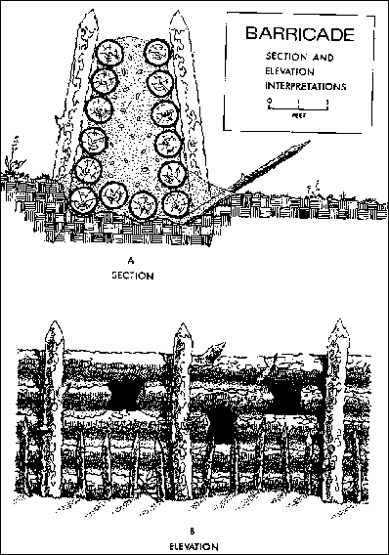
RED STICK WEAPONS AT HORSESHOE BEND 2
--One other Red Stick ‘weapon’ was the impressive log wall they built at the narrow ‘neck’ of the river peninsula. It stood about 5-8 feet high, sat just south of a slight depression in the terrain, ran the 300-400 yards across the peninsula into the river, and was of a double-log and earth construction. Apertures in the wall allowed the Red Sticks to fire through it; and it was curved and/or zig-zagged in such a way as to enfilade approaching troops. The small cannon couldn’t breach it.
Tennessee State Library & Archives
Hand-drawn contemporary battle maps and modern wall diagram.
Notes:
--The maps and diagram are from Horseshoe Bend National Military Park online curriculum materials, “The Battle of Horseshoe Bend: Collision of Cultures,” https://www.nps.gov/hobe/learn/education/curriculummaterials.htm Accessed October 2021 Specifically:
---The left-hand map is Colonel Cheatham’s post-battle sketch map, from the National Archives
---The center diagram is from Horseshoe Bend National Military Park
---The right hand map is an excerpt from ”Major General Andrew Jackson's official report (with map) to Tennessee Governor Willie Blount following the 1814 Battle of Horseshoe Bend,” courtesy Tennessee State Library and Archives, Tennessee Virtual Archive, https://teva.contentdm.oclc.org/digital/collection/p15138coll33/id/248, , "Page 5"
--The Red Sticks’ defensive wall was distinctly concave and perhaps also ‘zig-zag’ in its positioning, which made any attack vulnerable to shots from the side.
--Only a part of the wall’s foundation has actually been surveyed—but results indicate that historians’ estimates are accurate. The western part sloping down to the culvert is a ‘guesstimate.’ The drop might not have been so dramatic.
--Recent research using American veterans’ pension applications reveals that Jackson’s troops encountered some kind of improvised redoubt system behind the wall after they breached it. No one is sure about the exact location and nature of these redoubts.

Slide 225
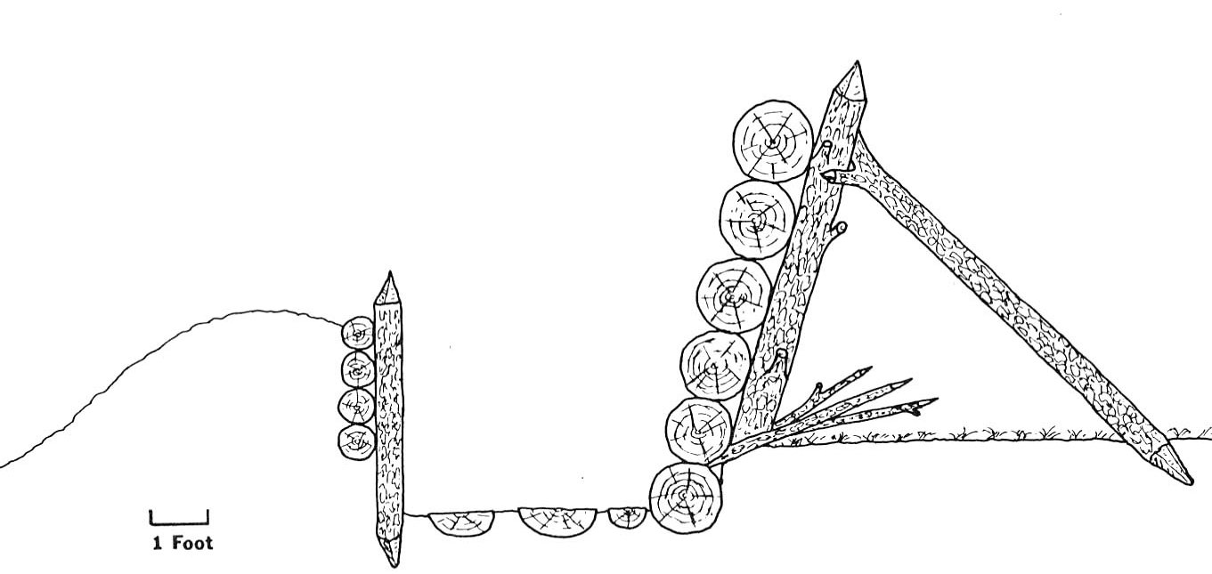
RED STICK WEAPONS AT HORSESHOE BEND 2
An Intriguing Take on the Red Stick Wall
--In 1986, Creek history scholar Greg Waselkov proposed that the wall looked like that seen in the drawing below. To him, the double-wall construction meant that a trench was between the walls, with the taller wall facing the expected attack (in this case, north toward Jackson’s main body). For proof, Waselkov used a contemporary battle-map drawing, passages from the few participants’ reports, and descriptions of other defensive walls built by eastern Indians.
South:
Tip of the Peninsula
North: Jackson’s main body
Notes:
--Waselkov, “A Reinterpretation of the Creek Indian Barricade at Horseshoe Bend” in Journal of Alabama Archeology, 32, #1, December 1986
http://www.usouthal.edu/archaeology/writings/pdfs/a-reinterpretation-of-the-creek-indian-barricade.pdf

Slide 226
Horseshoe Bend Functional Topics:
Tactics

Slide 227
TACTICS FOR JACKSON’S ARMY AT HORSESHOE BEND, Pt.1
--Research indicates that Jackson adopted William Duane’s drill-and-tactics manual just before the Horseshoe Bend Campaign. Again, many officers considered Duane’s linear-tactics procedures to be too simple, but the militia liked them and Duane still followed the linear-tactics essentials seen in other manuals.
--We assume that linear tactics applied to the initial attack by Jackson’s troops at about 1230, 27 March, upon the Red Stick wall (a possible option will be discussed later) After the wall’s breach, the fight became a melee. While accounts described a long-term struggle, none described its exact details.
--Linear tactics exploited the smoothbore flintlock musket’s capabilities while minimizing its faults. Tight, shoulder-to-shoulder, two-three rank formations of soldiers maneuvered as entire regiments. By the War of 1812, many armies had transitioned to a two-rank setup.

Slide 228
TACTICS FOR JACKSON’S ARMY AT HORSESHOE BEND Pt. 2
--In linear tactics, each rank could volley fire in succession. Thus, linear tactics delivered higher-rate massed volley fire that ensured the formation would hit something, and with many rounds.
--Due to the smoothbore musket’s short range, the line had to get close to the enemy and be prepared to use the bayonet for charging or being charged. Socket bayonets allowed the Soldier to fire his weapon or be a glorified ‘pikeman’ as the situation demanded.
--Officers usually worked behind the formation to steer it. However, officers could lead from the front, with obvious risks. An example is MAJ Lemuel Montgomery’s death while leading the attack upon the Red Stick wall at Horseshoe Bend.

Slide 229
TACTICS FOR JACKSON’S ARMY AT HORSESHOE BEND Pt. 3
--Montgomery’s death during the wall melee brings up close-in fighting. Linear tactics stressed adroit, aggressive use of bayonets. However, it’s unknown how many of the militiamen who comprised most of Jackson’s force had them. They may have used frontier hatchets and knives. Besides the vanguard units’ motivation, bayonet possession might have been another reason why Jackson put the regulars and a small hand-picked militia advance guard in his wall attack’s front line.
--Linear tactics provided cohesion, strict command, and massed firepower. If handled correctly, such formations could maneuver reasonably well so that their volleys could deliver a real punch.

Slide 230
TACTICS FOR JACKSON’S ARMY AT HORSESHOE BEND, Pt.4
--Tight, regiment-sized linear formations served other functions: command, control, cohesion, courage and communication in combat. With a finicky weapon that fired a round once every twenty seconds—IF reloaded properly—how could Soldiers, especially militia, feel brave and follow orders unless under close control and amongst a large group of their peers? With an enemy formation visible and close by, dispersal could breed confusion, cowardice and maybe calamity as that enemy cut down a fleeing mass of individuals. Given the circumstances of that time—finicky muskets, no radios, social and training issues, etc.—close linear formations were a compelling tactical option.
--However, linear tactics required rigorous training to work well, especially when close to a hostile force. The militia lacked that training. Perhaps Jackson modified his tactics further—see next slide.

Slide 231
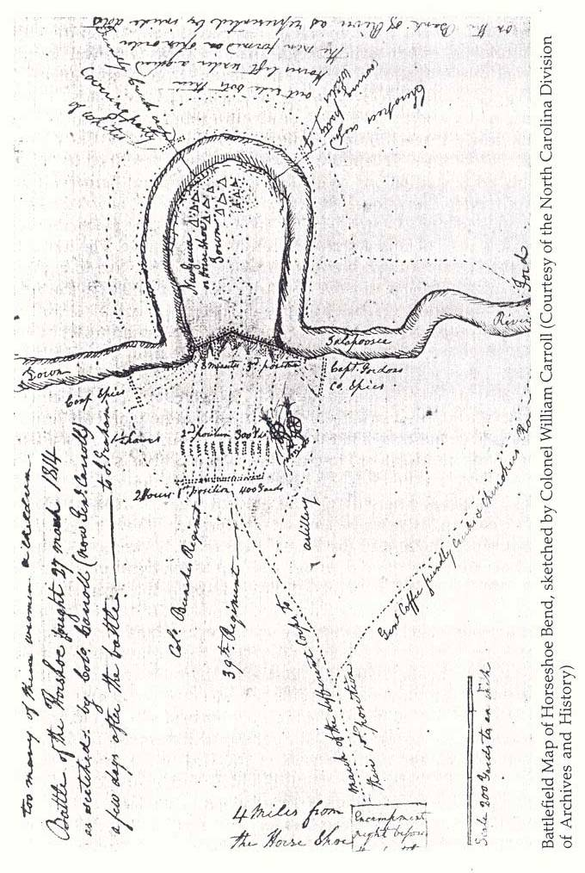
TACTICS FOR JACKSON’S ARMY AT HORSESHOE BEND Pt. 5
--No one is sure how exactly the wall assault proceeded. Did the lines break and run towards the wall as they neared it? Did they stop and fire beforehand? Unknown.
--For possible tour-stop discussion, a participant’s rough sketch offers an intriguing optional view of the assault on the Red Stick wall. Colonel William Carroll drew what seem to be column formations which dispersed as they neared the wall. Carroll’s symbols may mean something else--e.g., the dispersal points may signify wall extensions--but the column-advance-and-close-in-dispersal approach makes some sense given that it: (a) minimized exposure under Red Stick fire while approaching the wall; and (b) addressed the difficulty of advancing quickly while trying to maintain linear formations, especially with less well-trained militia.
Map is courtesy North Carolina Division of Archives and History, https://archives.ncdcr.gov/contact/staff-list#specialcollections
Notes:
Map excerpts are from William Carroll’s post-battle sketch map, courtesy North Carolina Division of Archives and History,
https://archives.ncdcr.gov/contact/staff-list#specialcollections

Slide 232
TACTICS FOR JACKSON’S ARMY AT HORSESHOE BEND Pt. 6
--The post-wall attack melee seems to have featured more free-style tactical methods.
--’Free-style’ tactics applied to the Allied Indians, as evidenced by their conduct at the river bend and their attack north into the peninsula. Some evidence of their preferred close-in, individual, and fierce fighting style comes in their casualties at Horseshoe Bend: 41 of their 500-man Cherokee Regiment and of the 202 total US casualties.

Slide 233
RED STICK TACTICS AT HORSESHOE BEND, PT. 1
--As mentioned, staff-ride participants often question the Red Sticks’ tactics at Horseshoe Bend. And again, no one knows exactly why they defended as they did.
--They focused upon defending their main wall. They did not track or try to disrupt Jackson as he surrounded the peninsula. They left few if any forces to cover the rest of the peninsula beyond the wall.
Here are some possible reasons.
--Spirituality; and True Believer Influence. Obviously the prophet Monahoe was influential if some accounts say he led the Red Sticks at Tohopeka. Accounts describe prophets dancing near the wall during the bombardment phase. Did these prophets place good tactical sense over spiritual faith? The Creek War’s previous battles indicate no--and Tohopeka was apparently a holdout for many True Believers and die-hards.

Slide 234
RED STICK TACTICS AT HORSESHOE BEND, PT. 2
REASONS FOR RED STICK TACTICAL ERRORS (cont.)
--Glorious Combat, and Defending Homeland. Perhaps the Red Sticks relished a head-on fight that would favor their individual warrior prowess and their fearlessness in the face of death. Also, many apparently believed they must fight to the last against merciless invaders. Cocke’s Hillabee fiasco was evidence, because Hillabees were among those defending Tohopeka.
--Confidence? Hadn’t all of the previous US forces eventually retreated? Weren’t these US forces always rather small, say, only about a thousand troops? And wouldn’t spiritually blessed warriors prevail in individual combat against supposedly weaker opponents?

Slide 235
RED STICK TACTICS AT HORSESHOE BEND, PT. 3
REASONS FOR RED STICK TACTICAL ERRORS (cont.)
--Focus, and Assumptions. Given its evidently superb construction, perhaps the wall led the defenders to fixate upon it. Also, Tohopeka’s Red Sticks may have assumed Jackson’s force would be as small as it had been in January, and would thus restrict its approach to the north. The early 27 March gathering of about two-thousand armed men north of the wall would have been a compelling sight that might also have distracted the Red Sticks from the threat across the river. Regarding the river, its current was not strong, but perhaps its width and late-winter/early-spring temperature led Red Sticks to assume that it would serve as a better obstacle than it actually did.

Slide 236
RED STICK TACTICS AT HORSESHOE BEND, PT. 4
REASONS FOR RED STICK TACTICAL ERRORS (cont.)
--Numbers. Perhaps the Red Sticks opted to put their limited resources in one key spot rather than spread them out everywhere. Further, they may have expected more people to help man the fort, and then had to do the best they could when that didn’t happen. For example William Weatherford, who may have fought Jackson’s January raid, apparently left Tohopeka on some errand days before Jackson’s advance. Creek writer George Stiggins claimed that the January Calabee Creek battle crippled the ardor of the Red Stick movement, which may have left the Tohopeka Red Sticks short of warriors.
--Rescue? One big reason Coffee’s brigade took station across the river was concern that neighboring Red Sticks would come to Tohopeka’s aid. Perhaps Tohopeka’s defenders expected it too. If so, they were tragically disappointed. Again as Stiggins observed, perhaps other Red Sticks were too frustrated after Calabee Creek.
Notes:
For Weatherford, see Griffith, McIntosh and Weatherford, 138, 150. Griffith doubts accounts that say Weatherford was at the Emuckfau and Enitachopco battles, but does believe that he was at Tohopeka through much of early 1814.

Slide 237
RED STICK TACTICS AT HORSESHOE BEND, PT. 5
REASONS FOR RED STICK TACTICAL ERRORS (cont.)
--Escape? The Red Sticks had escaped traps previously: Autassee, Holy Ground, and Talladega. Horseshoe Bend’s battle accounts mention many canoes along the river, and the Red Sticks’ break for the river once it seemed the battle was lost.

Slide 238
Horseshoe Bend Functional Topics:
Terrain

Slide 239
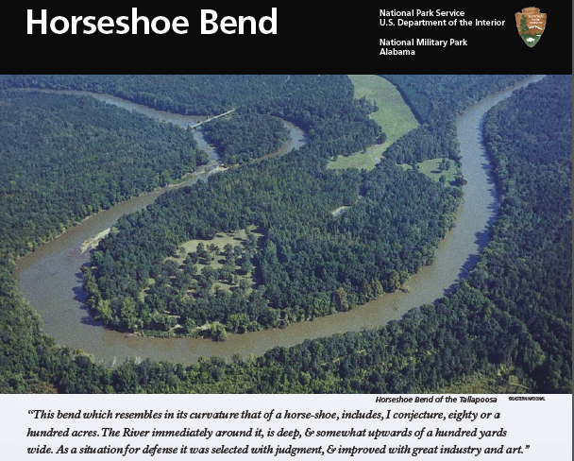
HORSESHOE BEND TERRAIN, Part 1
Notes:
Horseshoe Bend National Military Park brochure cover

Slide 240
HORSESHOE BEND TERRAIN, Part 2
Notes:
Horseshoe Bend National Military Park brochure map

Slide 241
HORSESHOE BEND TERRAIN, Part 3
--Beyond the park images on the previous slides, use a topographical map or Google Earth to note that the peninsula has a small plateau at its base that tapers downward to river level at its tip. The plateau’s sides slope to the river in varied degrees of steepness. As for the plateau itself, its base is a small hill (the tour’s Stand 2, Overlook Hill) that slopes gently downward in undulating terrain toward the site of the Red Stick Wall (Stand 5). Regarding uneven terrain, there is a slight depression north of the wall site; and the terrain rises slightly for about 250 yards south of the wall. Then it starts a general descent toward river level at the tip. At the wall the height of the plateau above the river is about 30-40 feet. (See Tour Stand pictures.)
--Across the river, the terrain east of the peninsula is relatively flat, but south-southwest of the bend it rises steeply from the river about seventy feet. At the tip of the bend, the river flowed slowly then, and it still does now. Its width is about one-hundred yards.

Slide 242
HORSESHOE BEND TERRAIN, Part 4
--The flora was probably different from what appears now. The Indians’ slash-and-burn techniques may have created a forest that was clear of clutter and underbrush, like the terrain near the in HSB park headquarters today (see Tour-Stand 1 photo). Even though the big central meadow between the overlook pavilion and the wall location might not have been as clear as it is now, it was apparently clear enough to maneuver entire regiments, baggage trains, and two cannon. One must recall that the Indians had to get wood from nearby to build the village and the formidable wall at the base of the peninsula.
--The wall was at a narrow section of the peninsula’s base. Gideon Morgan’s account (see Personal Accounts) and recent research indicate that fall-back redoubts existed on the slightly rising terrain further behind the wall—though no one is sure how they looked. Apparently the terrain behind the wall was a little rockier and crested a little more than nowadays. At least one account describes the post-breach fighting as being in timber and brush.

Slide 243
HORSESHOE BEND TERRAIN, Part 5
--Tohopeka village was near the peninsula’s tip. ‘Tohopeka’ translates to something like ‘stronghold,’ or ‘fort.’ The Creek name for the peninsula area was ‘Cholocco Litabixee,’ which means ‘horse’s foot.’
--Jackson estimated that the Red Sticks’ peninsula perimeter encompassed about one-hundred acres of land.
--The village was one of at least three settlements that the Red Sticks built as divinely protected towns. Eccanachaca—the ‘Holy Ground’ that Claiborne took in 1813—was one. Othlewalee, near Autassee, was another.
--Thus Tohopeka’s creation was recent. The wall was apparently built rapidly, between the time of Adams’ December 1813 Nuyaka raid (Nuyaka village was to the east of HSB) and Jackson’s January raid.

Slide 244
Horseshoe Bend Functional Topics:
Logistics
Communications

Slide 245
LOGISTICS AT HORSESHOE BEND
--Up through early January 1814, Jackson faced logistical nightmares. However, he resolved most of these for his March 1814 campaign against Tohopeka. One should recall that for the advance on Tohopeka from Fort Williams, he carried eight days’ worth of food and his Soldiers each had about twenty-four rounds of ammunition. Thus his supplies were with him at the battle, which fortunately was a quick one. The rest of his supplies were two days’ march away, back at his Fort Williams forward base.
--The Red Sticks likewise had no on-going supply line. Their village and fort supported itself. Note two things. Jackson suspected the Horseshoe Bend Red Sticks might receive outside help, and so put Coffee and his men outside the peninsula as a blocking force. Also, by this time, the ravages of civil war and US Army raiding had created near-famine conditions in Creekland.

Slide 246
COMMUNICATIONS AT HORSESHOE BEND
--Communication was by runner. For the US Army, signal flags were in the future. At Horseshoe Bend, the distances were short enough and the battle movements simple enough to ensure adequate commo for both sides’ actions.
--An example comes in the Cherokees’ decision to attack the village. They could hear the bombardment and decided to attack. A messenger went to Jackson’s side of the line informing him of same. Jackson had visual confirmation via smoke rising from the direction of the village—and so did the Red Sticks at the wall.

Slide 247
Horseshoe Bend Functional Topics:
Laws of War

Slide 248
LAWS OF WAR AT HORSESHOE BEND, Part 1
--The Tennesseans’ handling of Red Stick dead and captives at Horseshoe Bend often raises law-of-war questions.
--There was no Hague or Geneva Convention in 1814. The first serious attempts to provide armies with formal Prisoner of War (PoW) guidance were decades in the future.
--Western nations observed informal rules regarding fighting. Depending on circumstances, these could be followed or discarded. An example is prisoner exchange. Not wanting to deal with prison camps and such, the rising nation-states often established PoW exchange rules, but imperfectly observed them.
Notes:
For the ferocity aspect in Indian wars, see John Grenier, The First Way of War.

Slide 249
LAWS OF WAR AT HORSESHOE BEND, Part 2
--Regarding informal law-of-war conventions, ’discarded’ especially applied to Indian wars. It didn’t seem to whites that the Indians honored any such customs, and between the desire for revenge and existing racial attitudes, Indian wars were notable for the ferocity shown by both sides.
--Indeed, among Indians such practices as torture, scalping and desecration of dead enemies were common. Jackson was annoyed with Indian allies’ desecration of dead enemies, and wanted it stopped.
--However, during Jackson’s campaign Red Stick PoWs were usually turned over to the Indian allies, who would’ve handled them per custom. In a few cases the Allied Indians executed enemy warriors on the spot. In others they took the Red Sticks away to be slaves or to be adopted into the tribe, depending on age and gender.
Notes:
For the ferocity aspect in Indian wars, see John Grenier, The First Way of War.

Slide 250
LAWS OF WAR AT HORSESHOE BEND, Part 3
--Many staff-ride questions deal with the conduct of Jackson and his men during and just after the Horseshoe Bend battle. Note that sometime after his forces breached the wall Jackson asked the Red Sticks to surrender, but was refused. Note also that most non-combatants were taken prisoner.
--Accounts mention disgraceful acts by individual troops against the Red Sticks during and just after the fighting, such as the killing of a boy and an old man--and most notoriously, the alleged cutting of dead Red Sticks’ skin to make bridle reins. To determine the exact number of Red Stick dead on the battlefield, Jackson’s men removed noses—an unacceptable act nowadays, but apparently seen as practical back then.

Slide 251
The Battle of Horseshoe Bend

Slide 252
From Horseshoe Bend National Military Park brochure
Notes:
Map is from Horseshoe Bend National Military Park brochure.

Slide 253
THE HORSESHOE BEND BATTLE, Part 1
--At about 0630 on 27 March, Jackson’s force left camp and split up. Coffee’s Mounted Brigade forded the Tallapoosa a couple miles downstream from Tohopeka. Jackson’s main force proceeded to the Tohopeka wall at the base of the peninsula. The Red Sticks did not oppose either force on its approach march.
--Coffee’s brigade took station on the south side of the riverbend so as to do two things: block any Red Stick outside help and prevent Red Stick escape. The scout and Indian units faced inward, while the rest of the force faced out.

Slide 254
THE HORSESHOE BEND BATTLE, Part 2
--By about 1000, Jackson’s main force took position just north of the Red Sticks’ wall. Existing maps and accounts show something like the following.
--In the very front, Jackson set a small ‘Advance Guard’ consisting of Gordon’s Company of Spies and a selected part of the West Tennessee militia. Apparently the Guard tried to help the nearby artillery battery nearby, and exchanged shots with the Red Sticks behind the wall until the actual assault. Just behind the Guard was the 39th Infantry on the left and a regiment of East Tennessee militia on the right. The other militia units took station behind these forces. Jackson posted the baggage train along with a rear guard behind them.
--Jackson put his adjutant, Colonel James Sitler, in charge of the Advance Guard. They may have been better equipped—the 39th likely would have bayonets. Top units usually lead a breaching operation, but Jackson also may have wanted units like the Advance Guard and 39th Regiment’s regulars to set the example for the rest of the militia.
Notes:
Sources differ slightly on the exact formation arrangement. For example, see Jensen, “Horseshoe Bend,” in Braund, ed. Tohopeka, pp. 148-149; Kanon, Tennesseans at War, p. 100; O’Brien, In Bitterness and in Tears, pp. 141-143; and Weir, Paradise of Blood, p. 410.

Slide 255
THE HORSESHOE BEND BATTLE, Part 3
--Jackson put his two cannon close to the wall--about 100 yards away. This spot was at the base of the hill now known as Gun Hill. Its proximity to the Red Sticks can be gauged by the fact that the gunners took casualties before the assault. At about 1030 the two guns started bombing the wall. Jackson hoped the cannon could breach it, but two hours and seventy rounds’ worth of cannonade had little effect. (NOTE: the park’s cannon at the top of Gun Hill is too large and is in the wrong spot re Jackson’s actual gun placement.)
--Red Stick warriors and prophets jeered at the bombardment; and fighters on each side heckled and fired potshots at each other. Some of Jackson’s commanders asked to start the infantry assault.
Notes:
For gunner casualties, see Bassett, ed. Correspondence of Andrew Jackson, Volume I, page 492
https://catalog.hathitrust.org/Record/001639368 and Jensen, “Horseshoe Bend,” in Braund, ed., Tohopeka, p. 149

Slide 256
THE HORSESHOE BEND BATTLE, Part 4
--The noise of the cannonade was too much for some of the allied Cherokees across from the tip of the peninsula. To them, as warriors, the blocking assignment was mundane duty, and they could see that the village near the tip was very lightly guarded.
--A few, including a big fellow named Whale who later received a musket for this exploit, swam across the river and secured some of the many canoes on shore. Using the canoes, more Cherokees crossed and tore through the village against an increasing Red Stick resistance.
--That resistance was too late. Cherokees, Loyal Creeks, and some of Captain Russell’s scouts burned the village as they pressed further. The Cherokees’ commander, Colonel Gideon Morgan, had already ridden to Jackson with the news. General Coffee endorsed the action by shifting his forces to maintain a cordon across the river. He placed riflemen at key spots—Bean’s Spies and Guides took station on an island west of the peninsula—to shoot escaping Red Stick warriors.
Notes:
See Coffee’s account in this guide.

Slide 257
THE HORSESHOE BEND BATTLE, Part 5
--As the scouts and Allied Indians advanced, Red Stick resistance intensified on the small plateau north of the village as Red Sticks left the wall to stop the growing threat from the south. The fighting was close and often individual as the scouts and allied warriors swarmed northward. (To ensure that allied white Soldiers recognized them as friendly, the Indian Allies wore deer tails and feathers in some way.) The attackers apparently came within sight of the Red Stick wall; but their casualties mounted and their advance stalled.
--However, for the Red Sticks the damage had been done. Jackson could see the action, and with the Red Sticks thus distracted, he ordered his main force to assault the wall at about 1230. Roughly 2000 troops marched against Red Stick warriors whose numbers at the wall were reduced by the fighting in their rear.
Notes:
--See Jackson, Morgan and Reid’s accounts in this guide.

Slide 258
THE HORSESHOE BEND BATTLE, Part 6
--The militia Advance Guard and 39th Regiment regulars led the attack, with the rest of the militia just behind. There was pitched close-in fighting as Jackson’s forces approached and surmounted the wall. Then Jackson’s men broke through.
--There is no clear account of how the battle then developed. Most accounts say the Red Sticks retreated to a back-up redoubt system near the crown of the plateau and along its sides. One historian notes that some Red Sticks already tried to escape by the river, but the battle is notable for continuing into the evening, with resistance not ending completely until the next morning.
--At one point Jackson had an envoy ask for surrender, but the Red Sticks rejected the request. By some accounts, Red Stick prophets took cloud movement as a sign to keep fighting. The fight became a methodical, bloody affair—Jackson observed that the “carnage was dreadful”—as his troops eliminated redoubts and bunkers on the plateau and its slopes.
Notes:
--Weir, in Paradise of Blood, 410-417, writes that with Jackson’s breakthrough, the Red Sticks at the wall then allegedly ran down the trench to the riverside. However, Weir also says that there were other Red Stick positions.
--Quote is from Bassett, ed. Correspondence of Andrew Jackson, Volume I, page 493
https://catalog.hathitrust.org/Record/001639368

Slide 259
THE HORSESHOE BEND BATTLE, Part 7
--The battle broke down into individual and small-unit fights against Red Stick strongpoints, which were taken in turn. Jackson’s troops brought at least one of the cannon up for assistance against these minor strongholds, but the cannon’s support was ineffective because they could not bring the gun to bear properly. The few individual accounts of this phase describe intense fighting and serious injuries suffered in same. As patience wore thin, Jackson’s men burned Red Stick defenders out of one dugout and forced the collapse of another bunker, crushing those Red Sticks inside.

Slide 260
THE HORSESHOE BEND BATTLE, Part 8
--The post-wall breach melee is remarkable due to its length. Yet Jackson’s force on the peninsula increased to about 2500 troops versus the Red Sticks, whose defensible terrain and estimated 800 warriors dwindled by the hour. Consider:
---The terrain must have been complex enough to have allowed the kinds of redoubts and bunkers described in the accounts.
---Red Stick warriors who didn’t try to escape would not quit, even after a surrender request by Jackson.
---Would all of the US force have been as committed as the fighting ebbed? Sam Houston tried to get a group to follow him against one of the strongholds, and found himself alone.
---Available firepower: the cannon couldn’t eliminate the strongholds, and the musket ammunition stocks were low for this raid.
---Fatigue: direct physical combat could not be continuous.
---The lack of a clear account may also be a clue. A large part of Jackson’s force was frontier militia and Indians, neither of whom followed strict military procedure. From the breach onwards, command and control like that seen nowadays had to be a challenge.

Slide 261
THE HORSESHOE BEND BATTLE, Part 9
--Coffee’s riflemen shot and killed an estimated 300 Red Stick warriors as they tried to flee on the river.
--All Red Stick resistance ended by early the next morning. The casualty count was lopsided. Jackson lost 49 killed and 153 wounded. Of these, the Cherokees and the 39th Regiment took more losses than the other units, with the Cherokees suffering a slightly higher number of killed than the 39th. The Red Sticks lost about 850 killed: 557 on site and the estimated 300 in the river. There were about 300 captives, and nearly all were the non-combatants. Jackson put them under the 39th Regiment’s charge. The regiment later took them north to be incarcerated in Tennessee, but along the way, Loyal Creeks or Cherokees claimed many of them as prisoners/slaves.
Notes:
For POWs, see Griffith, McIntosh and Weatherford, 148; and Weir, Paradise of Blood, 421-422, 424. For evidence of graves desecration, see p. 510.
For Jackson’s casualty statistics, see Jackson’s post-battle report to Tennessee Governor Blount, slide 273-274; and O’Brien, In Bitterness and in Tears, 150-151.

Slide 262
THE HORSESHOE BEND BATTLE, Part 10
--It is uncertain how many Red Sticks escaped. Jackson’s side estimated between 10-20, but one Red Stick survivor claimed over 200. Menawa escaped in spite of being badly wounded.
--Jackson’s men sank their weighted dead in the river to prevent Red Stick desecration. They did bury MAJ Montgomery on site and disguised his grave. Tales of white desecration of dead Red Sticks are prominent in many histories (see Laws of War section). The Red Stick dead were apparently left where they lay.
Notes:
NOTE: The tale about Red Stick skin being cut for bridle strings comes from Halbert and Ball, who cite one source who got his info from veterans’ recollections. Even so, other individual accounts describe some cold-blooded killing. Two examples are the alleged murders of an old man and a child. Only a few warriors were captured. There were not many non-combatants at HSB—many had been sent downriver to a safe spot. About 300-400 non-combatant women, children, and elderly were there.

Slide 263
The Battle of Horseshoe Bend’s Aftermath,
and Creek War Aftermath

Slide 264
THE AFTERMATH, Part 1
--Jackson arrived back at Fort Williams on 31 March. Though Horseshoe Bend was a smashing victory, Jackson did not think it would be the last big battle with the Red Sticks. He expected to encounter another Red Stick stronghold at the Hickory Ground, at the confluence of the Tallapoosa and Coosa Rivers.
--Jackson re-stocked another eight days of supplies; and on 7 April advanced along the banks of the Tallapoosa River, burning Red Stick villages and farms along the way. He met no serious Red Stick opposition; but about twenty miles from the Hickory Ground, he did meet Homer Milton’s eastern force. On 17 April they arrived at the Hickory Ground. Again, no Red Sticks resisted the move.

Slide 265
THE AFTERMATH, Part 2
--The armies took advantage of the river supplies and named the new spot Fort Jackson. By May, increasingly large numbers of Red Sticks came to the fort to surrender and beg for food. The civil war and war with the US had destroyed at least fifty Creek towns. The most notable surrender was that by William Weatherford, whose courage and dignity so impressed Jackson that Jackson let him go free.
--On 20 April, MGEN Pinckney arrived to oversee operations. He sent troops south, assisted by new-ally Weatherford, to round up Red Stick holdouts. These sweeps encountered scattered, small Red Stick attacks; but hard-line resisters like Josiah Francis went to Spanish Florida to seek foreign help.
--In late May, Jackson received a regular-army general’s commission and assumed command of the southern district.

Slide 266
THE AFTERMATH, Part 3
--At about that same time, British officials arrived in Florida to set up an Indian campaign, but discovered they were too late. Instead, they encountered Red Stick refugees like Josiah Francis. Even so, with Napoleon’s downfall earlier in 1814, they could now concentrate more upon the American war. Part of their plan was to seize the Gulf Coast, especially New Orleans.
--Jackson was concerned about British/Spanish meddling, which sparked two notable actions.
---The August 1814 Treaty of Fort Jackson took half of the Creeks’ land regardless of the loyalties of the Creeks therein. Land greed was one reason. Jackson’s legendary vindictiveness was another. Yet another was a desire to create a buffer between the Creeks and the British (the land taken was the Creeks’ western and southern sections).
---In November 1814 Jackson took Pensacola in Spanish Florida to shoo away the British and remaining Red Sticks.

Slide 267
THE AFTERMATH, Part 4
--Jackson went on to defend New Orleans successfully against a British attack in January 1815. This battle ended for all practical purposes the War of 1812.
--But Jackson and the Red Sticks were not through with each other. After the War of 1812 a British officer, Lieutenant Colonel Edward Nichols, remained in Spanish Florida to encourage the Red Sticks to fight against the Treaty of Fort Jackson. The Treaty of Ghent, which ended the War of 1812, was supposed to restore all lands to their pre-war owners.
--The British government was eager to move on from the war and did not endorse Nichols’ actions. But before he left Florida, Nichols helped Red Sticks, Seminoles, and fugitive slaves build a fort on the Apalachicola River near the Gulf Coast.

Slide 268
THE AFTERMATH, Part 5
--The fort’s presence blocked American transit down the Chattahoochee and Flint Rivers to the Apalachicola and the coast. After an incident that killed US sailors, US forces blew up the fort in 1816, with tacit Spanish permission. Further white-Indian unrest on the border led Jackson to launch an 1818 punitive raid into the Florida Panhandle. These events became known to history as the First Seminole War.
--In this raid Jackson also fought Red Stick Creeks, and even captured and hanged the old Red Stick prophet Josiah Francis.

Slide 269
THE AFTERMATH, Part 6
--When Andrew Jackson became president in 1829, he carried out what predecessors like Washington and Jefferson had considered: the removal of southeastern Native Americans to what is nowadays Oklahoma.
--Called the Trail of Tears, this forced removal of Cherokees, Choctaws, Chickasaws and Creeks was mostly peaceful. There was some sporadic fighting in the remaining Creek land, and this small struggle is called the Second Creek War.
--In what is called the Second Seminole War, the Florida Indians (Florida was now a U.S. territory) put up a tougher fight from the mid 1830s to the early 1840s. Ironically, some of the US Army’s Indian allies versus the Seminoles were Creeks, including the former leader at Tohopeka, Menawa. The US Army and these loyal Indians fought Seminole leaders such as Osceola, who was the son of a Red Stick refugee from the Creek War.

Slide 270
BATTLE OF HORSESHOE BEND
PERSONAL ACCOUNTS
NOTE:
These are among
the few available personal accounts
from Jackson’s side of the battle.
There are no known Red Stick accounts.

Slide 271
Andrew Jackson to his wife, Rachel Jackson
Head quarters Fort Williams
April 1rst. 1814
My Dear,
I returned to this place on yesterday three oclock P.M. from an excursion against Tohopeka, and about one hour after had the pleasure of receiving your affectionate letter of the 22nd ultimo----
I have the pleasure to state to you that on the 27th march that I attacked & have destroyed the whole combined force, of the Newyokas, oakfuskes, Hillabays, Fishponds, ocaias, and ufalee, Tribes – The carnage was dreadfull – They had possessed themselves of one of the most military sites, I Ever saw, which they had as strongly fortified with logs, across the neck of a bend – I endeavored, to levell the works with my cannon, but in vain – The balls passed thro the works without shaking the wall – but carrying destruction to the enemy behind it – I had sent Genl Coffee across the river, with his horse and Indians who had compleatly surrounded the bend which cut off (compleatly) their escape – and the Cherokees Effected a landing on the extreme point of the bend with about one hundred and fifty of Genls coffees Brigade, including Capt Russles spy company – The Battle raged, about two hours, when I found those engaged in the interior of the bend, were about to be overpowered, I ordered, the charge and carried the works, by storm – after which they Indians took possessession of the river bank, and part of their works raised with brush getting into the interior of the bend – and It was dark before we finished killing them – I ordered the dead bodies of the Indians to be counted, the next morning, and exclusive of those buried in their watry grave, who were killed in the [river] and who after being wounded plunged into it, there were counted, five hundred and fifty seven – from the report of Genl Coffee and the officers surrounding the bend, they are of the opinion, that there could not be less than three hundred, killed in the river, who sunk and could not be counted – I have no doubt, but at least Eight hundred and fifty were slain – about twenty who had hid under the bank in the water, made their Escape in the night, one of whom was taken the next morning who gives this account, that they were all wounded from which I believe about 19 wounded Indians alone escaped – we took about three hundred and fifty prisoners, weomen & children and three warriors – What effect this will produce upon those infatuated and deluded people I cannot yet say – having destroyed To’hope’ka, three of the principal prophets leaving but two in their nation – having tread their holy ground as they termed it, and destroyed all their chiefs & warriors on the Tallapoosee river above the big bend, it is probable they my now sue for peace should they not (If I can be supplied with provisions) I will give them, with the permission of heaven the final stroke at the hickory ground, in a few days we have lost in killed of the whites 26, and one hundred and seven wounded – amonghst the former is Major Montgomery who bravely fell on the walls, and of the latter Colo. Carroll – slightly – our friends all safe, and Jack you may say to Mrs. Caffery realized all my expectations he fought bravely – and killed an Indian – every officer and man did his duty - the 39th distinguished themselves and so did the militia, who stormed the works with them. There never was more heroism of roman courage displayed – I write in haste surrounded with a pressure of business, and a little fatigued - I will write you again before I leave this place – for the present I can only add, that I hope shortly to put an end to the war and return to your arms, kiss my little Andrew for me, tell him I have a warriors bow & quiver for him – give my compliments to all friends, and cheer up the spirits of your Sister Cafferry – and receive my sincere prayers for your health & happiness untill I return – affectionately adieu –Andrew Jackson
Source: The Papers of Andrew Jackson, Vol. III, 1814-15, Moser, Harold D. ed., et al.
Notes:
Courtesy, Horseshoe Bend National Park, https://www.nps.gov/hobe/learn/historyculture/jackson_jackson.htm Accessed 10/1/2021

Slide 272
Andrew Jackson to Tennessee Governor Willie Blount, 1
“Battle of Tehopiska, or the Horse Shoe”
Ft. Williams, March 31, 1814
His Excellency, Willie Blount,
Sir,
I am just returned from the expedition which I advised you in my last I was about to make to the Tallapoosa; and hasten to acquaint you with the good fortune which attended it.
I took up the line of march from this place on the morning of the 24th instant, and having opened a passage of fifty two and a half miles over the ridges which divide the waters of the two rivers, I reached the bend of the Tallapoosa, three miles beyond where I had the engagements of the 22nd January and at the southern extremity of New Youka, on the morning of the 27th. This bend resembles in its curvature that of a horse shoe, and is thence called by that name among the whites. Nature furnishes few situations so eligible for defence; and barbarians have never rendered one more secure by art. Across the neck of land which leads into it from the North, they had erected a breast-work, of greatest compactness and strength – from five to eight feet high, and prepared with double rows of port-holes very artfully arranged. The figure of this wall, manifested no less skill in the projectors of it, than its construction: an army could not approach it without being exposed to a double and cross fire from the enemy who lay in perfect security behind it. The area of this peninsular, thus bounded by the breast-works includes, I conjecture eighty or a hundred acres.
In this bend the warriors from Oakfuskee, Oakchaya, New Youka, Hillabees, the Fish ponds, and Eufaula towns, apprised of our approach, had collected their strength. Their exact number cannot be ascertained; but it is said, by the prisoners we have taken, to have been a thousand. It is certain they were very numerous; and that relying with the utmost confidence upon their strength – their situation, and the assurances of their prophets, they calculated on repulsing us with great ease.
Early on the morning of the 27th having encamped the preceding night at the distance of six miles from them – I detailed Genl. Coffee with the mounted men and nearly the whole of the Indian force, to pass the river at a ford about three miles below their encampment, and to surround the bend in such a manner that none of them should escape by attempting to cross the river. With the remainder of the forces I proceeded along the point of land which leads to the front of the breast-work; and at half past ten oclock A. M. I had planted my artillery on a small eminence, distant from its nearest point about eighty yards, and from its farthest, about two hundred and fifty; from whence I immediately opened a brisk fire upon its centre. With the musketry and rifles I kept up a galling fire whenever the enemy shewed themselves behind their works, or ventured to approach them. This was continued with occasional intermissions, for about two hours, when Capt Russell’s company of spies and a part of the Cherokee force, headed by their gallant chieftain, Col. Richard Brown, and conducted by the brave Col. Morgan, crossed over to the extremity of the peninsular in canoes, and set fire to a few of their buildings which were there situated. They then advanced with great gallantry towards the breast-work, and commenced firing upon the enemy who lay behind it.
Finding that this force notwithstanding the determined bravery they displayed, was wholly insufficient to dislodge the enemy and that General Coffee had secured the opposite banks of the river, I now determined upon taking possession of their works by storm. Never were men better disposed for such an undertaking than those by whom it was to be effected. They had entreated to be lead to the charge with the most pressing importunity, and received the order which was now given, with the strongest demonstration of joy. The effect was such, as this temper of mind foretold. The regular troops, led on by their intrepid and skillful commander Col. Williams, and by the gallant Major Montgomery were presently in possession of the nearer side of the breast-work; and the militia accompanied them in the charge with a vivacity and firmness which could not have been exceeded and has seldom been equalled by troops of any description. A few companies of General Doherty’s Brigade on the right were led on with great gallantry by Col. Bunch – the advance guard, by the Adjutant Sitler, and the left extremity of the line by Capt. Gordan of the Spies and Capt. McMurry of Gen’l Johnston’s Brigade of West Tennessee Militia . . . .
Notes:
Courtesy, Horseshoe Bend National Park

Slide 273
Andrew Jackson to Tennessee Governor Willie Blount, 2
“Battle of Tehopiska, or the Horse Shoe”
. . . . Having maintained for a few minutes a very obstinate contest, muzzle to muzzle, through the port-holes, in which many of the enemy’s balls were welded to the bayonets of our musquets, our troops succeeded in gaining possession of the opposite side of the works. The event could no longer be doubtful. The enemy altho many of them fought to the last with that kind of bravery desperations inspires, were at length entirely routed and cut to pieces. The whole margin of the river which surrounded the peninsular was strewed with the slain. Five hundred and fifty seven were found by officers of great respecability whom I had ordered to count them; besides a very great number who were thrown into the river by their surviving friends, and killed in attempting to pass by General Coffee’s men stationed on the opposite banks. Capt. Hammond who with his company of spies occupied a favorable position opposite the upper extremity of the breast-work did great execution and so did Lieu’t Bean who had been ordered by Gen’l Coffee to take possession of a small island fronting the lower extremity.
Both officers and men who had the best opportunities of judging, believe the loss of the enemy in killed, not to fall short of eight hundred and if their number was as great as it is represented to have been by the prisoners, and as it is believed to have been by Col. Carrol and other who had a fair view of them as they advanced to the breastworks, their loss must even have been more considerable – as it is quite certain that not more than twenty can have escaped. Among the dead was found their famous prophet Monahee – shot in the mouth by a grape shot; and if Heaven designed to chastise his impostures by an appropriate punishment. Two other prophets were also killed – leaving no others, as I learn, on the Tallapoosa. I lament that two or three women and children were killed by accident. I do not know the exact number of prisoners taken; but it must exceed three hundred, all women and children except three or four.
The battle may be said to have continued with severity for about five hours; but the firing and the slaughter continued until it was suspended by the darkness of the night. The next morning it was resumed and sixteen of the enemy slain who had concealed themselves under the banks.
Our loss was twenty six white men killed and one hundred and seven wounded – Cherokees, eighteen killed, and thirty six wounded, friendly Creeks Five killed and eleven wounded. The loss of Col. Williams’ reg’t of Regulars is seventeen killed and fifty five wounded; three of whom have since died. Among the former were Major Montgomery, Lieut’ Somerville, and Lieut’ Moulton, who, fell in the charge which was made on the works.¹ No men ever acted more gallantly, or fell more gloriously . . . .
Notes:
Courtesy, Horseshoe Bend National Park

Slide 274
Andrew Jackson to Tennessee Governor Willie Blount, 3
“Battle of Tehopiska, or the Horse Shoe”
. . . . Of the artillery company, commanded by Capt. Parish, eleven were wounded; one of whom, Sam’l Gaines, has since died; Lieutenants Allen and Ridley were both wounded. The whole company acted with its usual gallantry. Capt. Bradford, of the U.S. Infantry, who acted as chief engineer, and superintended the firing of the cannon, has entitled himself, by his good conduct to my warmest thanks. To say all in a word the whole army who achieved this fortunate victory, have merited by their good conduct, the gratitude of their country. So far as I saw, or could learn there was not an officer or soldier who did not perform his duty with the utmost fidelity. The conduct of the militia on this occasion has gone far towards redeeming the character of that description of troops. They have been as orderly in their encampments and on the line of march, as they have been signally brave in the day of battle.
In a few days I shall take up the line of march for the Hickory Grounds; and have every thing to hope from such troops. Enclosed I send you Gen’l Coffee’s Brigade report.
I have the honor to be with great respect,Your ob’t s’t
Andrew Jackson
¹ Several words are crossed out in the original which read, “Among the former were Major Montgomery, Lieut Somerville, Lieut Moulton and Capt Reynolds, the three first in the charge which was made on the works; and the last in attempting to oust a party of the enemy who had concealed themselves in the breast work which terminated the lower extremity of the fortification.”
Source: Correspondence of Andrew Jackson Vol. 1. pp. 489-492. The original is in the
handwriting of Maj. John Reid and was found in a building used by Gov. Willie Blount
as an office in Clarksville, Tennessee.
Notes:
Courtesy, Horseshoe Bend National Park

Slide 275
Andrew Jackson to Army District Commander Thomas Pinckney, 1
On the Battle ground, in the Bend of the Talapoose,
28th March, 1814
Maj. Gen. Pinckney
SIR,
I feel particularly happy in being able to communicate to you the fortunate evenutation of my expedition to the Tallapoosie. I reached the head near Emuc fau (called by the whites the Horse-shoe) about 10 o’clock on the forenoon of yesterday, where I found the strength of the neighboring towns collected; expecting our approach, they had gathered from Oakfuskee, Oakehoga, New Yaacau, Hillibees, the Fish Pond and Eufalee towns, to the number it is said of 1000. It is difficult to conceive a situation more eligible for defence than the one they had chosen, or one rendered more secure by the skill with which they had erected their breastwork. It was from 5 to 8 feet high, and extended across the point in such a direction, as that a force approaching it would be exposed to a double fire while they lay in perfect security behind. A cannon planted at one extremity could have raked it to no advantage.
Determining to exterminate them, I detached Gen. Coffee with the mounted and nearly the whole of the Indian force early on the morning of yesterday to cross the river about two miles below their encampment, and to surround the bend in such a manner, as that none of them should escape by attempting to cross the river. With the infantry I proceeded slowly and in order along the point of land which led to the front of their breastwork; having planted my cannon, (one six and one three pounder) on an eminence at the distance of 150 to 200 yards from it. I opened a very brisk fire, playing upon the enemy with the muskets and rifles whenever they shewed themselves beyond it; this was kept up with short interruptions for about two hours, when a part of the Indian force and Captain Russell’s and Lt. Bean’s companies of spies, who had accompanied Gen. Coffee, crossed over in canoes to the extremity of the bend, and set fire to a few of the buildings which were there situated; they then advanced with great gallantry towards the breastwork, and commenced a spirited fire upon the enemy behind it. Finding that this force, notwithstanding the bravery they displayed, was wholly insufficient to dislodge them, and that Gen. Coffee had entirely secured the opposite bank of the river, I now determined to take their works by storm. The men by whom this was to be affected had been waiting with impatience to receive the order, and hailed it with acclamation.
The spirit which animated them was a sure augury of the success which was to follow. The history of warfare I think furnishes few instance of a more brillant attack – the regulars led on by their intrepid and skillful commander Col. Williams, and by the gallant Major Montgomery, soon gained possession of the works in the midst of a most tremendous fire from behind them, and the militia of the venerable General Doherty’s brigade accompanied them in the charge with a vivacity and firmness which would have done honor to regulars. The enemy were completely routed. Five hundred and fifty seven were left dead on the peninsula, and a great number were killed by the horsemen in attempting to cross the river – it is believed not more than twenty have escaped . . . .
Notes:
Courtesy, Horseshoe Bend National Park

Slide 276
Andrew Jackson to Army District Commander Thomas Pinckney, 2
. . . . The fighting continued with some severity about five hours, but we continued to destroy many of them who had concealed themselves under the banks of the river until we were prevented by the night. This morning we killed 16 who had been concealed. We took about 250 prisoners, all women and children except two or three. Our loss is 106 wounded and 25 killed. Major M’Intosh (the Cowetau) who joined my army with a part of his tribe, greatly distinguished himself. When I get an hour’s leisure I will send you a more detailed account.
According to my original purpose, I commenced my return march to Fort Williams today, and shall, if I find sufficient supplies there, hasten to the Hickory Ground. The power of the Creeks is I think forever broken.
I send you a hasty sketch taken by the eye of the situation in which the enemy were encamped, & of the manner in which I approached them.I have the honor to be, with great respect, your obedient servant,
Andrew Jackson
Major General
Source: The Papers of Andrew Jackson, Volume III, 1814-1815, p. 52-53.
Notes:
Courtesy, Horseshoe Bend National Park

Slide 277
Mounted-Brigade Commander John Coffee to Andrew Jackson
Fort Williams, 1st April 1814
Sir,
Agreeably to your order of the 27th Ultimo, I took up the line of march at half past six Oclock A.M. of the same day with a detachment of seven hundred cavalry and mounted gunmen and about six hundred Indians, five hundred of which were Cherokees and the balance friendly Creeks – I crossed the Tallapoosey river at the little Island ford about three miles below the bend, in which the enemy had concentrated, and then turned up the river bearing away from its clifts – when within half a mile of the village the savage yell was raised by the enemy, and I supposed he had discovered and was about to attack me. I immediately drew up my forces in line of battle in an open hilly woodland, and in that position moved on towards the yelling of the enemy – previous to this I had ordered the Indians on our approach to the bend of the river to advance secretly and take possession of the bank of the river and prevent the enemy from crossing on the approach of your army in his front – when within a quarter of a mile of the river, the firing of your cannon commenced, when the Indians with me immediately rushed forward with great impetuosity to the river bank – my line was halted and kept in order of battle, expecting an attack on our rear from the Oakfuskee villages, which lay down the river about eight miles below us –The firing of you cannon and small arms in a short time became general and heavy, which animated our Indians, and seeing about one hundred of the Warriors and all the squaws and children of the enemy running about among the huts of the village, which was open to our view, they could no longer remain silent spectators, while some kept up a fire across the river (which is about one hundred & twenty yards wide) to prevent the enemy’s approach to the bank, others plunged into the water and swam over the river for canoes that lay at the other shore in considerable numbers, and brought them over, in which crafts a number of them embarked, and landed in the bend with the enemy – Colo. Gideon Morgan [Jr.] who commanded the Cherokees, Capt.[Hugh] Kerr, and Capt. William Russell, with a part of this company of Spies was amongst the first that crossed the river, they advanced into the village and very soon drove the enemy from the huts up the river bank to the fortified works from which they were fighting you – they pursued and continued to annoy them during the whole action – This movement of my Indians forces left the river bank unguarded and made it necessary that I should send a part of my line to take possession of the river bank. I accordingly ordered about one third of the men to be posted around the bend on the river bank, whilst the balance remained inline to protect our rear – Captain Hammonds company of Raingers took post on the river bank on my right and during the whole engagement kept up a continued and destructive fire on those of the enemy that attempted to escape into the river and killed a very large proportion of those that were found dead under the bank as well as many others sunk under water – I ordered Lieutenant Bean to take possession of the Island below with forty men, to prevent the enemy’s taking refuge there, which was executed with promptitude, and which had a very happy effect, as many of the enemy did attempt their escape to the Island, but not one ever landed, they were sunk by Leut. Beans command ere they reached the bank, and that few was killed the instant they landed – From the report of my Officers as well as from my own observation, I feel warranted in saying that from two hundred & fifty to three hundred of the enemy was buried under water and was not numbered with the dead that was found – My loss was two white men killed and ten wounded – and twenty three friendly Indians killed and forty seven wounded – making in the whole of my detachment, twenty five killed and fifty seven wounded – I left my position after you had gained possession of the bend and the enemy’s works, and after the few who survived had taken shelter under the banks of the river, and marched up thro’ the Newyorker village, crossed over and joined the main army at seven Oclock P.M. during the action all the men and Officers of my detachment acted their several parts well – no one neglected to do the duty assigned to him with great firmness – Quarter Master [Joshua] Haskell attached himself to Capt Hammonds company, and fired not less than fifty rounds at the enemy during the course of the day and no doubt, done much execution.I am Sir very respectfully you very Humble Servant
Jno. Coffee
Brigd. Genl.
Source: Horseshoe Bend NMP historical files.
Notes:
Courtesy, Horseshoe Bend National Park

Slide 278
Cherokee Regiment Commander Gideon Morgan to Tennessee Governor Willy Blount
Notes:
Courtesy, Horseshoe Bend National Park

Slide 279
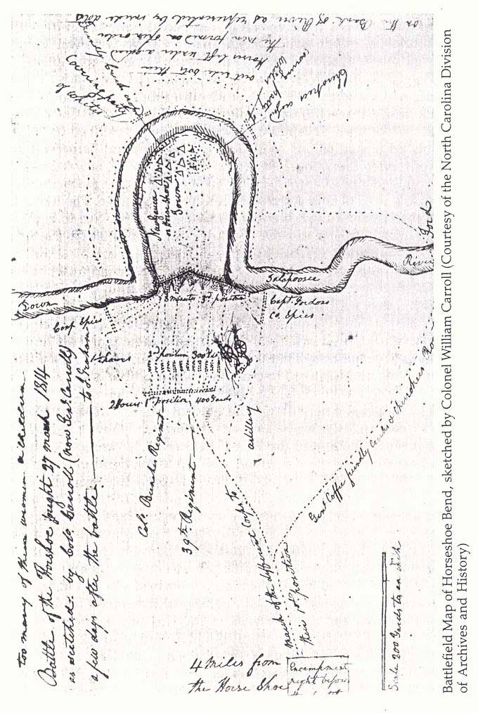
Account and Sketch Map by Jackson Aide, Colonel William Carroll
Map is courtesy North Carolina Division of Archives and History,
https://archives.ncdcr.gov/contact/staff-list#specialcollections
Notes:
Letter is courtesy of Horseshoe Bend National Park
Map is courtesy North Carolina Division of Archives and History,
https://archives.ncdcr.gov/contact/staff-list#specialcollections

Slide 280
John Reid Letters, Part 1
Notes:
Courtesy, Horseshoe Bend National Park

Slide 281
John Reid Letters, Part 2
Notes:
Courtesy, Horseshoe Bend National Park

Slide 282
John Reid Letters, Part 3
Notes:
Courtesy, Horseshoe Bend National Park

Slide 283
Private Jesse Webb’s Account of Melee Fighting and Wounds Suffered
Notes:
Courtesy, Horseshoe Bend National Park

Slide 284
Selected Creek War Site Visits

Slide 285
Site Visits 1
Notable Forts
--Fort Mims. The directions to the location of this catalytic event in the Creek War are based upon transit from Interstate Highway 65. Just east of the Tombigbee River, Middle River, and Tensaw River Bridge complex north of Mobile, Alabama, take I-65’s Exit 31 for Spanish Fort and Alabama State Highway 225.
Once off the interstate, turn north on Highway 225. Proceed 3.6 miles until meeting State Highway 59; bear left on Highway 59 and continue 13 miles north (beware of a road, 'Old Stage Road,' that veers to the right about a mile after joining 59--keep left). After the 13 miles, turn left off of 59 and on to County Highway 80 (a sign for Fort Mims is also there). Drive three miles and turn right on to Fort Mims Road. Follow Fort Mims Road 0.5 miles through a trailer park. Fort Mims parking will be on your right.
The open state park features a replica of part of the fort, with the existing replica structures standing where archaeological and historical research has placed them. Ample placards tell the visitor the Fort Mims story, as well as the significance of the various sections.

Slide 286
Site Visits 2
Notable Forts
--Fort Mitchell. A replica fort stands near where John Floyd established his main forward base for operations against the Red Sticks. Take US Highway 431 southwest out of Phenix City, Alabama. Just past the Chattahoochee Valley Community College, turn left southbound on State Highway 165 and proceed 5 miles. The visitor center and fort are on the left.
--Fort Strother. About 20 miles south of Gadsden, Alabama, turn off State Highway 77 west on to State Highway 144. Proceed 1.7 miles on Highway 144 across Henry Neely Dam. At 1.7 miles one will see Valley Drive on the left. At the intersection of Valley Drive and Highway 144 is a stone marker which commemorates Fort Strother. Obviously the dam and lake have altered the landscape, but the marker indicates the approximate location of the fort which was Jackson’s main base for much of the campaign.

Slide 287
Site Visits 3
Notable Forts
--Fort Williams. Note: Lay Lake now covers the site of Fort Williams, Jackson’s pre-Horseshoe Bend advance base, but the monument and cemetery markers' current location are not far from where the fort and actual gravesite sat on the east side of the Coosa River (the markers cannot be verified). In Sylacauga Alabama, there is a cemetery and historical marker that purports to be the site of Fort Williams, but the fort sat alongside the Coosa River, which is 12 miles from Sylacauga.
Directions to reach the markers are based upon proceeding south from Childersburg, Alabama and US Highway 280, which is a traffic artery between Columbus, Georgia, and Birmingham, Alabama.
Just east of the Coosa River bridge, turn south off 280 onto Highway 8 (Childersburg-Fayetteville Highway). Proceed 8.5 miles and turn right at Russell Chapel Road. Travel 2.8 miles on Russell Chapel and then turn left on Cedar Creek Road. Follow Cedar Creek Road for 1.8 miles and turn right on General Jackson Memorial Boulevard (the name is abbreviated on the road sign). Proceed 0.5 miles and on the right are the small stone monument and markers.

Slide 288
Site Visits 4
Notable Forts
--Fort Jackson. This was Jackson’s post-Horseshoe Bend main base, and is a state park nowadays. Directions are in reference to Interstate Highway 85 east of Montgomery Alabama. Take I-85’s Exit 6 and go north on US 231 for 12 miles. Turn left on West Fort Toulouse Road and travel 2.5 miles to the park entrance. A small fee is required.
The state park is named Fort Toulouse-Fort Jackson because in the 1700s a French fort existed on this site near the confluence of the Coosa and Tallapoosa Rivers. There is a replica stockade in the park.
Also on park grounds are the remnants of the earthwork fort that US troops built in the spring of 1814. General Pinckney named this fort for Jackson, who dictated harsh terms to the Creeks on this spot in summer 1814.

Slide 289
Site Visits 5
Battles
--Holy Ground. These directions are based upon transit on US Highway 80 between Montgomery and Selma Alabama. Approximately 25 miles west of Montgomery, turn north on County Road 29 and proceed 4.7 miles, where 29 crosses railroad tracks and becomes County Road 40 as 40 merges from the right. Proceed on 40 after the rail crossing for 4.5 miles. Turn right off 40 and on to Holy Ground Road. Drive 1.8 miles to the Holy Ground Battlefield Park entrance.
As of this writing, archaeological studies have been underway to learn more about the battle site, but the park currently focuses upon outdoor recreation and is not actually a battlefield park.
--Autassee and Calabee Creek. There are no markers for either of these battles between John Floyd’s force and the Red Sticks. Also, estimated sites for the battles are on private land.

Slide 290
Site Visits 6
Battles
--Tallushatchie. The marker and approximate site of this first big battle between Jackson’s force and the Red Sticks is not too far from Fort Strother. About 20 miles south of Gadsden, Alabama, turn off State Highway 77 east on to State Highway 144. Go straight ahead on Highway 144 for 8.5 miles to Highway 144's intersection with Highway 431. Turn left and proceed 2.1 miles. A roadside historical marker is on the left, next to a small lake. The lake and adjoining land are on private property.
--Emuckfau Creek and Enitachopco Creek. There is no historical marker or definitive location for where Jackson fought these battles in his January 1814 raid. However, for general reference State Highway 49 crosses Emuckfau Creek just over one mile from the Horseshoe Bend National Military Park’s headquarters. Access to Enitachopco Creek, which mostly runs through private land, requires navigating a series of country roads west-northwest of Goldville Alabama, and is too involved to be described here.

Slide 291
Site Visits 7
Battles
--Horseshoe Bend. The scene of the Creek War’s climactic battle is a well-kept national military park. Directions will be from US Highway 280 just west of Dadeville, Alabama. Turn right on to State Highway 49 and drive 11.5 miles, and the park entrance is on your right. There is no entrance fee. The park headquarters has a small but informative museum about the Creek Confederacy and Creek War. As of this writing, the displays include the prize musket awarded to the Cherokee warrior called Whale.

